Slide 1
Aery Glider Design

Slide 2
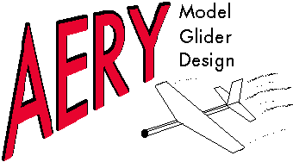

Slide 3
AERY Model Glider Software
Design and analysis of simple gliders
Center of gravity
Neutral point determination
Stabilizer and vertical tail volume coefficients
Stabilizer angle of incidence determination
Creation of plan for glider construction
Prints dimensioned drawings of glider

Slide 4
Validity of Design Analysis
Comparison of output to expected results
Construction of test gliders
Insufficient directional stability
Required lateral balancing
Center of gravity determination based on materials used

Slide 5
References
Mycroft’s Home. (2005). AERY model glider design software. Retrieved from http://home.comcast.net/~estenson/aery/aery.htm

