Slide 1
Forces of Flight and Stability

Slide 2
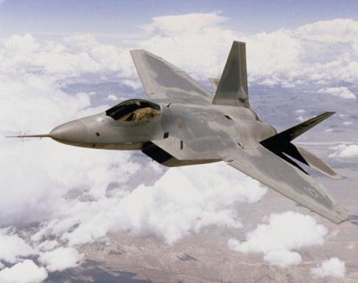
Forces on an Aircraft
Lift
Drag
Thrust
Weight

Slide 3
Forces on an Aircraft
Four forces on an aircraft in flight:
Weight: Gravitational attraction of the Earth
Lift: Created by the effect of airflow as it passes over and under the wing
Thrust: Forward-acting force which opposes drag
Drag: Acts in the opposite
direction of flight
Lift
Drag
Thrust
Weight

Slide 4
Forces of Flight
Force is what type of quantity?
Vector
What is a vector quantity?
Quantity that has both magnitude and direction
Represented by arrows
Length of arrow is the magnitude
Orientation of arrow is the direction
Force 1
Force 2
What force has a greater magnitude?
Force 1

Slide 5
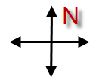
Forces of Flight
Force 1 (75 N)
Force 2 (40 N)
What is the direction of force 1?
East
What is the direction of force 2?
West
If the two forces are applied to an object, what will occur?
Force 2 (40 N)
Force 1 (75 N)

Slide 6
Forces of Flight
When two or more forces are applied to an object, the resulting force is called the resultant force.
Force 2 (45 N)
Force 1 (75 N)
Resultant
(30 N)

Slide 7
Forces of Flight
What is the resultant force?
Force 2 (465 N)
Force 1 (465 N)
Resultant is zero
When opposing forces have the same magnitude and opposite directions, the resultant is zero and the object is in static equilibrium.
Notes:
Static equilibrium means that there is no acceleration. The object stays at rest or continues at its same velocity if already in motion.

Slide 8
Forces of Flight
What forces will the aircraft need to move from position A to position B?
A force applied in the forward direction of movement
B
A
Thrust – Forward-acting force which opposes drag and propels the aircraft through the air
Notes:
Thrust is generated by various types of engines (i.e., propeller, turbine, ramjet, or rocket).

Slide 9
Forces of Flight
Does thrust experience opposition?
B
A
Drag – Acts in the opposite direction of flight, opposes the forward-acting force of thrust, and limits the forward speed of the aircraft

Slide 10
Forces of Flight
What occurs when thrust and drag are equal?
Thrust
Drag
Equilibrium or zero net force, resulting in a constant velocity
How do you increase acceleration?
Increase thrust, decrease drag, or decrease mass
Thrust
Drag
Thrust
Drag

Slide 11
Forces of Flight
What additional forces act on an aircraft?
Weight
Downward pull of gravity
Weight

Slide 12
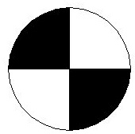
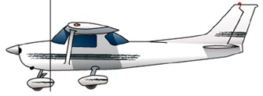
Weight and Balance
Center of gravity must be located within a manufacturer’s determined range
Inside the range, aircraft is controllable
Outside the range, aircraft is unsafe
Must calculate and adjust weight pre-flight
Notes:
More information is available in Cessna 172: A Pilot’s Guide, which is cited in the references of this presentation.

Slide 13
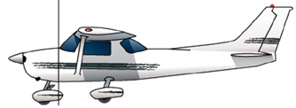
Weight and Balance
A stable reference point is used
Datum is at front face of firewall
Total weight onboard and its location is calculated
What weight comprises an aircraft?
Weight of aircraft
Pilot(s) and passenger(s)
Cargo
Fuel
Notes:
Firewall in a light aircraft provides a stable reference point because it is one of the few structural components that is unlikely to be modified during the lifespan of the aircraft.

Slide 14
Moment Review
Moment =
Force (distance)
Distance (d) is called the moment arm. It must be measured perpendicular to the line of action of the force.
Point of Rotation
d
Line of Action
F
Notes:
This is a review of torque from the POE curriculum. This concept will be applied in the next slide.

Slide 15
Weight and Balance
Datum is at front face of firewall
Force
Weight (lb)
Distance
Arm (in.)
Moment (in.-lb)
M = Fd = weight ● arm
Item
Empty weight
1,460
37.4
54,604
?
Pilot
160
37.0
5,920
180
37.0
6,660
Co-pilot
Fuel
240
45.3
10,872
Rear seat passengers
340
72.8
24,752
Baggage 1
20
94.9
1,898
Baggage 2
0
n/a
0
Total
?
2,400
?
104,706
What now?
Determine whether the plane is safe to fly.
Notes:
Weight and balance calculations are the same as the torque concept learned in the POE curriculum. Moment is another term for torque. Torque is calculated by multiplying force applied at a right angle to distance from a pivot point. The force in this example is weight and arm is the distance between the pivot point and the force applied at a 90° angle. Note that in aviation operations the term weight is used in place of force as a specific force being considered for the weight and balance calculation. The term arm is used in place of distance as a specific distance being considered.

Slide 16
Weight and Balance
From Pilot Operating Handbook (POH)
Center of Gravity Moment Envelope
2,500
2,400
2,300
2,200
Safe to fly?
2,100
Barely!
2,000
Loaded Airplane Weight (lb)
1,900
1,800
1,700
1,600
1,500
45
50
60
70
80
90
100
110
Loaded Airplane Moment (in.-lb/1000)
Notes:
This is a weight and balance chart from the manufacturer often found in a Pilot Operating Handbook (POH). The weight and moment must fall within these boundaries for the airplane to be controllable. If the center of gravity lies too far back, then the aircraft is inclined to pitch up, potentially entering a stall condition. If the center of gravity is too far forward, then the aircraft is inclined to pitch down.
A pilot and supporting ground crew, if applicable, need to perform several important tasks prior to flight. Weight and balance calculations and adjustments are performed by the pilot or supporting ground crew and verified by the pilot. If the ground crew performs this task, then the information is delivered to the pilot on a piece of paper prior to closing the main cabin door. You may have found yourself in the situation on a small commuter aircraft where the flight attendant asks for passengers to change seats. This is to adjust the weight and balance of the aircraft to a more ideal flight condition.
An advanced assignment could be to assign students a more advanced aircraft and then assign seats and position cargo for a safely loaded aircraft.
Note that the change of slope in the upper limit of the graph is because the stability of the aircraft with respect to the weight distribution is more complex than a linear relationship such as applying a load to a wrench. This graph is the result of extensive modeling and testing by aerospace engineers.

Slide 17
Forces of Flight
What forces act on an aircraft to ensure flight?
Lift – The force that is created by the effect of airflow as it passes over and under the wing
What occurs when lift and weight are equal?
Lift
Equilibrium will result in flight at same attitude (climbing, descending, or level flight)
Weight
Notes:
This is only for a short duration. As an aircraft ascends, the air becomes less dense, so lift decreases resulting in the aircraft no longer being in equilibrium.

Slide 18
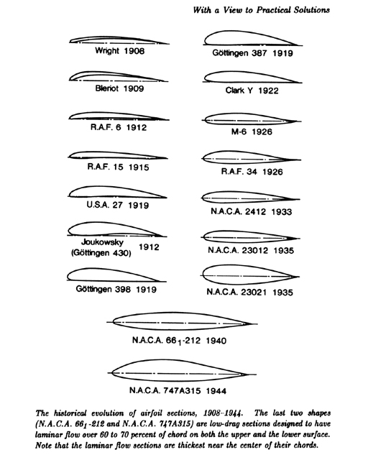
How Is Lift Created?
Airfoils have a curved shape to direct airflow
Air movement over and under aircraft wing creates pressure difference on upper and lower wing surfaces
Notes:
The image is of historical airfoil shapes catalogued by N.A.C.A.

Slide 19
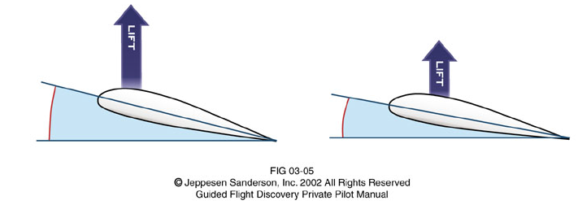
Lift
Air movement over and under aircraft airfoil creates pressure difference on upper and lower airfoil surfaces
Lift force used to oppose weight in straight and level flight
Lift force used to turn aircraft when aircraft rolls
Notes:
Other examples of airfoils on an aircraft include the propeller and horizontal stabilizer. The concept of lift is applied to other devices such as wind turbines and automobile exteriors. This will be explored later in the course.

Slide 20
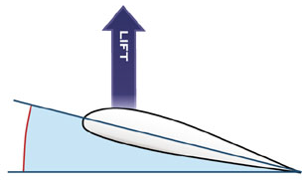
Lift
Lift is created when airflow is redirected
Deflection
Coanda Effect
Bernoulli
Circulation

Slide 21
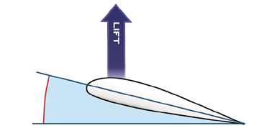
Lift – Deflection
Lift is the reaction vector
Relative air flow
direction change
Vector composed
of vertical and horizontal
Newton’s Third Law of Motion
For every action there is an equal and opposite reaction.
Downward deflected air produces an upward reaction force

Slide 22
LIFT – Bernoulli’s Principle
Conservation of Energy
Energy in a system remains the same
One component increases, then another must decrease to maintain same energy level

Slide 23
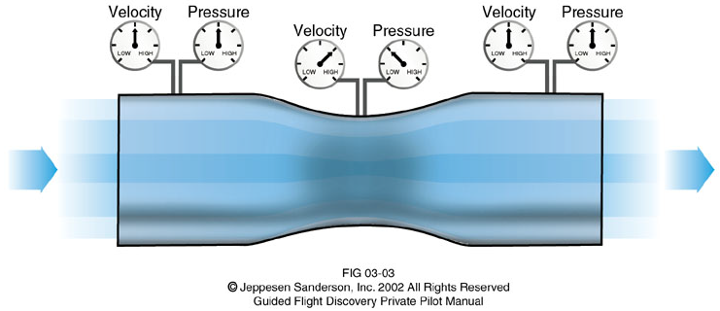
LIFT – Bernoulli’s Principle
Cross section smaller
Fluid velocity increases
Pressure decreases to compensate
Fluid expands
Fluid enters
tube
Notes:
It is important to develop the concept beginning with the cross section decreasing. Do not begin by illustrating that the fluid is squeezed because one will expect the pressure to increase.
The above example assumes that the fluid remains at the same temperature so that only pressure and volume change.
The tube above is also known as a Venturi. It is the principle used in automobile carburetors. Modern automobiles are typically designed with fuel injection instead of carburetors.

Slide 24
LIFT – Bernoulli’s Principle
More camber upper airfoil
Fluid cross section reduced
Low pressure above airfoil
High pressure below airfoil

Slide 25
Lift – Coanda Effect
Fluid flow pulled toward the solid surface (airfoil)
Flow accelerates over the airfoil top surface
Most pronounced on high angle of attack slow fluid flow

Slide 26
Lift – Coanda Effect
Similar to water flowing over a spoon
Free Stream
Coanda Effect
Overlay
Notes:
The slide animations require 3 clicks to advance to show as overlay of the water streams. This can be physically demonstrated to the students for more effect if your classroom has the appropriate facilities.

Slide 27
Lift – Circulation
Fluid flow direction changed above and below airfoil
Flowlines more curved on upper surface than lower
Results in a greater pressure gradient across upper streamlines

Slide 28
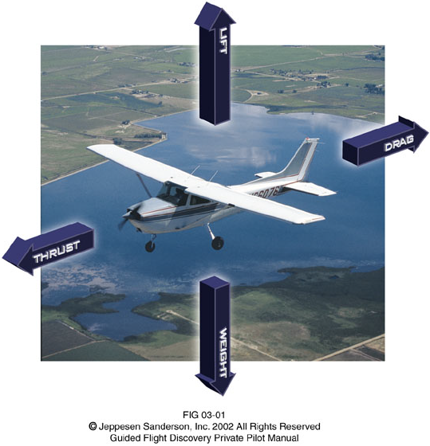
Forces of Flight

Slide 29
References
Anderson, J.D. (2000). Introduction to flight (4th ed.). New York, NY: McGraw-Hill Higher Education.
Anderson, J.D. (2007). Fundamentals of aerodynamics (4th ed.) New York, NY: McGraw-Hill Higher Education.
Cessna (2010). Caravan. Retrieved from http://www.cessna.com/caravan.html
Davies, M., Bazirjian, R., Strauch, K., & Speck, V. (2002). Charleston conference proceedings 2002. New York: Libraries Unlimited, Inc.

Slide 30
References
Jeppesen Sanderson, Inc. (1989). Aviation fundamentals. Englewood: 1989.
Jeppesen Sanderson, Inc. (2006). Guided flight discovery private pilot images [CD-ROM]. Englewood, CO: Jeppesen Sanderson, Inc.
Pratt, J. (1995). Cessna 172: A pilot’s guide. Newcastle, WA: Aviation Supplies & Academics, Inc.

