Slide 1
Airfoils

Slide 2
Airfoil
Any surface that provides aerodynamic force through interaction with moving air
Aerodynamic force (lift)
Moving air
Airfoil

Slide 3
Airfoil Lift
Any surface that provides aerodynamic force through interaction with moving air
Direction of Flight
Empennage
Lift
Airfoil is a 2D cross section
of a 3D wing
Air
Notes:
The airfoil shape is a 2D cross section of a 3D wing.

Slide 4
Aircraft Airfoils
Wing components
Leading Edge
Point of first contact between airfoil and moving air

Slide 5
Aircraft Airfoils
Wing components
Trailing Edge
Point of last contact between upper and lower surface air flow

Slide 6
Aircraft Airfoils
Wing components
Chord Line
Imaginary line drawn between the leading edge and the trailing edge
Chord Line

Slide 7
Aircraft Airfoils
Wing components
Camber
Curve of the upper and lower surfaces of the airfoil
Determines the air flow velocity on the upper and lower wing surface
Upper Camber
Mean Camber Line
Lower Camber
Chord Line
Notes:
Air separates at the leading edge and travels above and below the wing. The separated air meets at the trailing edge. The upper camber is more pronounced than the lower camber; therefore, the distance from the leading edge to the trailing edge is a farther distance above the wing compared to below the wing. Since the air meets at the same time, the air traveled faster above the wing than below the wing. According to Bernoulli's law, the increased velocity means a decrease in pressure. A lower pressure above the wing compared to below the wing sucks the wing upward, creating lift.
The top wing surface is critical for generating lift. Anything that slows the airspeed above the wing will decrease lift. Major sources of velocity reduction of this airflow are dirt, ice, and surface deformities.

Slide 8
Aircraft Airfoils
Wing components
High Lift Devices
Flaps increase camber equally on both wings
Increase lift and drag at slow speeds for
takeoff and landing
Increased Camber
Flap Retracted
Flap Extended
Notes:
Many styles of flaps exist; however, all serve the same purpose of increasing lift and drag. This allows a slower takeoff and landing speed, improving safety and aircraft control.

Slide 9
Aircraft Airfoils
Wing components
Angle of Attack
Angle between the chord line and direction of the relative wind
Relative Wind
Angle of
Attack

Slide 10
Aircraft Airfoils
Wing components
Angle of Attack
The maximum angle of attack where airflow separates from the top wing surface is the critical angle of attack
Condition is called a stall
Critical Angle of Attack
Notes:
A stall is a dangerous condition where nearly all lift is lost, resulting in a rapid loss of altitude. An aircraft typically has a high angle of attack during takeoff and landing so there is a danger of impacting the ground before aircraft control is regained.
The critical angle of attack is determined for each aircraft model and is the same for that model regardless of the aircraft airspeed, altitude, or weight.

Slide 11
Aircraft Airfoils
Wing components review
Upper Camber
Mean Camber Line
Leading Edge
Trailing Edge
Relative Wind
Angle of Attack
Lower Camber
Chord Line

Slide 12
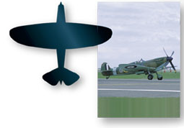
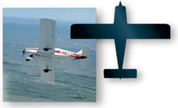
Airfoil Design Components
Planform
Top and bottom view of the airfoil shape
Elliptical
Straight

Slide 13
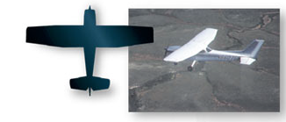
Airfoil Design Components
Planform
Top and bottom view of the airfoil shape
Tapered

Slide 14
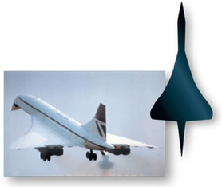
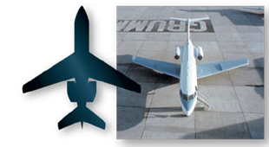
Airfoil Design Components
Planform
Top and bottom view of the airfoil shape
Sweptback
Delta

Slide 15
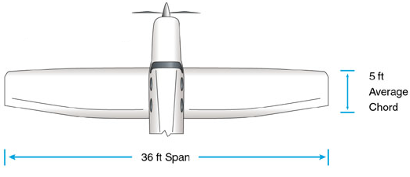
Airfoil Design Components
Aspect Ratio
Ratio of wing span to the average chord width
The higher the aspect ratio, the higher the lifting efficiency
What is the aircraft’s aspect ratio?
7.2
What is the aircraft’s planform?
Tapered

Slide 16
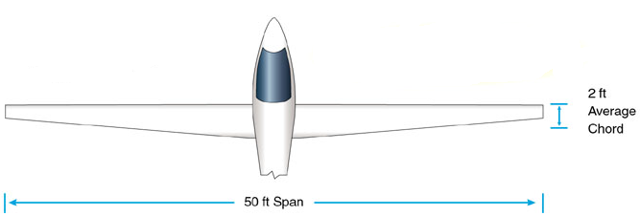
Airfoil Design Components
Aspect Ratio
What is the aircraft’s aspect ratio?
25
What is the aircraft’s planform?
Tapered

Slide 17
Airfoil Design Components
Wing Area
Total surface area of the wing
What is the aircraft’s wing area?
180 sq ft

Slide 18
Airfoil Design Components
Wing Area
What is the aircraft’s wing area?
100 sq ft

Slide 19
References
Davies, M., Bazirjian, R., Strauch, K., & Speck, V. (2002). Charleston conference proceedings 2002. New York: Libraries Unlimited, Inc.
Jeppesen Sanderson, Inc. (1989). Aviation fundamentals. Englewood: 1989.
Jeppesen Sanderson, Inc. (2006). Guided flight discovery private pilot images [CD-ROM]. Englewood, CO: Jeppesen Sanderson, Inc.

