Slide 1
Engineering Notebook

Slide 2
Engineering Notebook
What Is an Engineering Notebook?
Why Keep an Engineering Notebook?
Who Keeps an Engineering Notebook?
Contents
Engineering Notebook Sections
Standard Page Layout
Best Practices
Historical Example
Notes:
It is important to clarify to students that there are many formats used to document within an engineering notebook. The notebook format introduced in IED accumulates best practices and presents a standard for the purpose of consistency in the curriculum. As a student gains experience and as that student becomes a professional, they will evolve their practice and procedures for the engineering notebook to match preference and company policies, which vary widely.

Slide 3

What Is an Engineering Notebook?
  An engineering notebook is a book in which an engineer will formally document, in chronological order, all of his/her work that is associated with a specific design project.
  Clear and detailed description of your design process
  Someone unfamiliar with work could take over project without additional information
®istockphoto.com

Slide 4
Why Keep an Engineering Notebook?
An engineering notebook is recognized as a legal document that is used in patent activities to…
Prove the origin of an idea that led to a solution
Prove when events or ideas occurred
Prove diligence in turning the idea into a solution
Prove when an idea became a working solution (“reduced to practice”)
®istockphoto.com

Slide 5
Who Keeps an Engineering Notebook?
Engineers that work on R & D
Legal documentation of work
Continuity in projects
College engineering students
Develop time management skills
Improve research, documentation, and communication skills
Basis for professional presentation of work
®istockphoto.com
Notes:
In addition to individual inventors that may eventually want to claim intellectual property rights for a new idea or product, research and development firms as well as companies that perform their own research and development require their engineers to keep engineering notebooks. Engineering notebooks provide evidence when seeking a patent and facilitate the continuity of a project when personnel changes occur.
In addition, many college engineering programs require students to keep an engineering journal as process documentation of a project. Fully documenting the design process provides students will an opportunity to gain experience and skills that are important in the engineering profession.

Slide 6
Contents
Discovering the problem Research Sketches with labels and descriptions Brainstorming Calculations Your daily thoughts and ideas Pictures | Expert input (names, positions, contact info, details of conversations) Work session and meeting summaries Test procedures, results, and conclusions Digital technical drawings Design modifications
Everything you do/think related to a specific design project
Notes:
An engineering notebook should provide a record of all details related to a design project. This list is not all-inclusive. Everything you do or think about with respect to the design project should be included in the engineering notebook. Pictures are an excellent way to document parts of your process and can provide evidence that words alone can not convey. Take pictures throughout the process and insert them into your engineering notebook.

Slide 7
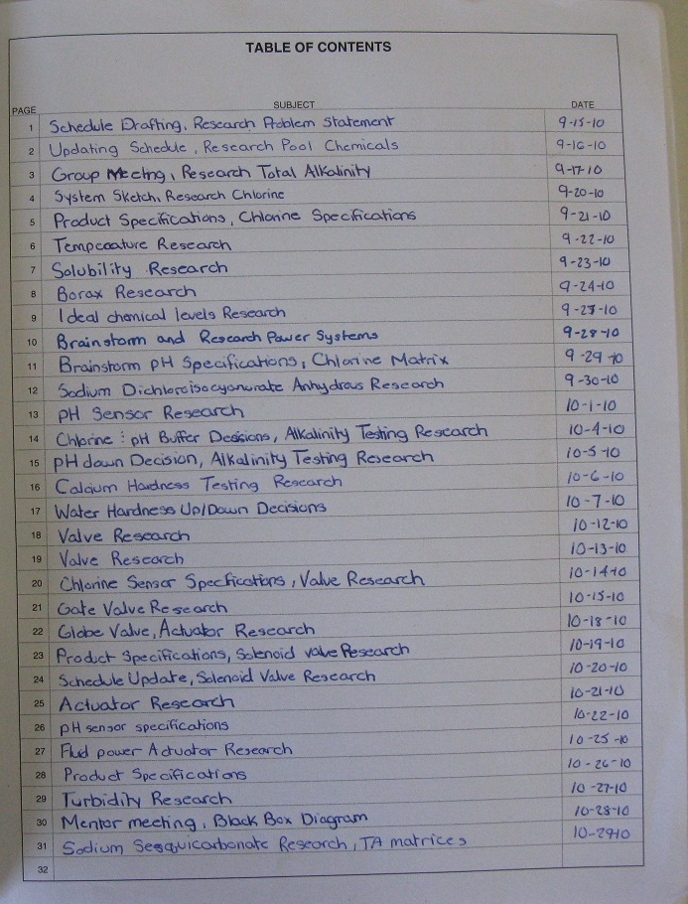
Engineering Notebook Sections
Title Page
Table of Contents
General Chronological Entries
References
Business/Expert Contacts
Notes:
The items on this page are highly recommended, but there is NO one correct way to keep an engineering notebook. Remember that the goal is to document your design process so that you can prove that the work is original, when it was completed, and that it belongs to you. The more details you include and the better organized your notebook, the better.
It is best to include a title page and table of contents at the front of your engineering notebook. Set up separate sections within your engineering notebook for general chronological daily entries (which can include any combination of notes, sketches, images, summaries, technical drawings, etc. related to the project). Include a References section to list reference sources using APA citation. Leave several pages at the back of your engineering notebook for a Contacts section to list all of your contacts for the project.

Slide 8
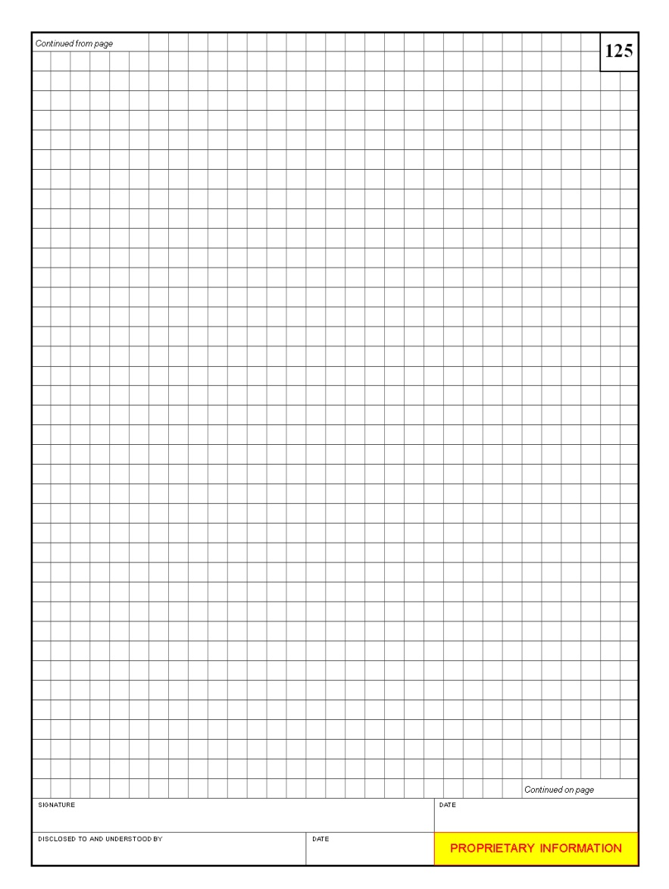
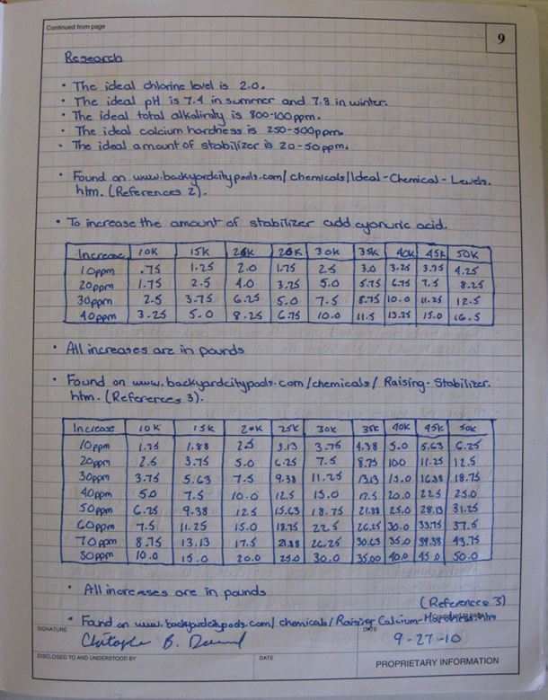
Standard Page Layout
Quad ruled paper
All pages are
  Numbered
  Dated
  Signed by the designer
  Signed by a witness
  Include a statement of the proprietary nature of notebook
Notes:
Again, these are suggestions for your engineering notebook and highly recommended. In IED you will be assessed on your diligence in following these practices. However, remember that there is NO one correct way to keep an engineering notebook.

Slide 9
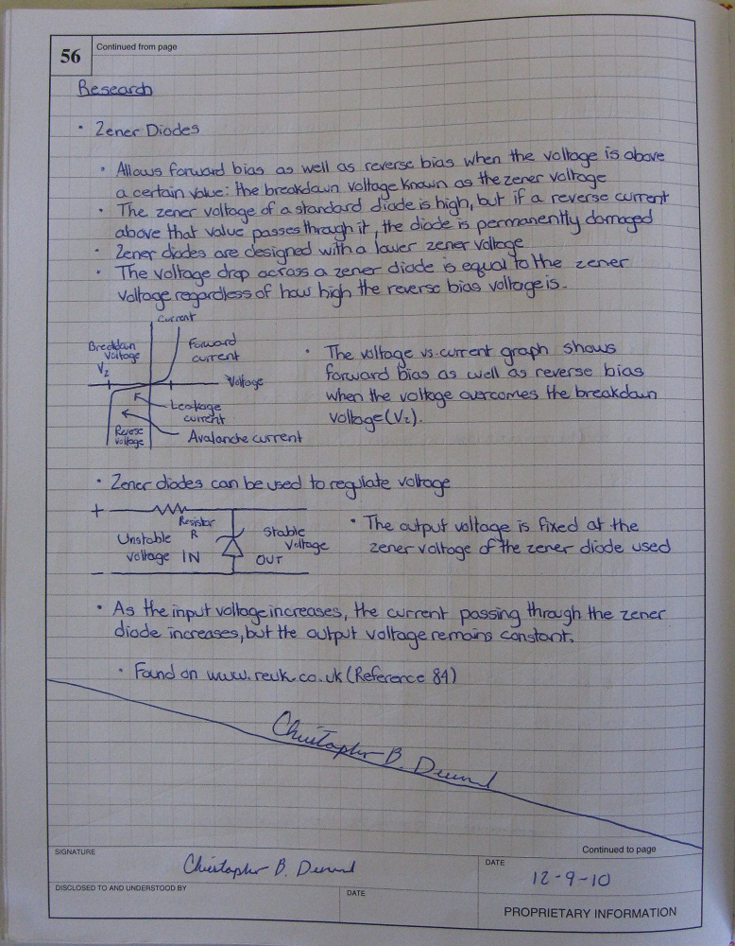
Best Practices
All work is in pen.
Markers that bleed through the paper are not used.
Pages are sequentially numbered in ink on the top outside edge.
Notebooks are bound.
  Cannot add pages
  Cannot remove pages
Notes:
These are Best Practices for keeping an engineering notebook. Again, your goal is to provide as much detail and organization as possible so that there is not question about your design process and when it was completed.
At this level, you may not feel comfortable completing sketches in ink. If you must complete sketches in pencil, it is suggested that you trace over the pencil sketches with pen immediately after completion but do all other work in pen initially.
Do not use markers that bleed through the paper.
It is important that the engineering notebook is bound. Do not use a spiral or loose leaf notebook. Pages should never be removed from the notebook.

Slide 10
Best Practices
Entries begin at the top of the page, working left-to-right and top-to-bottom
Do not leave blank space. If there is extra space, draw an X or a line across it and sign.

Slide 11
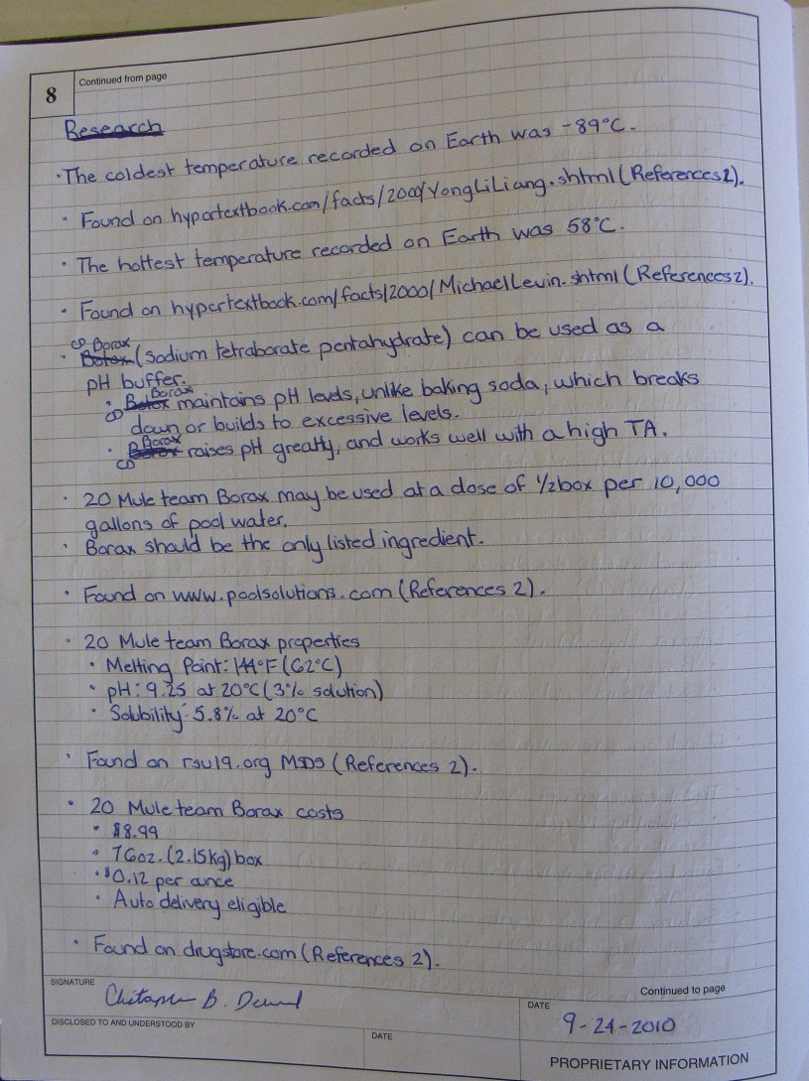
Best Practices
If you make a mistake, draw a line through it, enter the correct information, and initial the change.
Never erase or remove anything.
Notes:
Place any corrections next to the mistake or reference the page where the correction can be found.

Slide 12
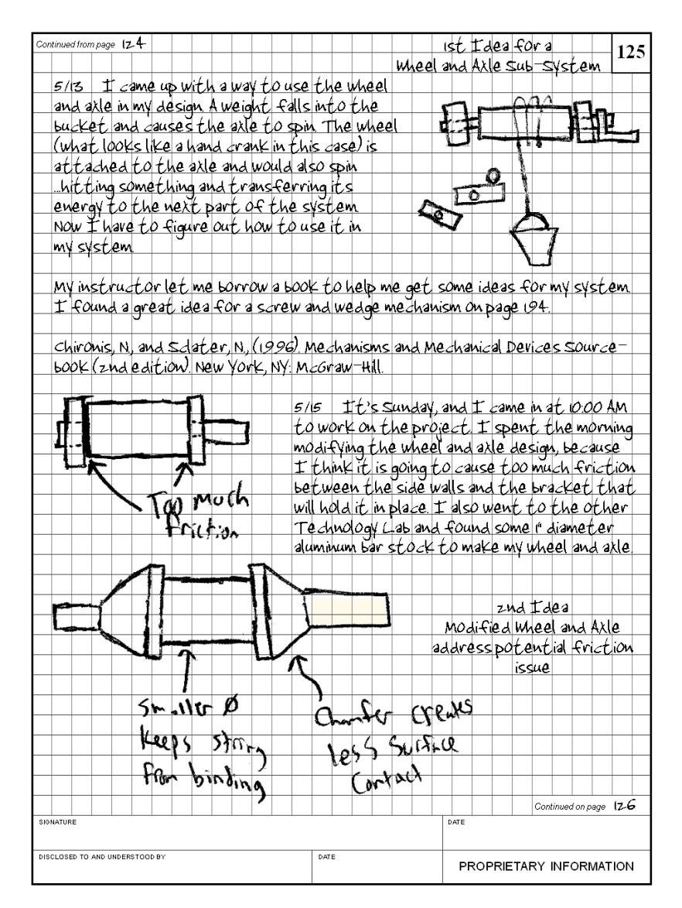
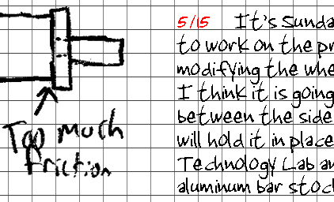
Best Practices
Date each entry
Notes:
Clearly indicate the date of each entry.

Slide 13
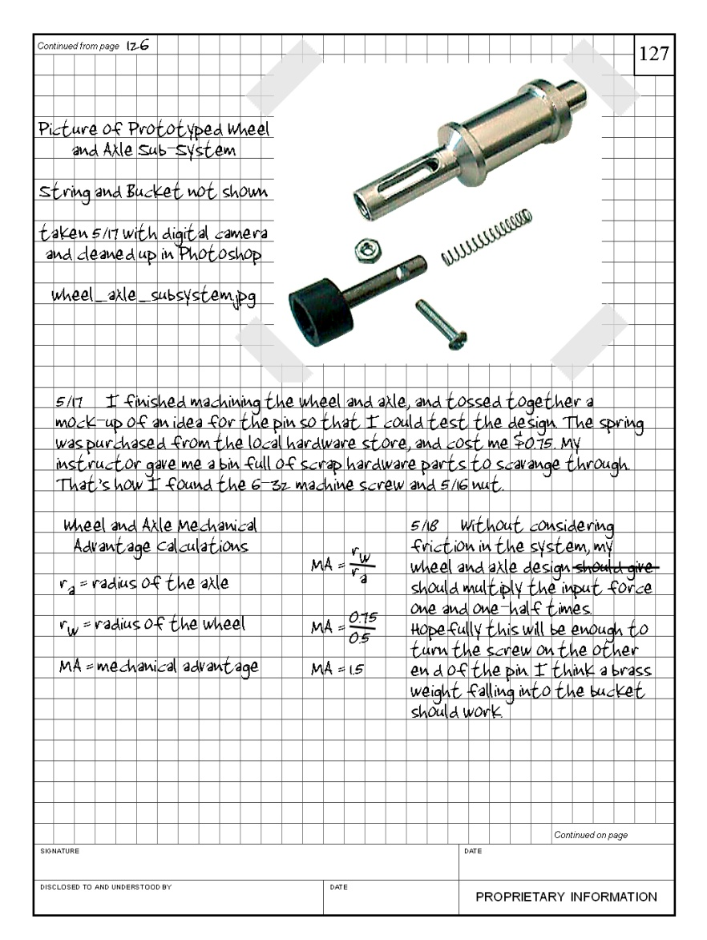
Best Practices
Inserted items are permanently attached
  Glue is preferred
  No loose leaf items
Sign your name so that it extends across both the notebook page and the inserted document.
Notes:
Glue is preferred over tape when inserting anything into the notebook because it is more permanent and less susceptible to alteration.
There should be no loose papers in the engineering notebook.

Slide 14
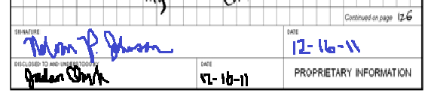
Best Practices
Sign and date each page before the next page is started.
A colleague or mentor should corroborate the events and facts on each page and sign as a witness.
Store the notebook in a safe location.
Notes:
A colleague or mentor should corroborate the events and facts on each page and sign off as a witness in the appropriate location.

Slide 15
Best Practices
Sketches
  Label all parts of the sketch
  Describe each sketch
Notes:
Label the sketch
Name, function, material, etc.
Include important dimensions.
Describe each sketch in detail
Write down what you would say to someone who asks, ”What is this a sketch of?” What would you write next to the sketch to make sure that someone receiving a fax could understand all aspects of the sketch?

Slide 16
Best Practices
Calculations and figures are clearly labeled.
Notes:
Be sure to define all variables and provide enough information that another person can follow your calculations and work.

Slide 17
Best Practices
Progress Entries
  Reflect on tasks accomplished, successes, and failures
  Reflect on future needs and tasks to be completed

Slide 18
Best Practices
Be Neat,
be Accurate,
be Legible,
and be Thorough.

Slide 19
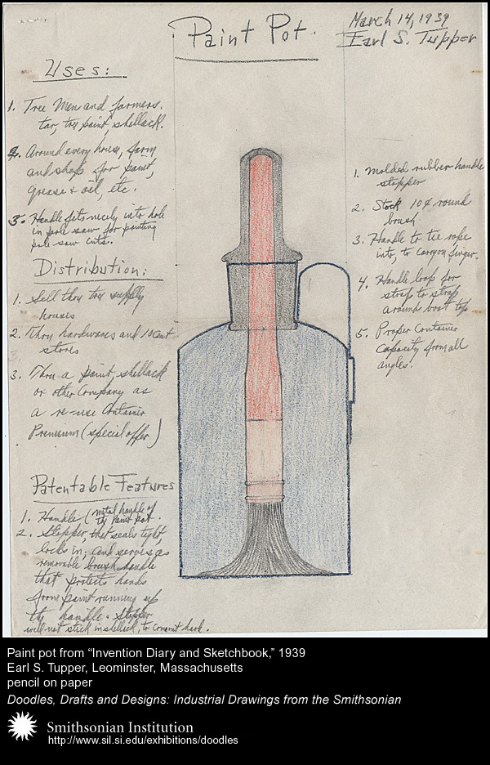
Historical Examples
Page from Earl Silas Tupper’s (1907 -1983) “Invention Diary and Sketchbook”
Mr. Tupper developed a wide range of inventions, including Tupperware
Courtesy of Smithsonian Institute: http://sil.si.exhibitions\doodles

Slide 20
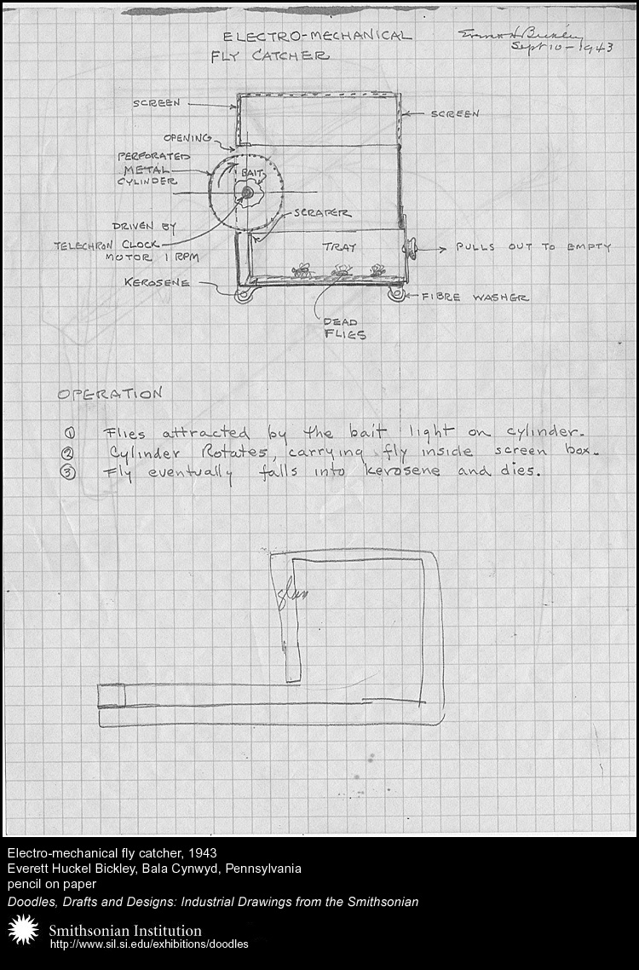
Historical Example
Everett Huckel Bickley (1888-1972) original design notes, for an electro-mechanical fly catcher, 1943
Mr. Bickley developed dozens of inventions. His most lucrative invention was a bean-sorting machine that separated good beans from bad.
Courtesy of Smithsonian Institute: http://sil.si.exhibitions\doodles

Slide 21
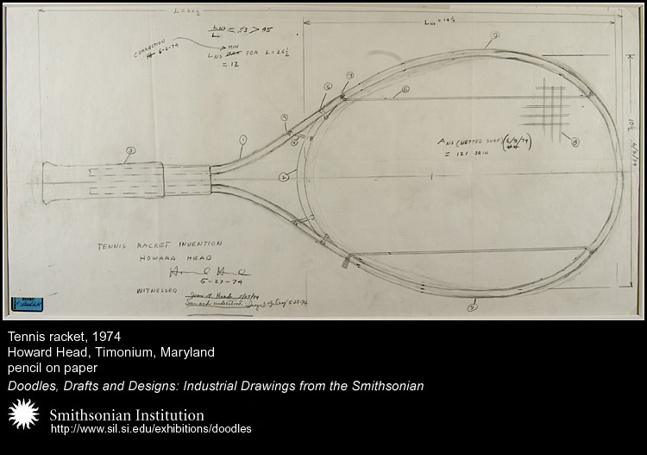
Historical Example
Howard Head (1914 – 1991) original design for an over-sized tennis racket, 1974
The larger racket more than doubled the sweet spot of the traditional racket
Courtesy of Smithsonian Institute: http://sil.si.exhibitions\doodles
Notes:
Note the inventor’s signature and date, as well as the dated signature of witnesses.

Slide 22
Engineering Notebook
What Is an Engineering Notebook?
Why Keep an Engineering Notebook?
Who Keeps an Engineering Notebook?
Contents
Engineering Notebook Sections
Standard Page Layout
Best Practices
Historical Example

Slide 23
Reference
Tupper, E. S. (1939). Invention diary and sketchbook. Retrieved from Smithsonian Institute website: http://www.sil.si.edu/exhibitions/doodles
Bickley, E. H. (1943). Design notes. Retrieved from Smithsonian Institute website: http://www.sil.si.edu/exhibitions/doodles
Head, H. (1974). Design drawing. Retrieved from Smithsonian Institute website: http://www.sil.si.edu/exhibitions/doodles

