Slide 1
Brainstorming Solutions

Slide 2
Brainstorming Solutions
Brainstorming
Rules for Brainstorming
Brainstorming Techniques
Concept Generation Dysfunctions
If You Get Stuck . . .

Slide 3

Brainstorming
A group technique for solving problems, generating ideas, stimulating creative thinking, etc.
It involves collecting ideas without regard to feasibility.
Notes:
Brainstorming is a way to generate a large quantity of ideas to solve a problem.
Several different techniques are used during brainstorming. Brainstorming can be done individually or in groups. It can be structured or free form. It can be timed or untimed.
The following slides present a few techniques that you can try when brainstorming possible solutions to a problem.

Slide 4

Rules for Brainstorming
No criticism allowed
Work for quantity
Welcome piling-on
Allow free-for-all

Slide 5
No Criticism Allowed
People automatically tend to evaluate each suggested idea - their own, as well as others
Allow all members to contribute
Notes:
Reiterate the need to avoid criticism. Often times if this happens, not everyone in the group will share their ideas with the rest of the group.

Slide 6
High Quantity Brainstorming
People must experience “brain-drain” before the innovative, creative ideas can surface.
Therefore, the more ideas, the more likely quality ideas will surface.

Slide 7

Welcome Piling-On
Piling-on occurs when a member’s idea produces a similar idea or an enhanced idea.
All ideas should be recorded.

Slide 8
Allow Free-for-All
Outrageous, humorous, and seemingly unimportant ideas should be recorded.
It is possible for the most off-the-wall idea to be one wherein lies the solution for the problem.
The sky is the limit.

Slide 9
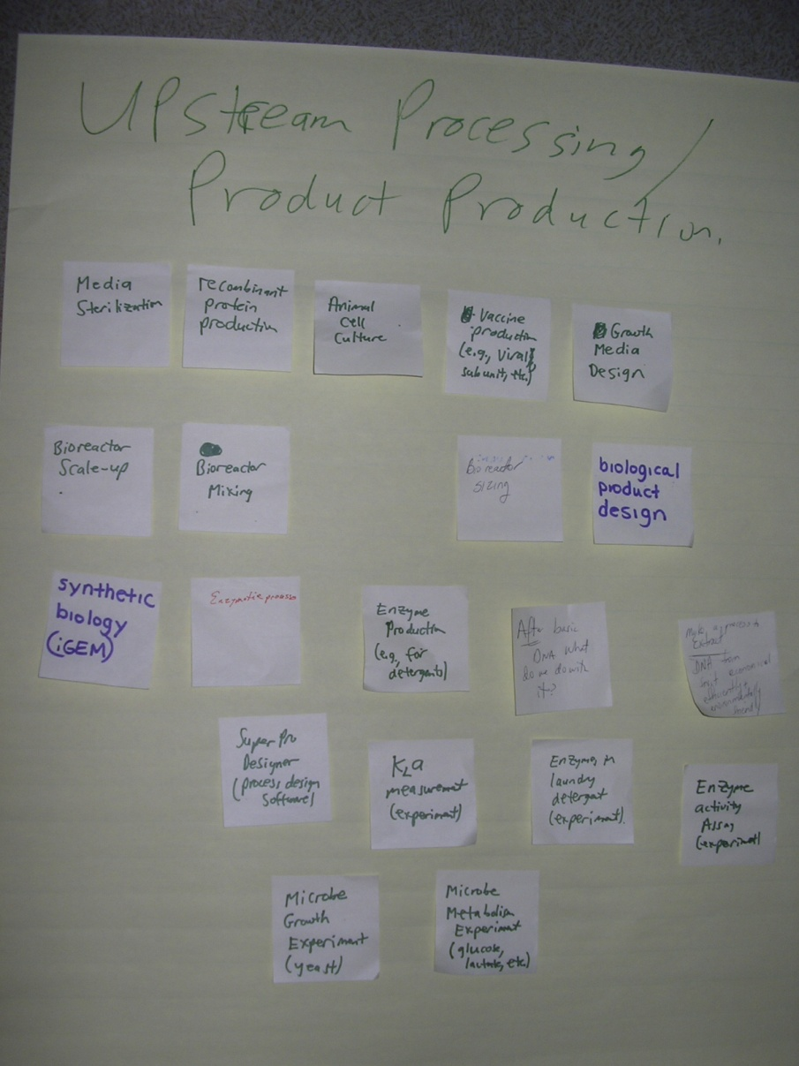
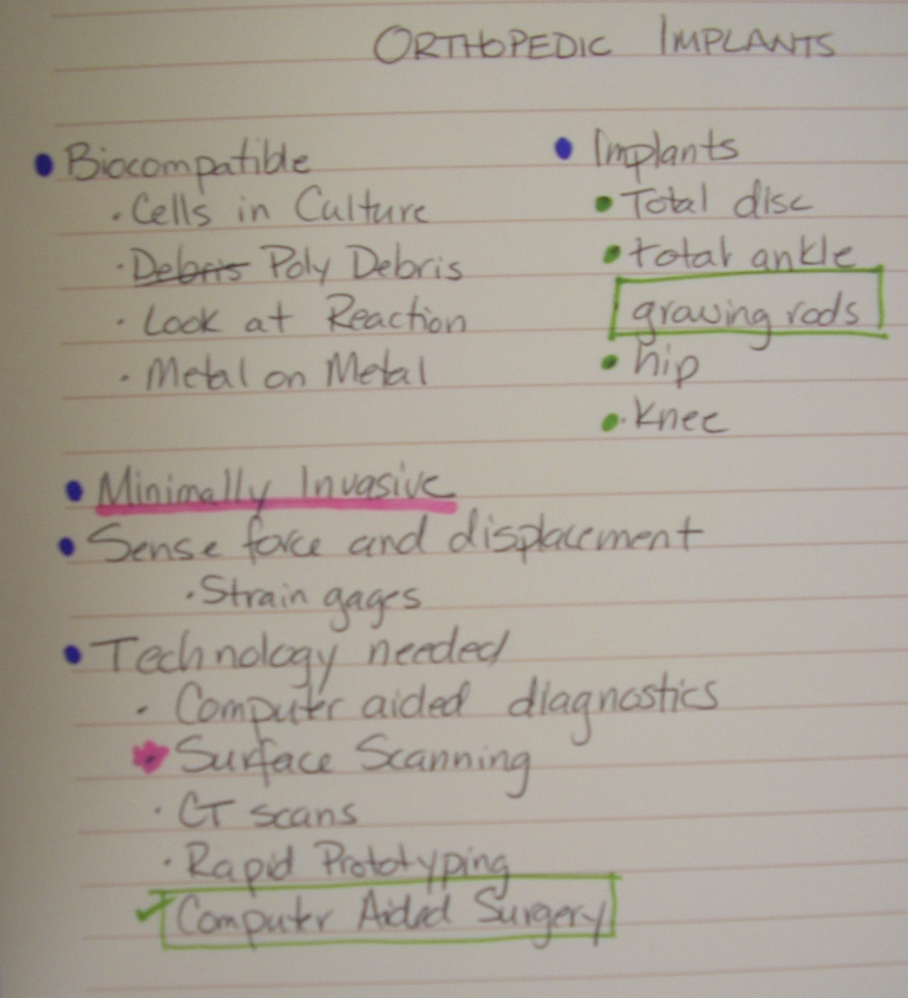
Free Form Brainstreaming
Post-It Notes
Free writing
“Blurting out”

Slide 10
Brainstorming Techniques
Forced Association
Ideas created by mentally forcing the association of two seemingly unrelated items
Johan Gutenberg
  Wine press + coin stamp = Moveable type press
Notes:
Create ideas by choosing a seemingly unrelated object and forcing yourself to somehow combine the two ideas.
For example, let’s say that you are brainstorming ideas to eliminate speeding on freeways. Choose a provocative stimulus that seems unrelated, such as a cell phone. Now think of ways that a cell phone could help you solve the problem.
Maybe you could offer rewards for people who report speeders using their cell phones. Maybe you could use the GPS capabilities of the phones to track car speeds. Maybe . . .

Slide 11
Brainstorming Techniques
SCAMMPERR
S | Substitute something . . .
C | Combine it with something else . . .
A | Adapt something to it . . .
M | Magnify or add to it . . .
M | Modify it . . .
P | Put it to some other use . . .
E | Eliminate something . . .
R | Rearrange it . . .
R | Reverse it . . .
Notes:
Michael Michalko, the author of Cracking Creativity, suggests a more structured approach to brainstorming. In the SCAMMPERR technique, you start with a current solution that somehow addresses the problem that you are investigating. Then try to generate new and different ideas or approaches by using each of the principles listed. For example, if you are trying to design a single-person motor vehicle to be used in a heavily congested urban environment, start with a moped.
Substitute something – perhaps substitute the large front wheel with a small wheel.
Combine it with something else – maybe combine the moped with a shopping cart.

Slide 12
Mind Mapping
Major Idea
Major Idea
Main Idea
Major Idea
Major Idea
Major Idea
Notes:
A mind map is a graphical representation that can be used to generate, visualize, and organize ideas to solve a problem. The ideas are arranged in a branching fashion according to relative importance, with the major ideas branching directly from the center main idea. Other ideas that are triggered by or related to the major ideas are then connected to major ideas.
Colors are often used to distinguish between major ideas.
[click] Additional connections can also be added to indicate relationships among different elements.

Slide 13
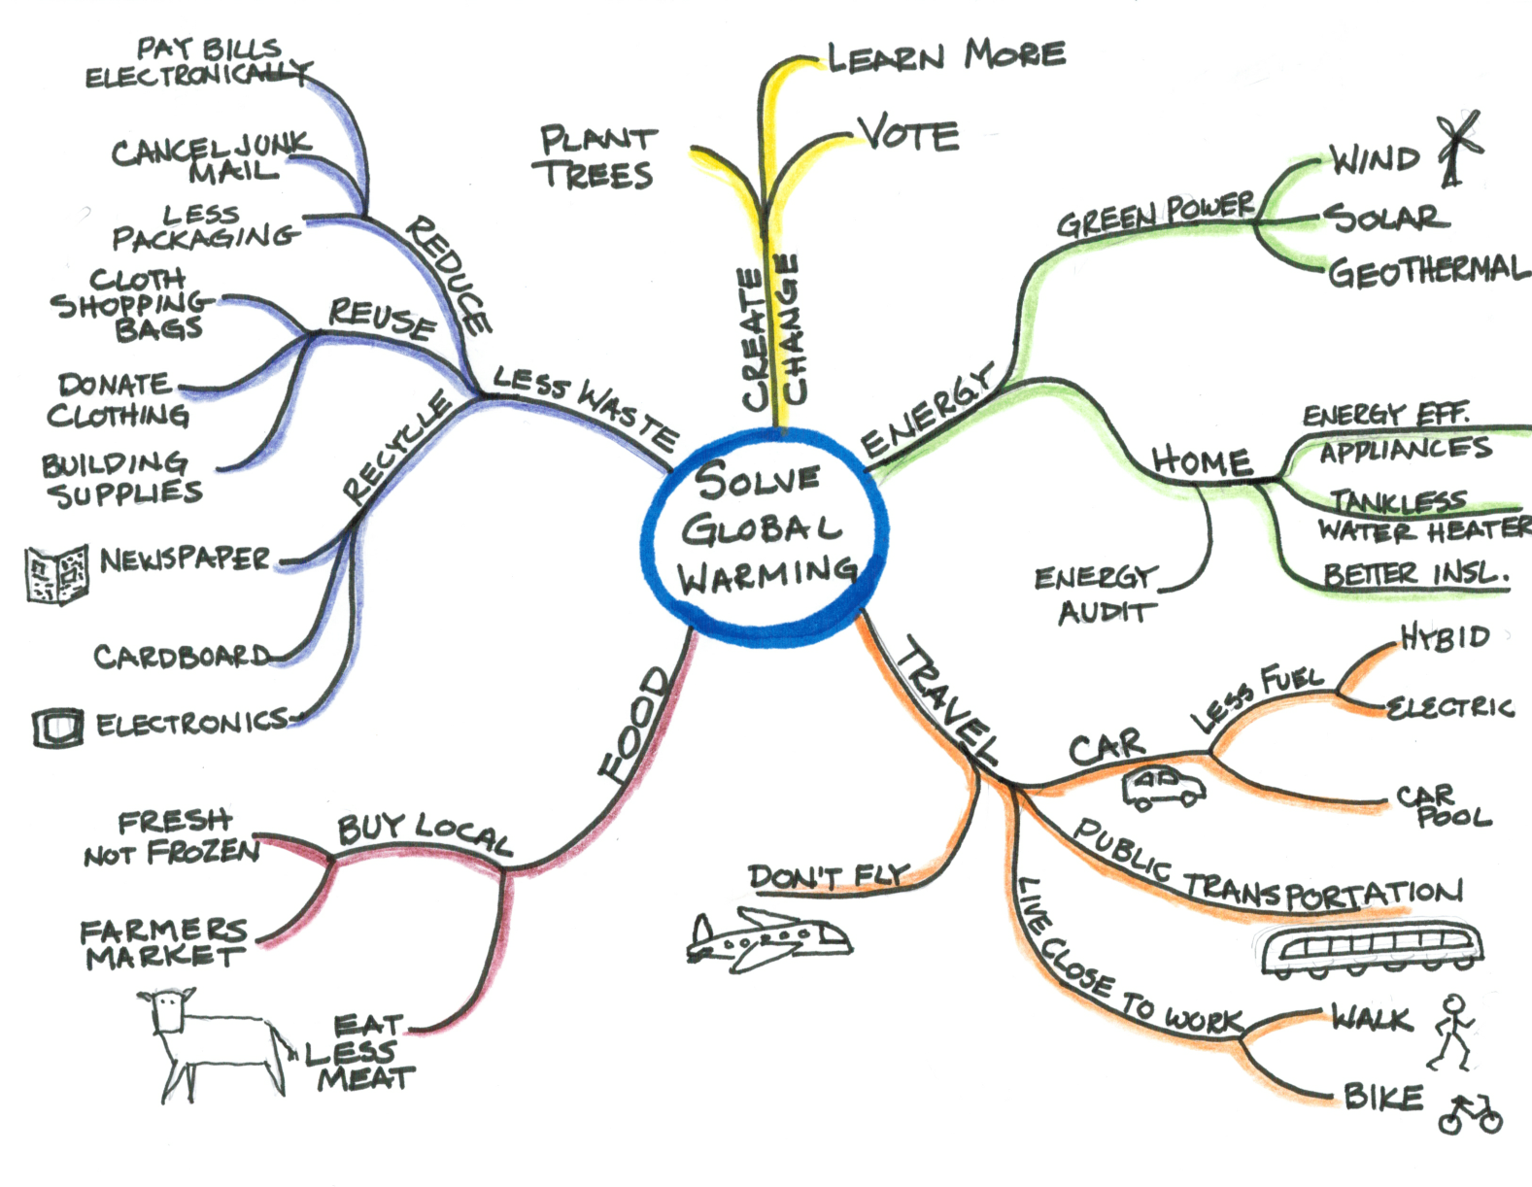
Mind Mapping
Notes:
This mind map illustrates ways to help solve global warming.

Slide 14

Brainstorming Documentation
All ideas should be captured
  Have a note taker
  Take photographs
  Compile ideas after the session

Slide 15
Concept Generation Dysfunctions
Utilizing a poor design brief
Assuming there is only ONE right answer
Getting hooked on the FIRST solution
Considering the ideas from only one or two team members

Slide 16
Concept Generation Dysfunctions
Feeling too anxious to finish
Becoming frustrated by the lack of success
Getting hooked on a solution that almost works

Slide 17
If You Get Stuck . . .
Combine promising partial solutions
Try a different brainstorming technique
Try both individual and group brainstorming
Do some more research
  Consider concepts used by other designs
  Consider concepts employed in unrelated products

Slide 18
Brainstorming Solutions
Brainstorming
Rules for Brainstorming
Brainstorming Techniques
Concept Generation Dysfunctions
If You Get Stuck . . .

Slide 19
Image Sources
Microsoft, Inc. (2008). Clip art. Retrieved from http://office.microsoft.com/en-us/clipart/default.aspx

