Slide 1
Activity 1.1.1a Simple Machines
Device Construction
Principles Of Engineering

Slide 2
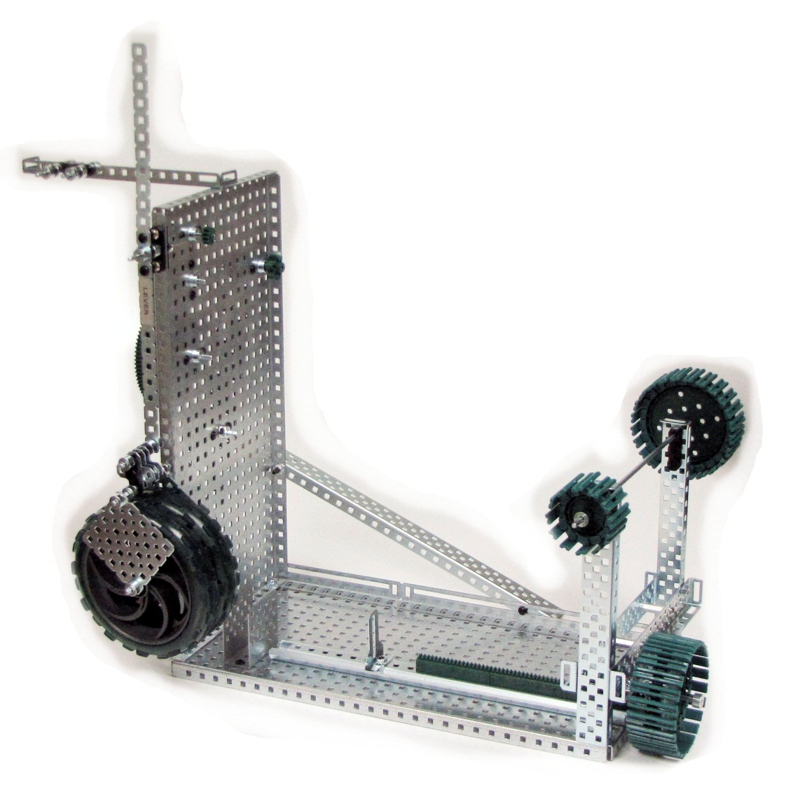
Presentation includes: instructions for building a simple machines device and measuring mechanical advantage

Slide 3
Base Equipment

Slide 4
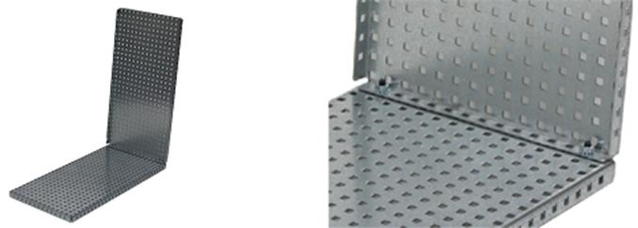
Step 1: Assemble the Base

Slide 5
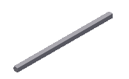
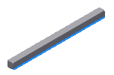
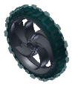
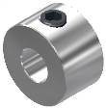
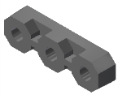
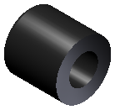


Resistance Equipment
Part | Name | Quantity
 | 3” Drive Shaft | 2
 | 2” Drive Shaft | 1
 | Large Wheel | 2
 | Shaft Collar | 8
 | Bearing Flat, Delrin | 2
 | Large Spacer | 4
 | Square Plate 5x5 | 2
 | Plus Gusset | 3

Slide 6
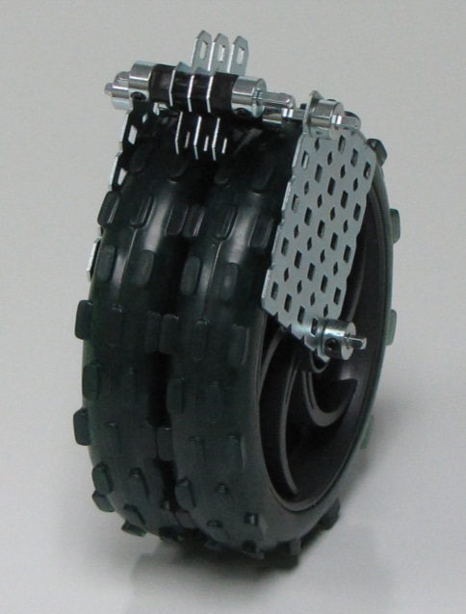
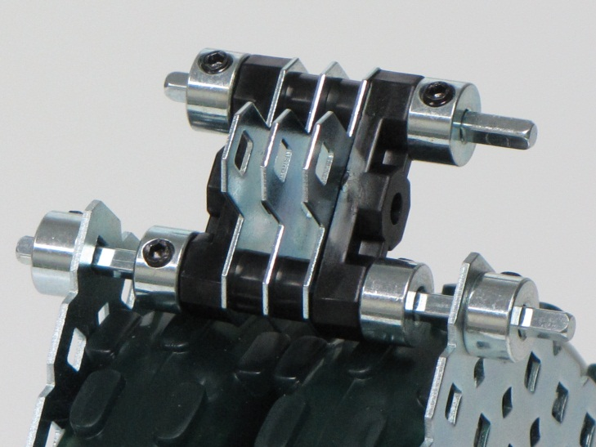
Step 2: Assemble the resistance force

Slide 7
Lever Equipment

Slide 8
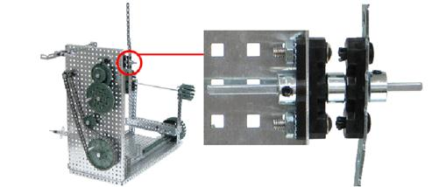
Step 3: Assemble the Lever

Slide 9
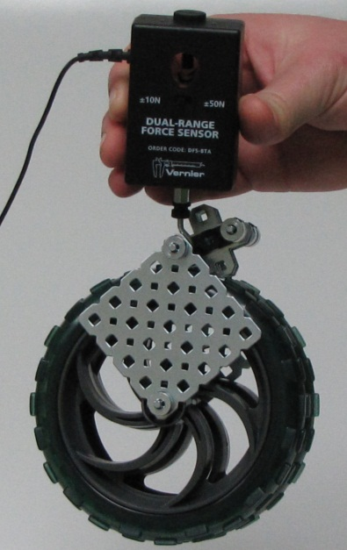
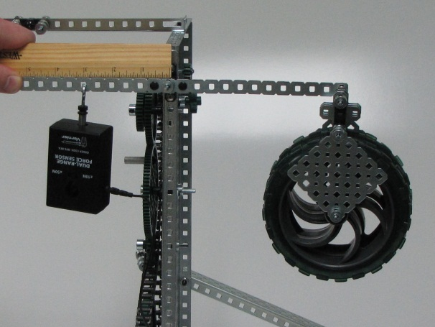
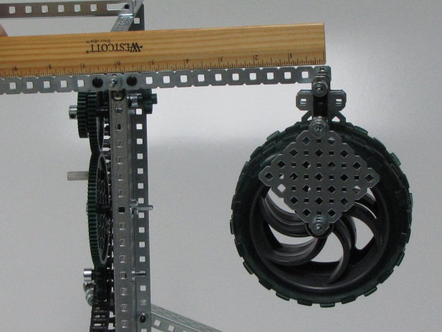
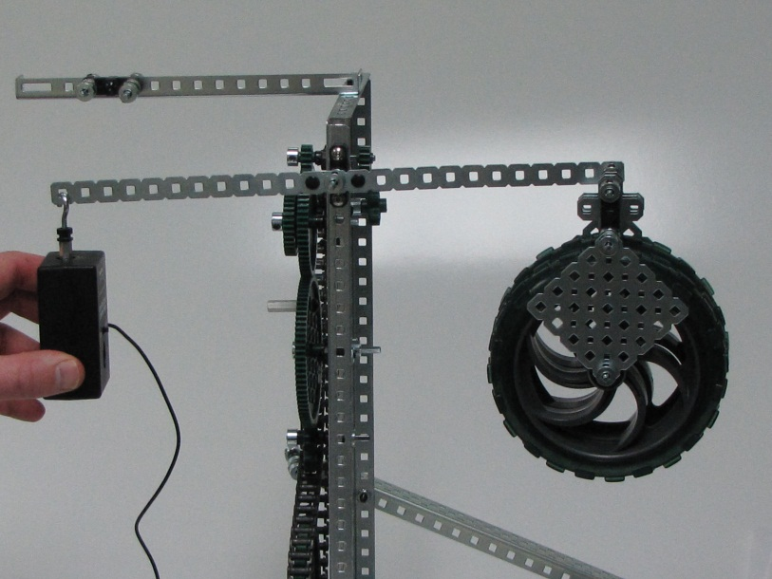
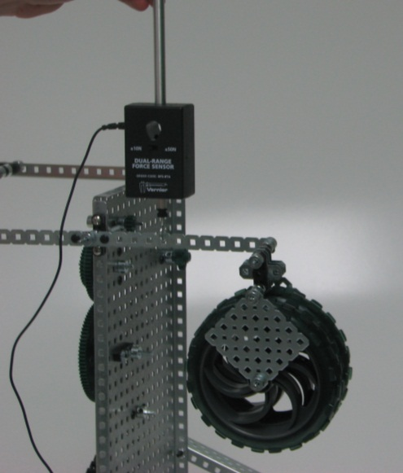
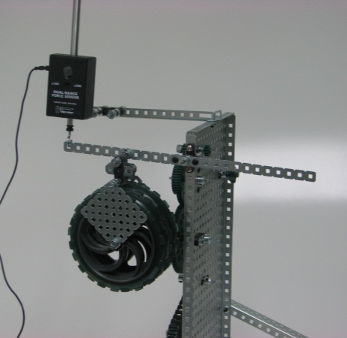
Calculating mechanical advantage with the lever
Measure distances
Measure resistance
Measure effort

Slide 10
Wheel and Axle Equipment

Slide 11
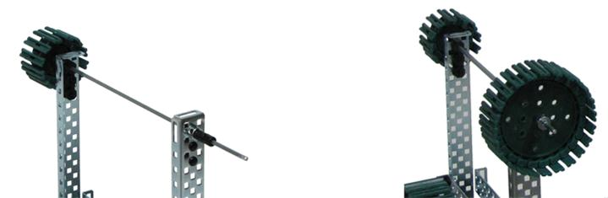
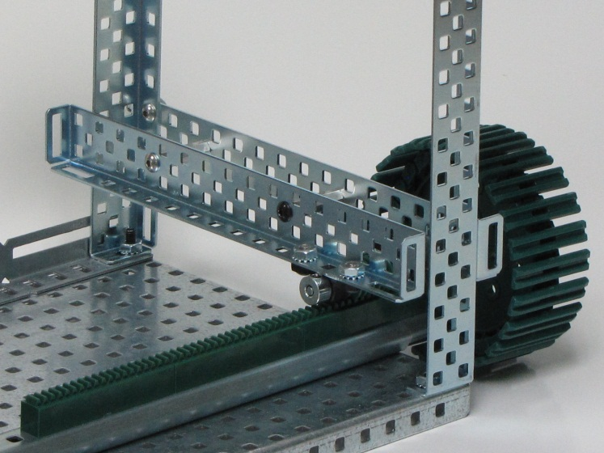
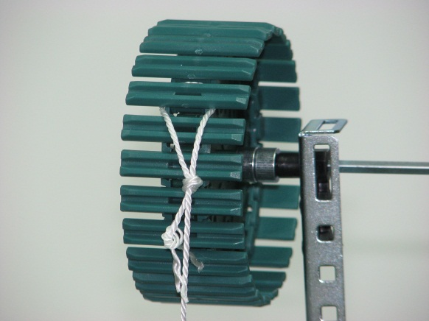
Step 4: Assemble the wheel and axle

Slide 12
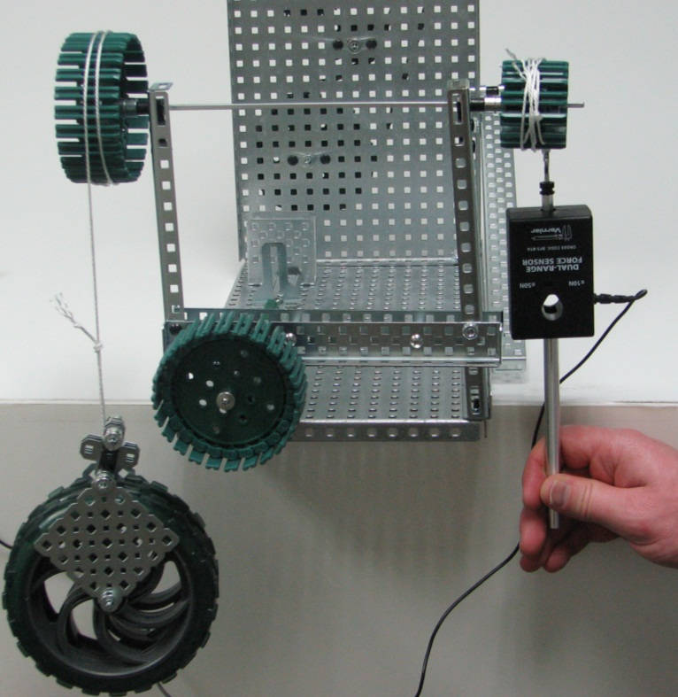
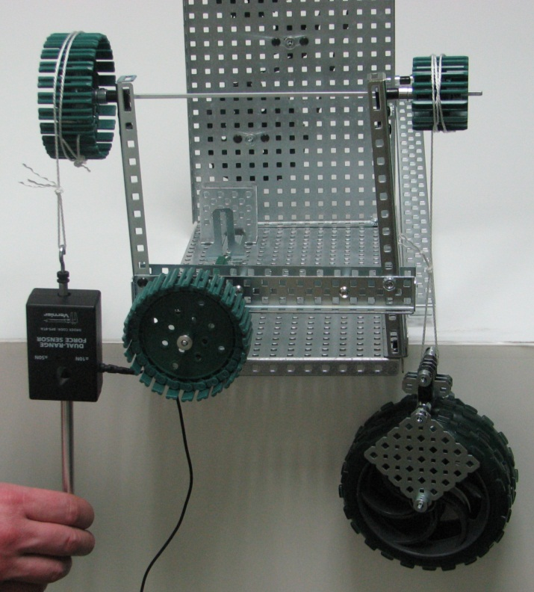
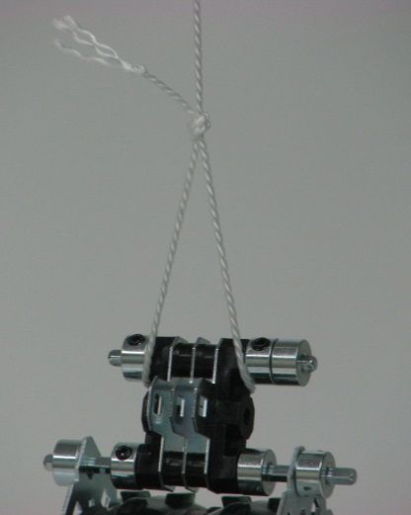
Calculating mechanical advantage of the wheel and axle
Loop string over wheel and axle in opposite directions

Slide 13
Pulley Equipment

Slide 14
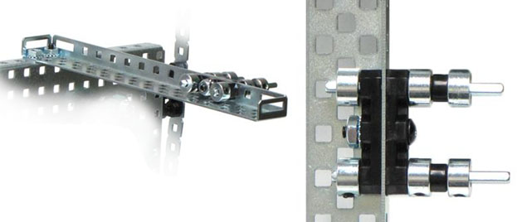
Step 5: Assemble the pulley system

Slide 15
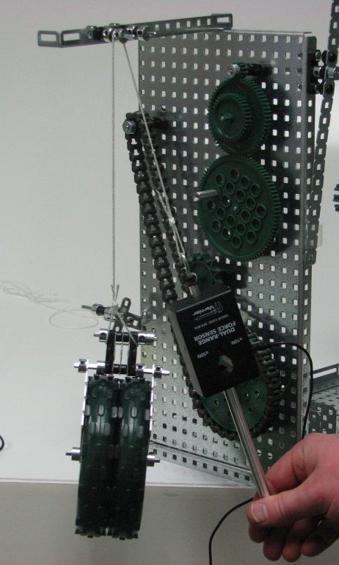
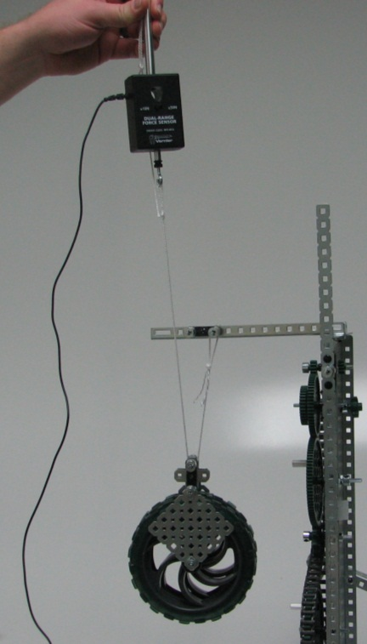
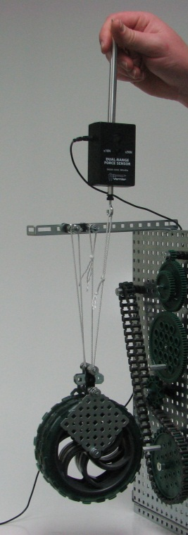
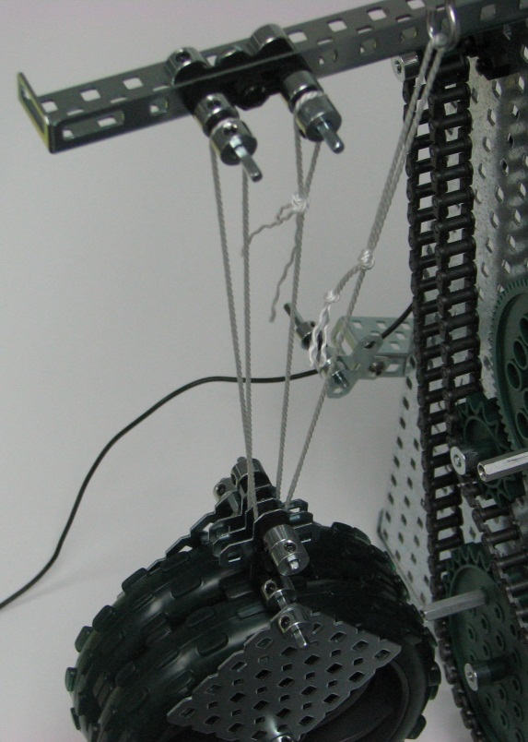
Calculating mechanical advantage of the pulley
fixed
moveable
Block and tackle

Slide 16
Inclined Plane Equipment

Slide 17
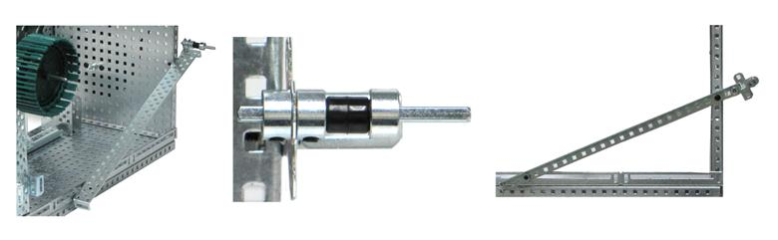
Step 6: Assemble the inclined plane

Slide 18
Screw Equipment

Slide 19
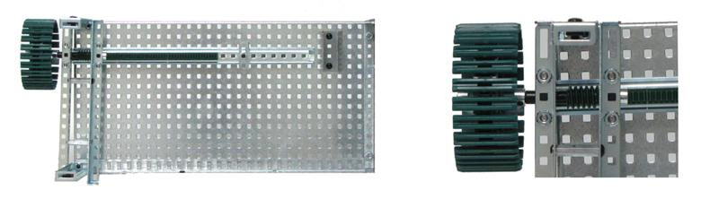
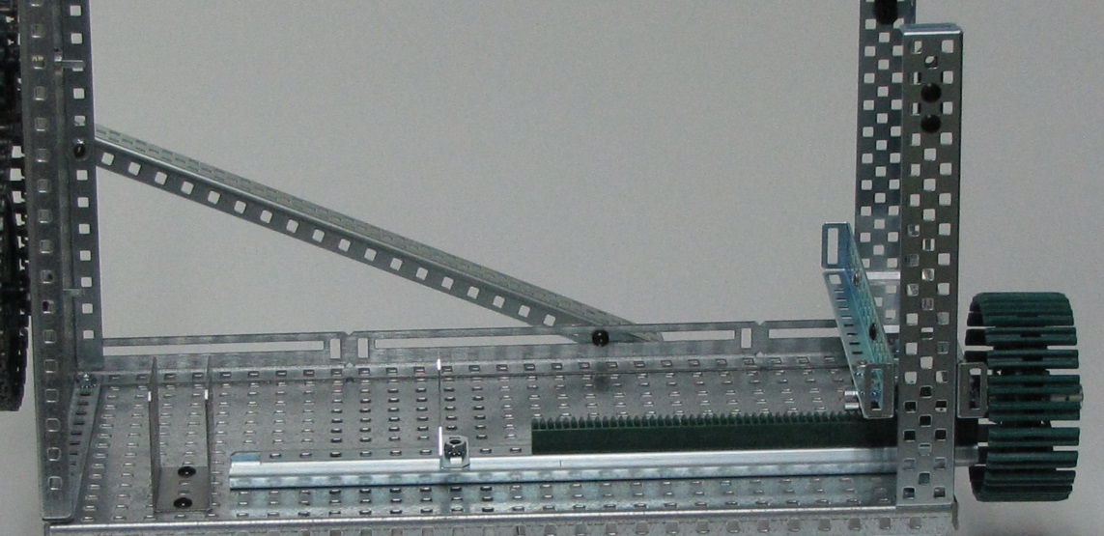
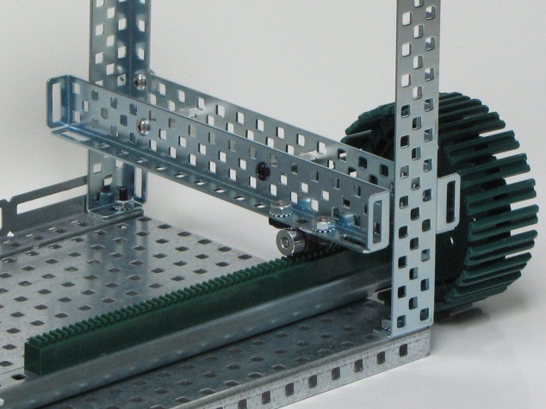
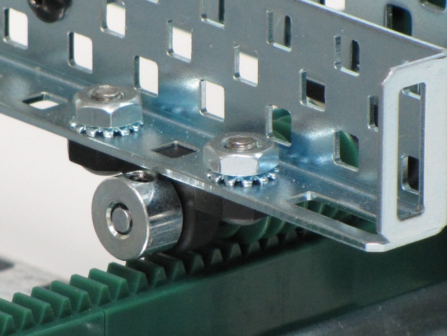
Step 7: Assemble the screw

