Slide 1
Perspective Sketching

Slide 2
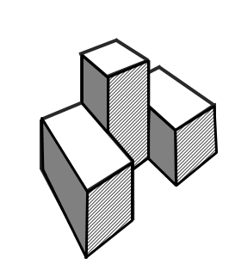
Perspective Drawings
A perspective drawing offers the most realistic three-dimensional view of all the pictorial methods, because it portrays the object in a manner that is most similar to how the human eye perceives the visual world.

Slide 3
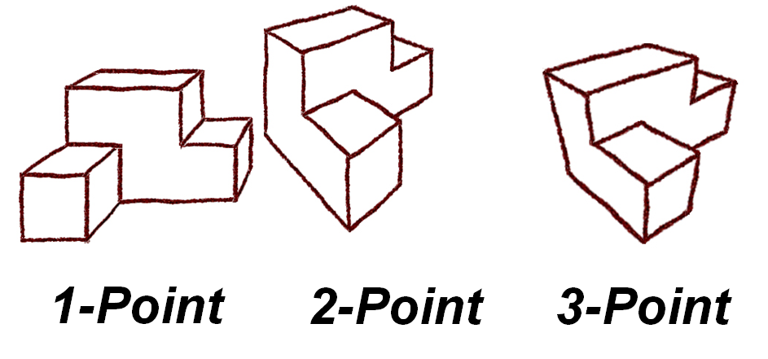
Perspective Drawings
Notes:
There are three different perspective representations (one-point, two-point, and three point). The number refers to the number of vanishing points used in the construction of the drawing, as you will learn.

Slide 4
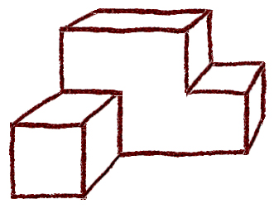
One-Point Perspective
The one-point perspective is relatively simple to make, but is somewhat awkward in appearance when compared to other types of pictorials.
A horizontal line represents the horizon.
One vanishing point is identified on the horizon line.
A series of lines are drawn from distinctive points on the object to the vanishing point, outlining the object being constructed.

Slide 5
One-Point Perspective
The following slides show the steps in creating a one-point perspective of the puzzle piece shown below.
Two different methods will be demonstrated.

Slide 6
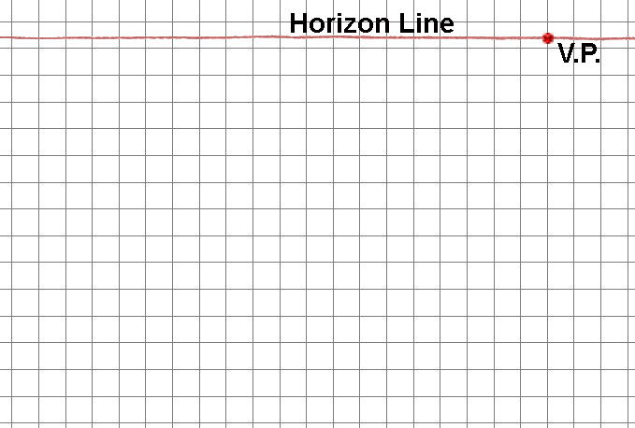
V.P.
METHOD 1 – The Box Method
1. Sketch a horizontal line across the upper portion of the paper to represent the horizon, and identify a vanishing point.
The vanishing point can be placed anywhere along the horizon line.

Slide 7
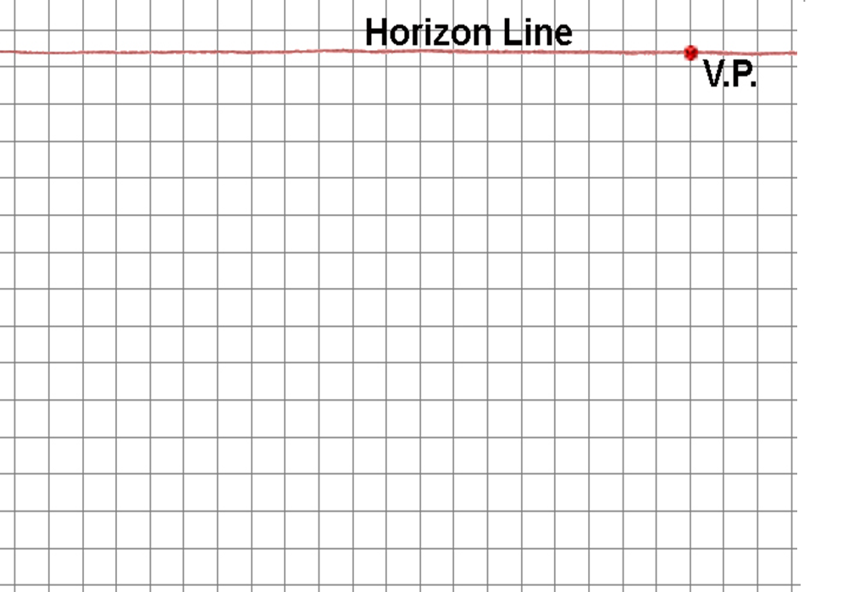
2. Sketch the front face of a “box” representing the overall size of the object.
The front face is constructed with vertical height lines and horizontal width lines.

Slide 8
3. Sketch construction lines from the corners of the front face of the “box” back to the vanishing point.

Slide 9
4. Sketch the visible back edges of the “box” to represent the overall size of the object.
Note that you will have to estimate the depth of the object.
Notes:
Estimate the depth of the object to create proportions that produce a realistic appearance.

Slide 10
5. Locate points and construction lines to identify corners and edges of the object on the surface of the “box”.

Slide 11
6. Use object lines to trace over the edges of the object on the visible surface of the “box”.

Slide 12
7. Continue to use construction lines to delineate the remaining corners and edges of the object inside the “box”.

Slide 13
PLTW
8. Trace over the construction lines with object lines to define the object.

Slide 14
One-point Perspective
V.P.
METHOD 2
1. Sketch a horizontal line across the upper portion of the paper to represent the horizon, and identify a vanishing point.
The vanishing point can be placed anywhere along the horizon line.
Notes:
This method may be easier to follow when sketching perspective views of puzzle pieces, however, the box method may be more appropriate for more organic objects and consumer products.

Slide 15
One-point Perspective
2. Sketch the front most face of the object such that the height lines are vertical and the width lines are horizontal.

Slide 16
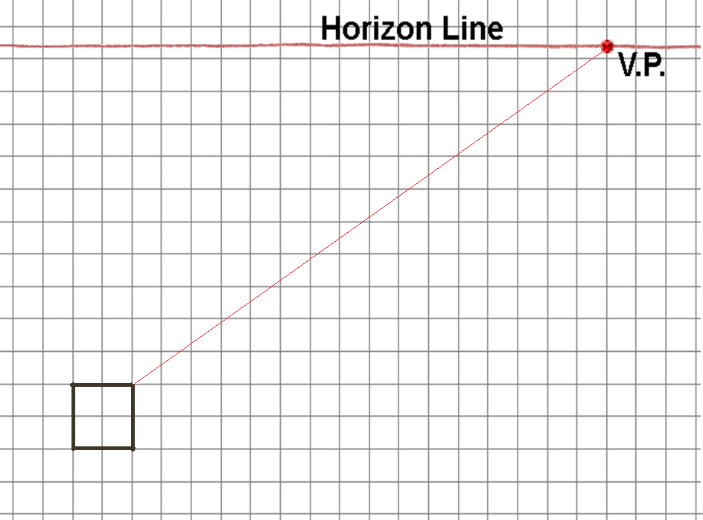
One-point Perspective
3. Project the corners of the front face back to the vanishing point using construction lines.

Slide 17
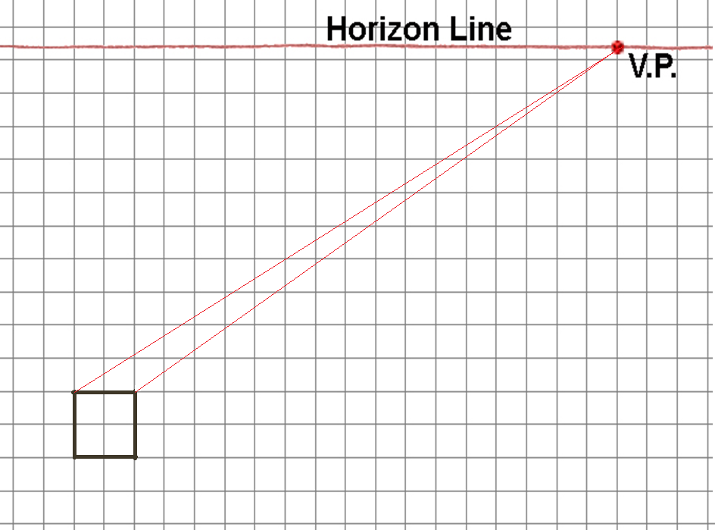
One-point Perspective
3. Project the corners of the front face back to the vanishing point using construction lines.

Slide 18
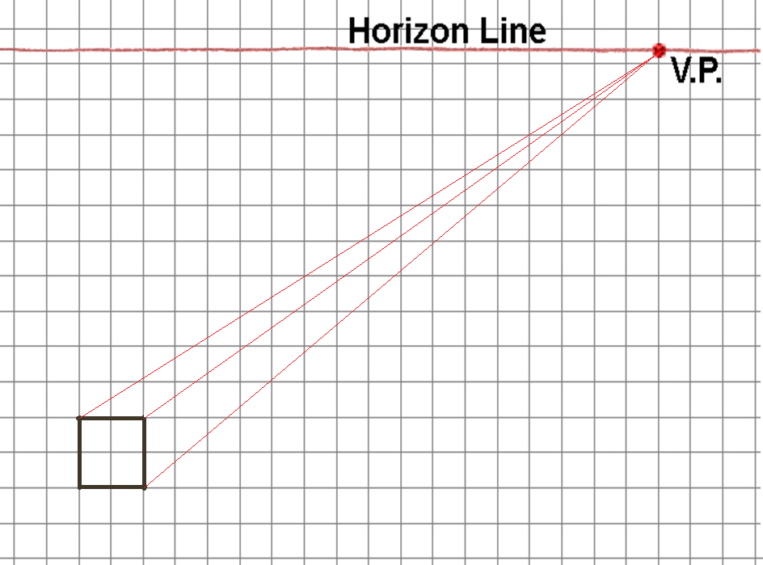
One-point Perspective
3. Project the corners of the front face back to the vanishing point using construction lines.

Slide 19
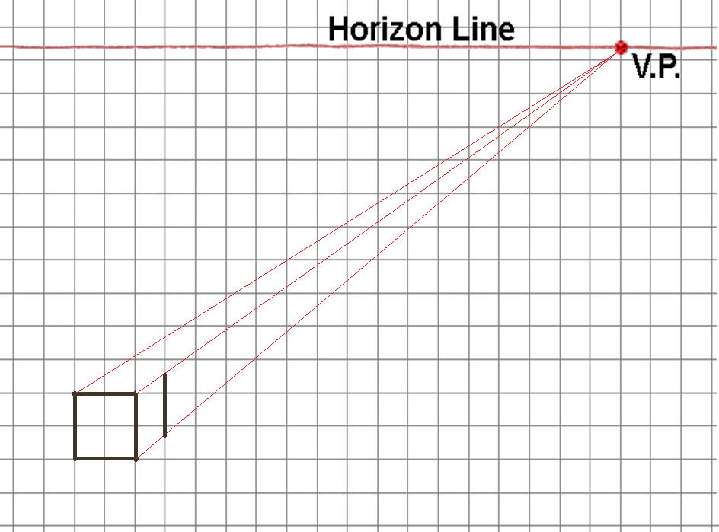
One-point Perspective
4. Sketch vertical object lines to represent the height edges of the object as necessary.

Slide 20
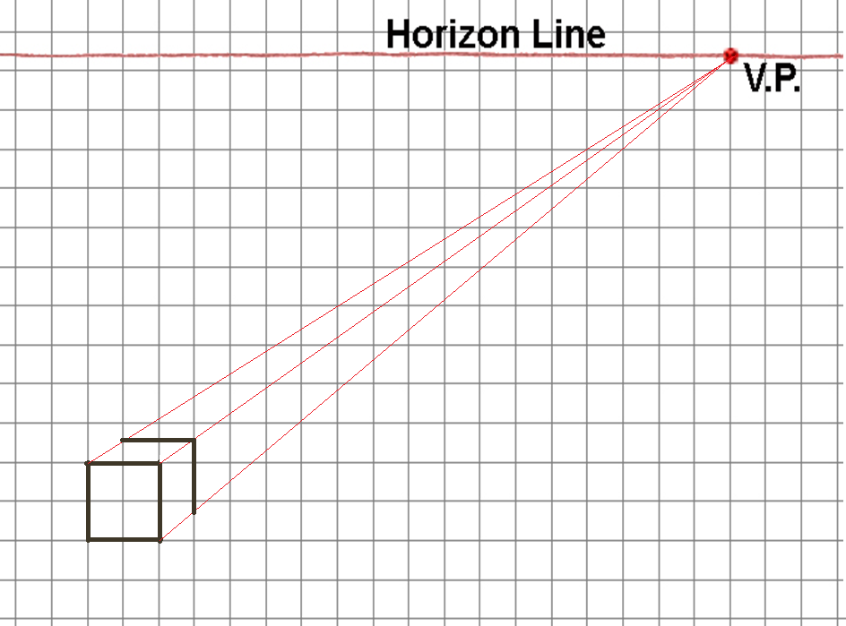
One-point Perspective
5. Sketch horizontal object lines to represent the width edges of the object as necessary.

Slide 21
One-point Perspective
6. Trace over the receding object lines to represent the depth edges of the object as necessary.

Slide 22
One-point Perspective
6. Trace over the receding object lines to represent the depth edges of the object as necessary.

Slide 23
One-point Perspective
6. Trace over the receding object lines to represent the depth edges of the object as necessary.

Slide 24
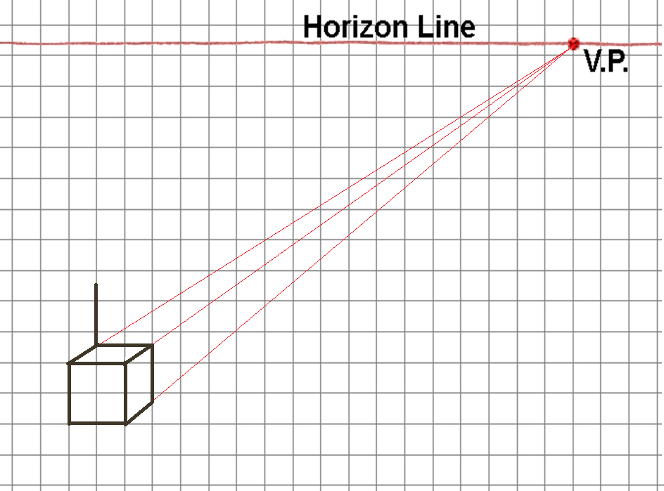
One-point Perspective
7. Continue to sketch height and width object lines as vertical and horizontal lines as necessary to define parts of the object.

Slide 25
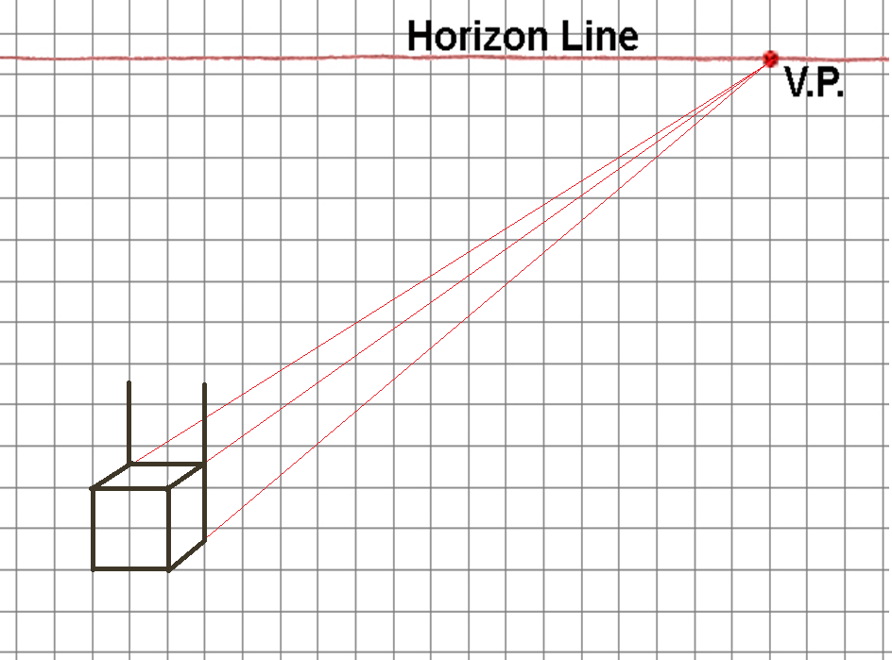
One-point Perspective
7. Continue to sketch height and width object lines as vertical and horizontal lines as necessary to define parts of the object.

Slide 26
One-point Perspective
7. Continue to sketch height and width object lines as vertical and horizontal lines as necessary to define parts of the object.

Slide 27
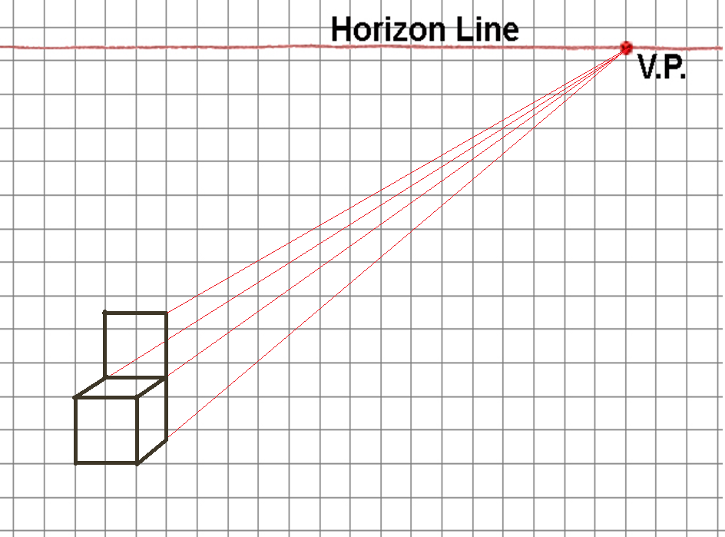
One-point Perspective
8. Continue to use construction lines to project object corners back to the vanishing point as necessary.

Slide 28
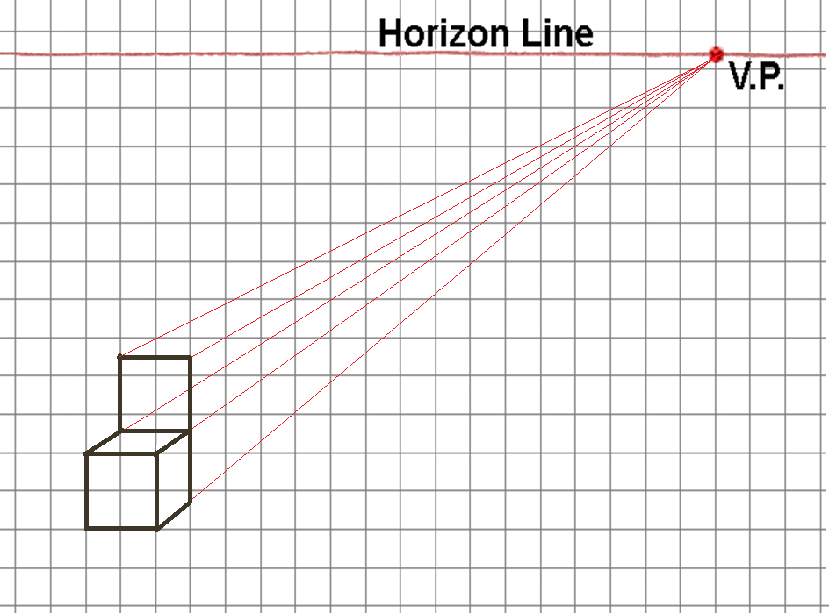
One-point Perspective
8. Continue to use construction lines to project object corners back to the vanishing point as necessary.

Slide 29
One-point Perspective

Slide 30
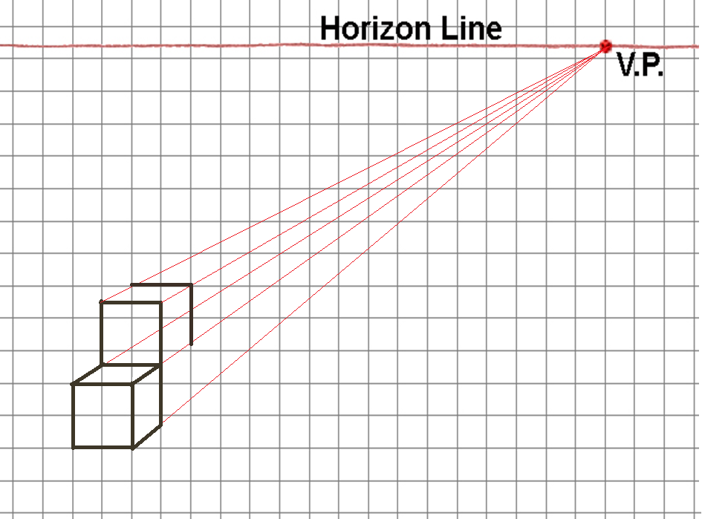
One-point Perspective

Slide 31
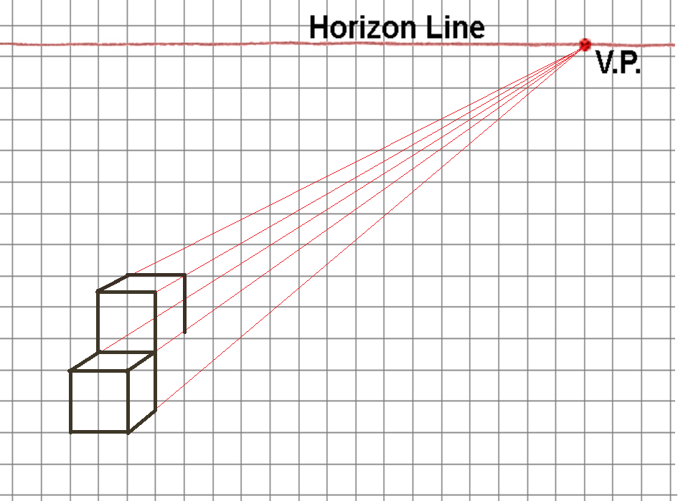
One-point Perspective
9. Continue to sketch object lines along the construction lines to represent the depth edges as necessary.

Slide 32
One-point Perspective
9. Continue to sketch object lines along the construction lines to represent the depth edges as necessary.

Slide 33
One-point Perspective
9. Continue to sketch object lines along the construction lines to represent the depth edges as necessary.

Slide 34
One-point Perspective

Slide 35
One-point Perspective

Slide 36
One-point Perspective

Slide 37
One-point Perspective

Slide 38
One-point Perspective

Slide 39
One-point Perspective

Slide 40
One-point Perspective

Slide 41
One-point Perspective

Slide 42
One-point Perspective

Slide 43
One-point Perspective
10. You may use tonal shading to enhance the appearance of the perspective sketch and create a more realistic representation.

Slide 44
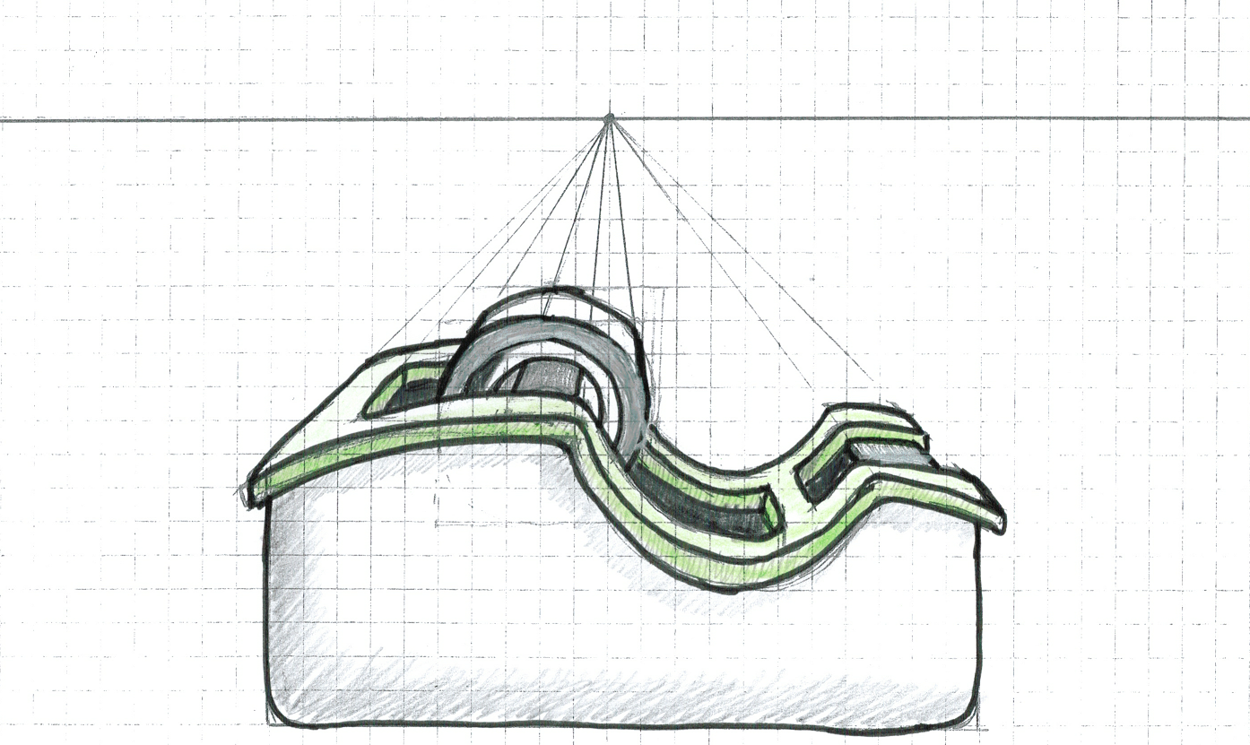
One-Point Perspective Example
Notes:
This is an example of a sketch of a tape dispenser in one-point perspective.

Slide 45
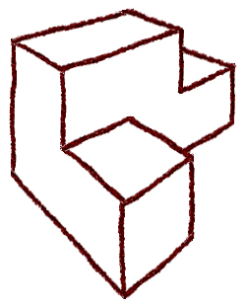
Two-Point Perspective
The two-point perspective is the most common perspective drawing.
A step-by-step procedure will be explained for the perspective.

Slide 46
Two-Point Perspective
The following slides show the steps in creating a two-point perspective of the puzzle piece shown below.

Slide 47
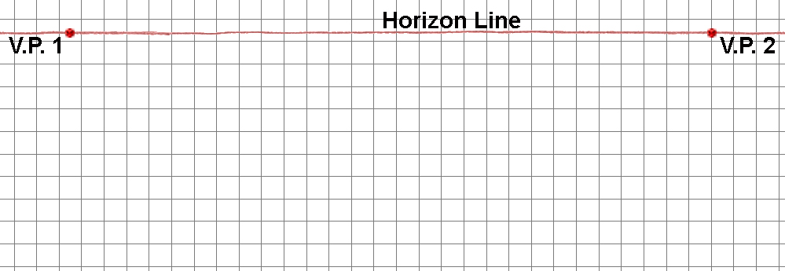
Two-point Perspective
1. Sketch a horizontal line across the upper portion of the paper to represent the horizon, and identify two vanishing points.
The vanishing points should can be placed toward each end of the horizon line.

Slide 48
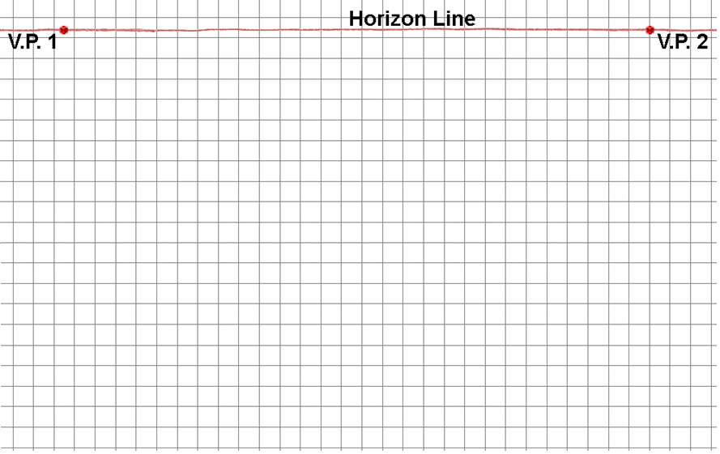
Two-point Perspective
2. Sketch a vertical construction line to represent the front edge of the object.
The construction line can be drawn below, above, or through the horizon line.
Front Edge

Slide 49
Two-point Perspective
An imaginary “box” encloses the entire object
3. Locate two points on the construction line to represent the top and bottom corners of the “box” within which the object will be sketched.

Slide 50
Two-point Perspective
4. Sketch a construction line from each point on the vertical line to each vanishing point.

Slide 51
Two-point Perspective
5. Sketch points and vertical construction lines to represent the overall width and depth of the object.
You will need to estimate the location of these to make the box proportional.

Slide 52
Two-point Perspective
6. Sketch construction lines to represent the top back edges of the “box”.

Slide 53
Two-point Perspective
7. Sketch points and construction lines to identify the edges of the object faces that occur on the visible surfaces of “the box.”

Slide 54
Two-point Perspective
7. Sketch points and construction lines to identify the edges of the object faces that occur on the visible surfaces of “the box.”

Slide 55
Two-point Perspective
7. Sketch points and construction lines to identify the edges of the object faces that occur on the visible surfaces of “the box.”

Slide 56
Two-point Perspective
7. Sketch points and construction lines to identify the edges of the object faces that occur on the visible surfaces of “the box.”

Slide 57
Two-point Perspective
8. Trace over the construction lines to delineate the edges of the object faces that occur on the visible surfaces of “the box.”

Slide 58
Two-point Perspective
9. Sketch additional construction lines to identify surfaces of the object inside of “the box.”

Slide 59
Two-point Perspective
10. Trace over construction lines to delineate the remaining object lines

Slide 60
Two-point Perspective
11. You may use tonal shading to enhance the appearance of the perspective sketch and create a more realistic representation.

Slide 61
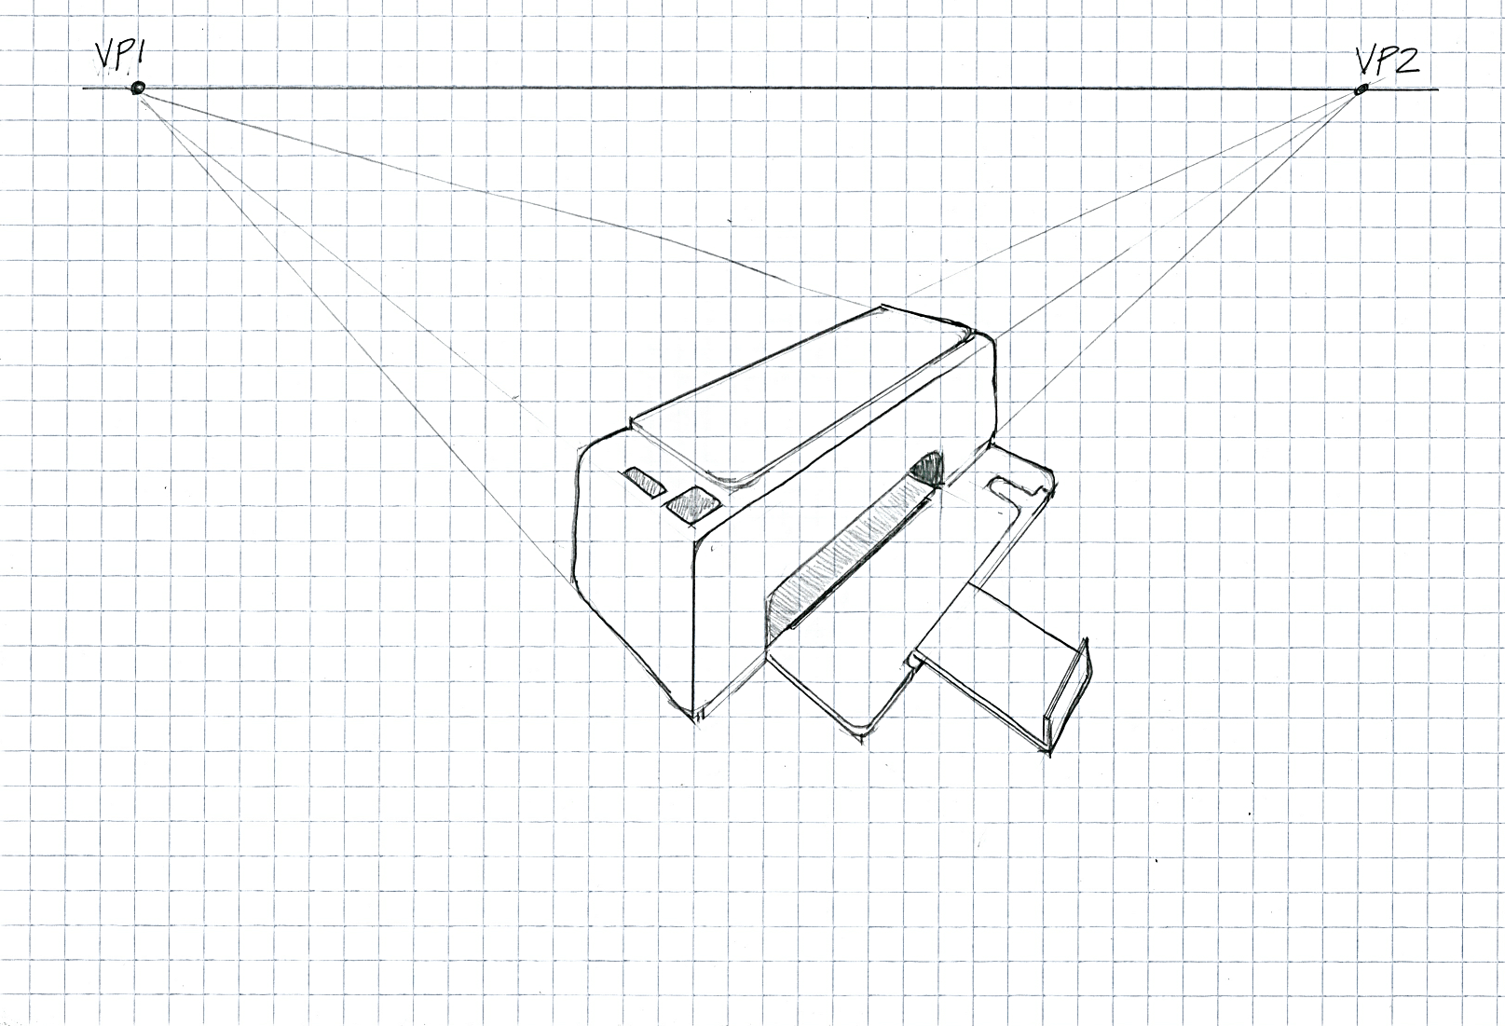
Two-Point Perspective Example

Slide 62
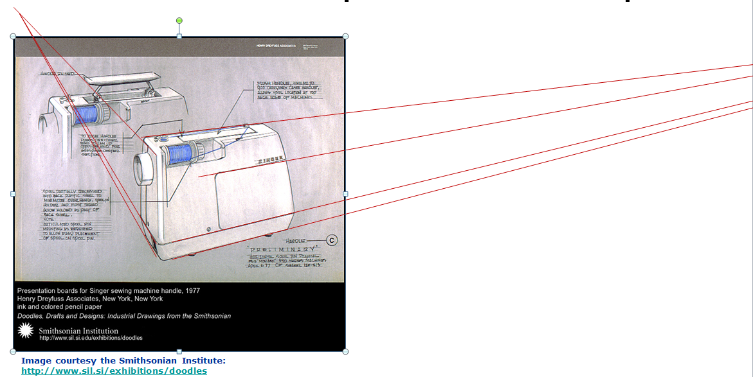
Two-Point Perspective Example
Two point perspective used in a presentation drawing for a Singer sewing machine handle.

Slide 63
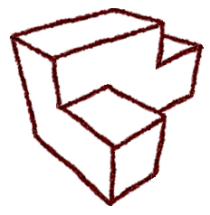
Three-Point Perspective
The three-point perspective gives the viewer either a worm’s eye, or bird’s eye view of an object.

Slide 64
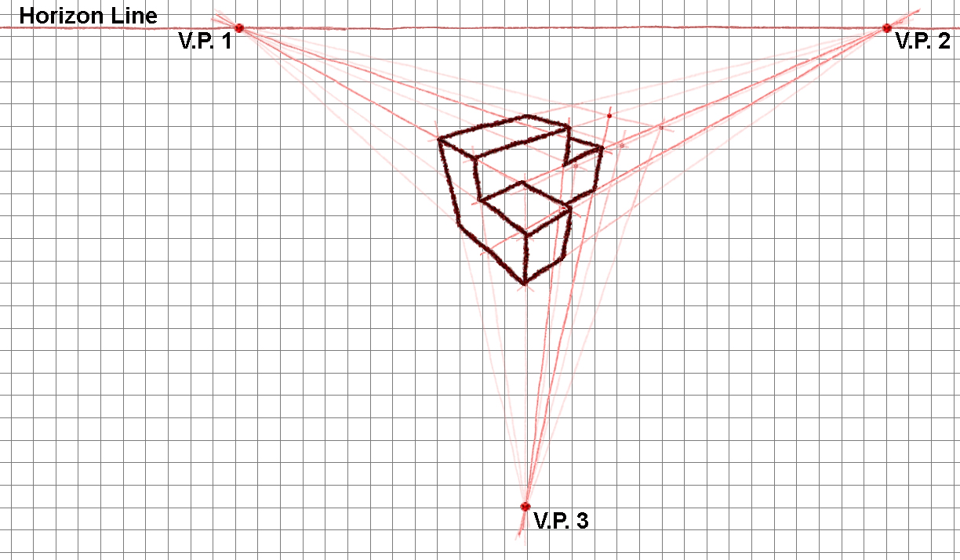
Three-Point Perspective

Slide 65
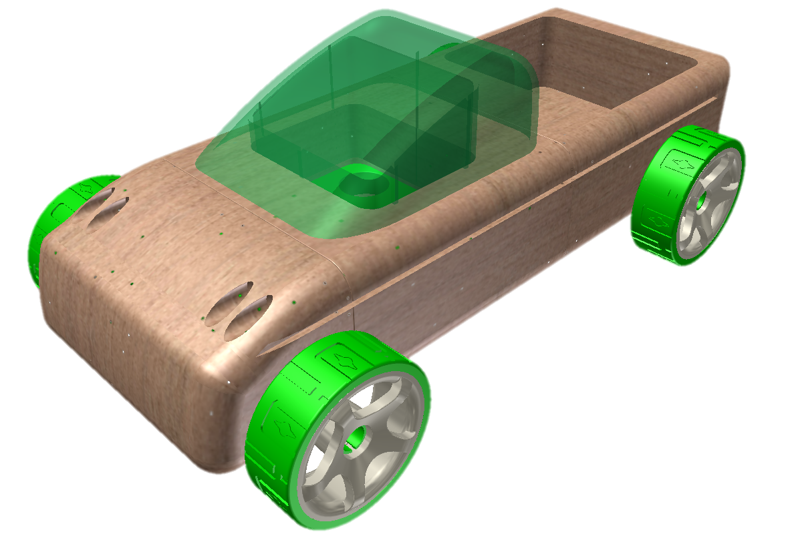
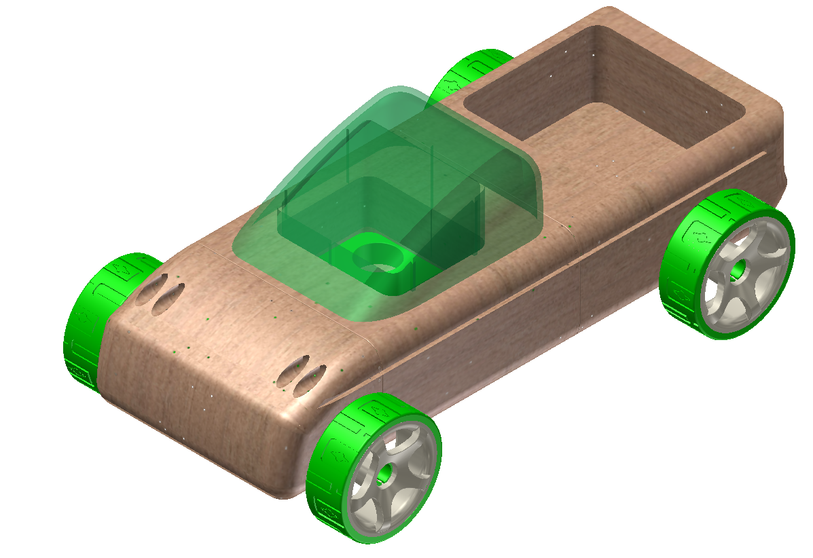
Perspective versus Isometric
Perspective
Isometric
Notes:
Which view is a perspective view and which is an isometric projection? How can you tell? [click several times]
The depth lines recede to a single vanishing point and the width lines recede toward a vanishing point in the perspective view. In the isometric projection, the depth lines are parallel and the width lines are parallel.

