Slide 1
Gliders in Flight
Stability for
Straight and Level Flight

Slide 2
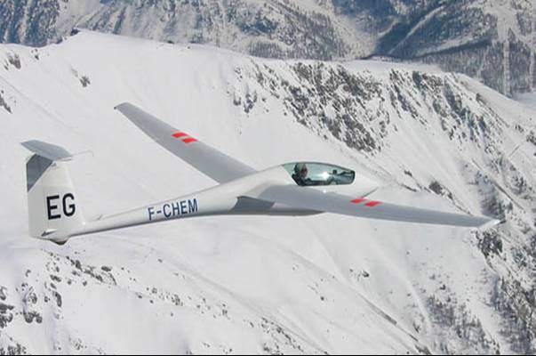
Glider in Flight

Slide 3
Gliders As Long Distance Fliers

Slide 4
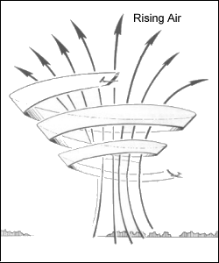
Gaining Altitude
Gliders do not have an engine
Gliders use rising air to gain altitude

Slide 5
Balsa Glider Flight
Straight and Level = Maximum Distance

Slide 6
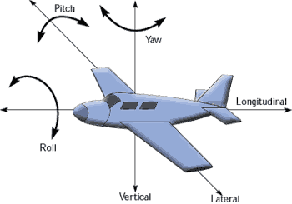
Tree Axis of Movement

Slide 7
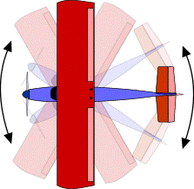
Movement in Yaw

Slide 8
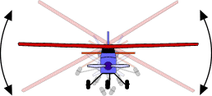
Movement in Roll

Slide 9
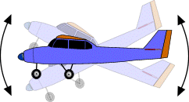
Movement in Pitch

Slide 10
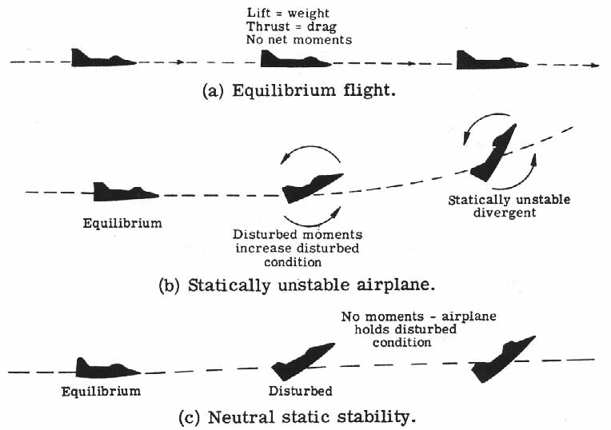
Static Stability

Slide 11
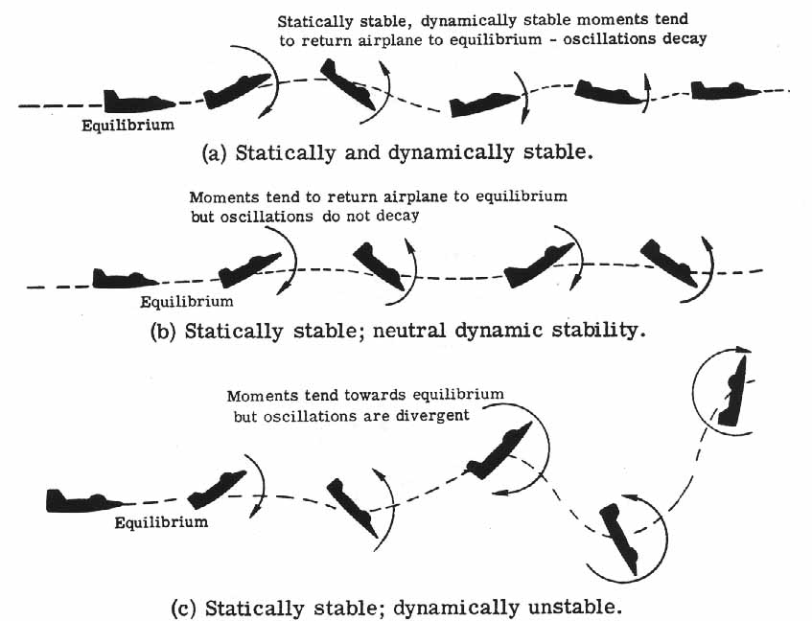
Dynamic Stability

Slide 12
Lateral Stability: Roll
High wing aircraft are naturally stabilizing

Slide 13
Lateral Stability: Dihedral

Slide 14
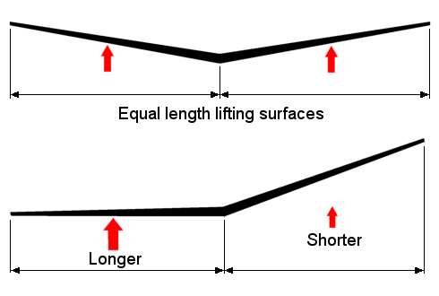
Why Does Dihedral Work?

Slide 15
Why Does Dihedral Work?
Uniform Lift
Weight

Slide 16
Why Does Dihedral Work?
Weight
Component of Weight
Causing a Sideslip

Slide 17
Why Does Dihedral Work?
Rolling
Moment
Lower Lift
Higher Lift
Lower AOA
Higher AOA
Induced Relative Wind

Slide 18
Lateral Stability: Types of Dihedral
No Dihedral
Straight Dihedral
Tip Dihedral
Polyhedral

Slide 19
Movement in Yaw

Slide 20
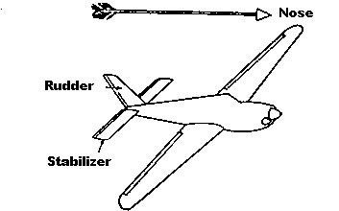
Directional Stability: Keel Effect

Slide 21
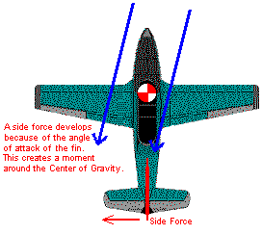
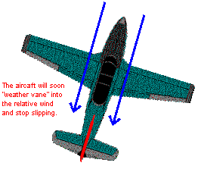
Directional Stability: Weather Vaning

Slide 22
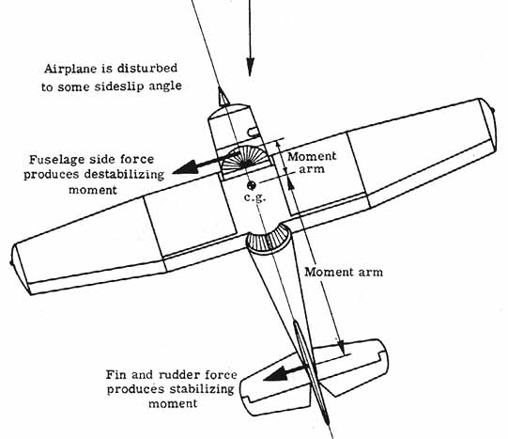
Directional Stability: Moment Arms

Slide 23
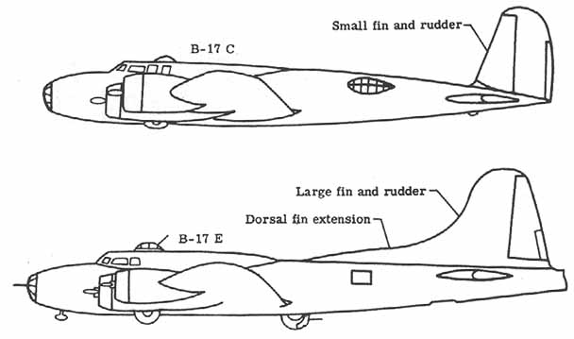
Directional Stability

Slide 24
Movement in Pitch

Slide 25
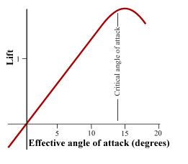
Avoiding the Stalling

Slide 26
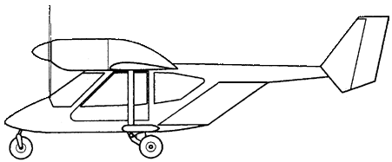
Weight and Balance
Center of Lift
Balanced, but easy to shift…
VERY nose heavy!
VERY tail heavy!
Weight at Center of Gravity

Slide 27
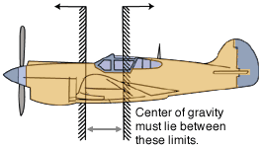
Center of Gravity Range

