Slide 1
Balsa Glider Construction

Slide 2
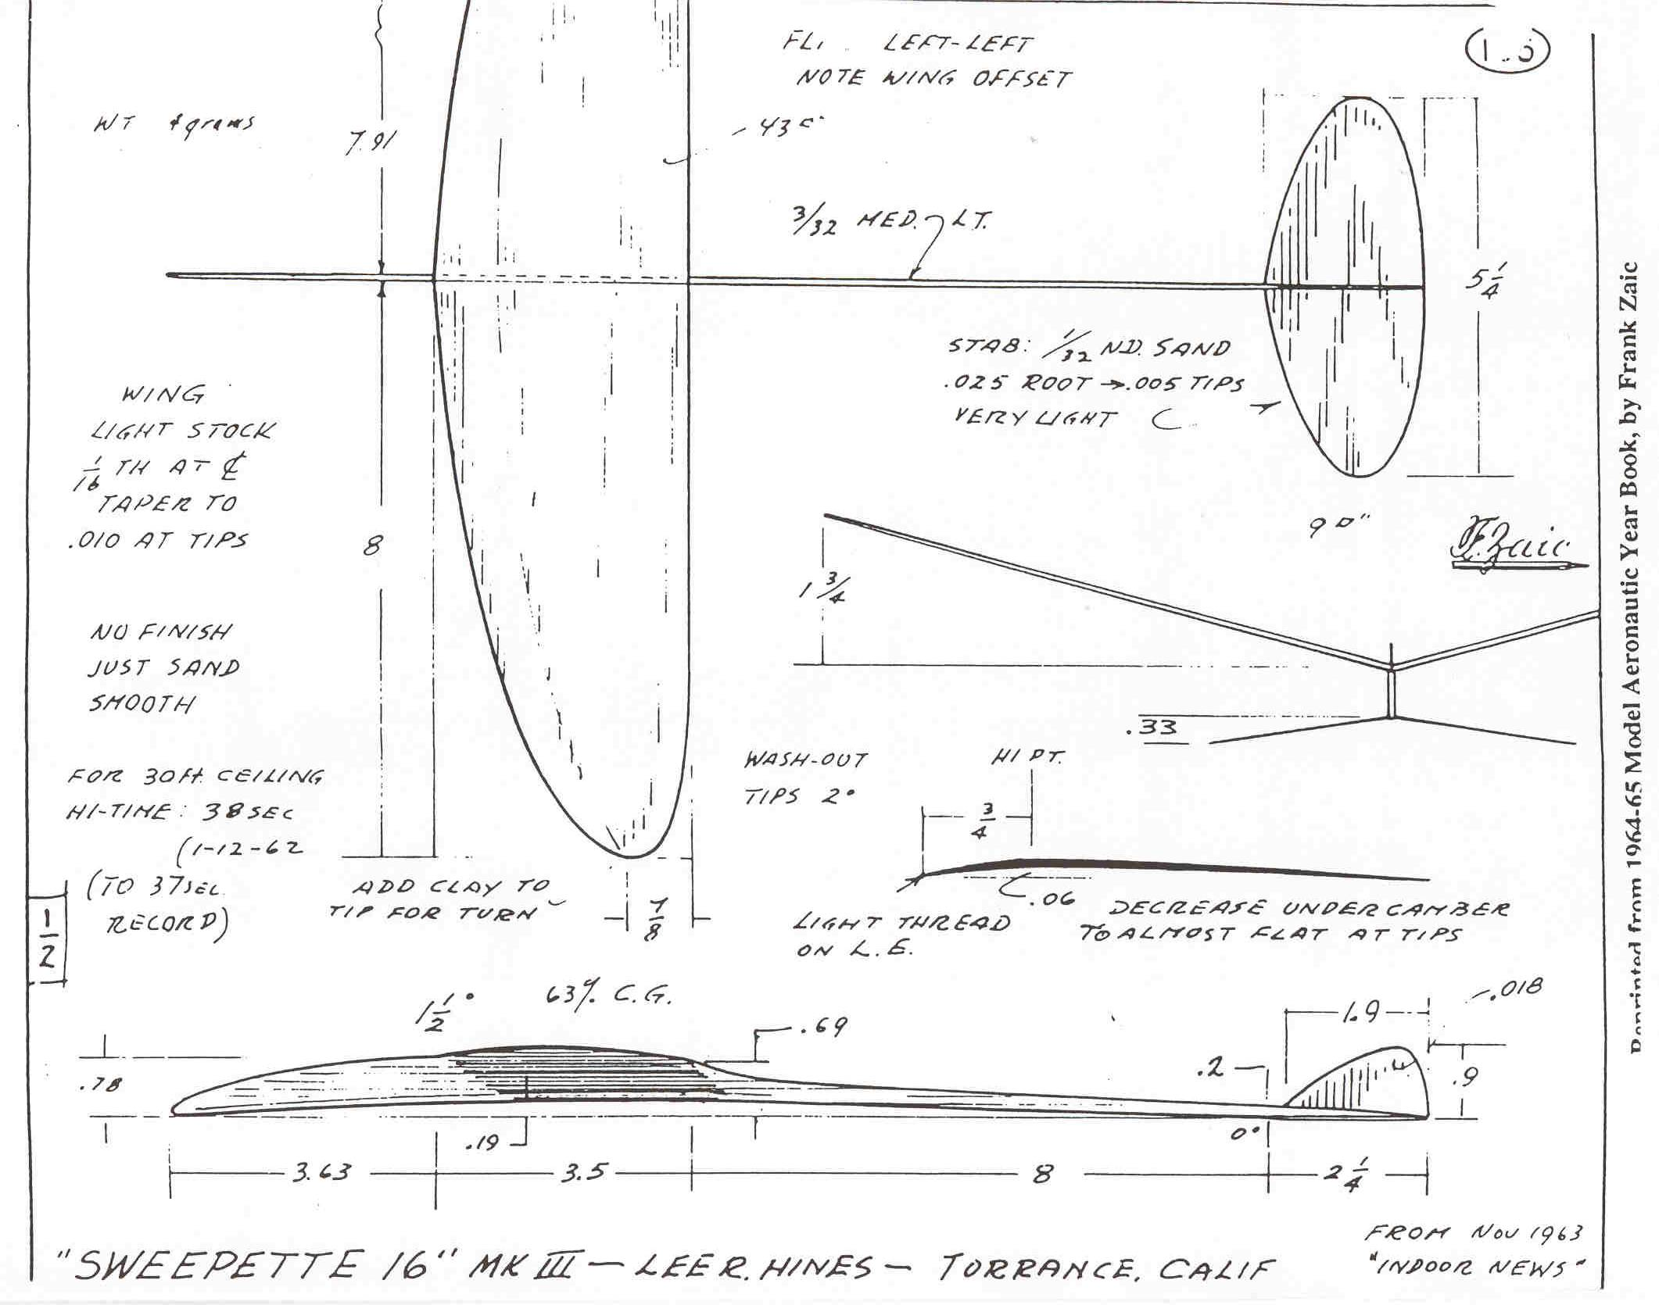
Balsa Glider Construction

Slide 3
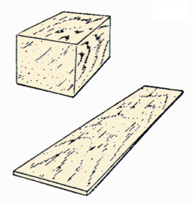
Balsa Wood
Very high strength-to-weight ratio
Easy to cut and sand
Grainy
Available in strips, sheets, or blocks
Not very durable for a fuselage . . . spruce is better

Slide 4
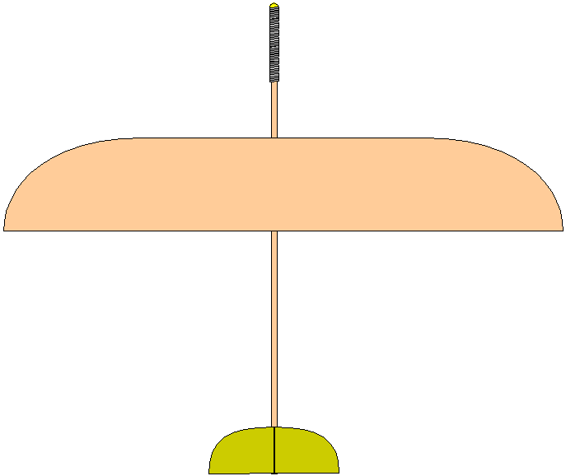
Glider Components
Fuselage
Wings
Horizontal stabilizer
Vertical tail (or stabilizer)
Nose weight

Slide 5
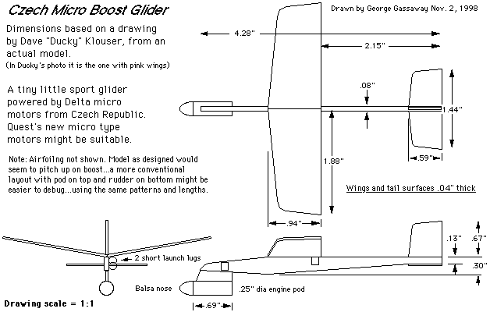
Familiarize Yourself with the Plan
Components
Dimensions
Materials
Outlines vs. cuts

Slide 6
Building on a Single Sheet
Wing
Horizontal
Stabilizer
Vertical
Tail
Leave extra space at these locations if material allows
Notice the grain direction: Always spanwise!

Slide 7
Marking the Fuselage
Cut for Length
Wing
Location
Center
of
Gravity
Horizontal
Stabilizer
Vertical
Tail
Neutral
Point

Slide 8
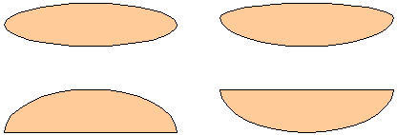
Choosing a Wing Planform
Elliptical wings might be great for full size aircraft, but they are challenging for small gliders
Straight leading edges tend to work well for small gliders

Slide 9
Cut Out Pieces
Cut the wing with extra span if material allows (see later note for reason)
Cut out stabilizers
Sand leading and trailing edges with minimal rounding

Slide 10
Finish Trailing Edge
Trailing edge imperfections most often occur at wingtips
If material allows, finish trailing edge then make final cuts for span and/or leading edge curvature

Slide 11
Shaping the Wing Profile
Leading edge should have minimal rounding
Trailing edge needs taper on top only
Use sanding block and edge of a solid surface for uniform sanding

Slide 12
Adding the Wing
Center the wing on the fuselage
Glue it on straight and square to the fuselage . . . this is critical

Slide 13
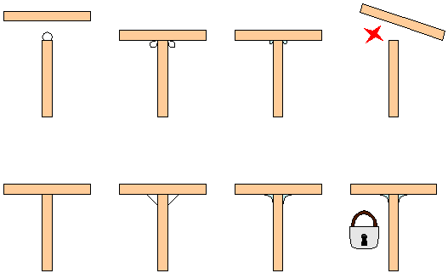
Making a Strong Bond
Avoid typical novice method of applying excessive glue on an edge and sticking material together
Light bond with reinforcing fillets increases the glue surface area and bond strength

Slide 14
Add Horizontal Stabilizer
One piece stabilizer
Stronger
Only possible if mounted somewhere away from vertical stabilizer
Two piece stabilizer
Weaker
Mount anywhere else

Slide 15
One Piece Stabilizer
Cut out wedge from glider plan
Trace on to fuselage wood scrap, then cut out wedge
Glue wedge (not stabilizer) to top of fuselage (direction dependent upon tail or canard mount)
Front
Back
HS
Side of Fuselage
Stabilizer
Wedge
HS
Canard Position
Front
Back
HS
Tail Position

Slide 16
Check Alignment
Hold stabilizer on wedge
Ensure from front or back that stabilizer is parallel to wing
If not, sand wedge slightly and recheck

Slide 17
Glue Stabilizer
Cut out wedge from the glider plan
Trace angled line onto side of fuselage
Direction dependent on tail or canard mount

Slide 18
Two Piece Stabilizer
Cut out wedge from glider plan
Trace angled line onto side of fuselage
Direction dependent on tail or canard mount
Front
Back
HS
Side of Fuselage
Wedge
HS
Canard Position
HS
Tail Position

Slide 19
Check Alignment
Cut stabilizer in two
Glue one side at a time to each side of fuselage
HS
Canard Position
HS
Tail Position

Slide 20
Glue Stabilizer
Glue to SIDE of fuselage
Make certain that each half is straight and square to fuselage

Slide 21
Vertical Stabilizer Side Mount
Requires tail at a completely different location on fuselage from horizontal stabilizer
Glue onto side of fuselage flush with bottom edge and front edge even with vertical tail mark
Front
Back
VT
Side of Fuselage
VT
VT
Top View

Slide 22
Vertical Stabilizer Top Mount
Can be used no matter where tail is located
Draw line down center of fuselage top starting at vertical tail mark
Glue on vertical tail straight and square
Front
Back
VT
Side of Fuselage
VT
Top View
VT
VT

Slide 23
Balance the Glider
Place pencil on table top and put glider on top of it with center of gravity directly over pencil
Add clay to nose until glider balances at the center of gravity

Slide 24
Balance the Glider
Hold glider on fingertips placed at nose and tail
Add clay to wingtips until glider balances at fuselage

Slide 25
Wings with Dihedral?
Prior to gluing to fuselage:
Completely finish and sand wing
Put wing vertical with its trailing edge flat on a smooth, level surface such as glass

Slide 26
Making Cuts
Put triangle at dihedral cut locations
Use sharp blade
Hold triangle firmly to the wing and cut partially through wing
Do this at each location (must be parallel cuts)

Slide 27
Assemble Wing
Put wax paper on glass surface
Hold wing panels together
Wick glue into wing joint (e.g., CA adhesive)
Complete polyhedral then central joint

Slide 28
Final Assembly
Dihedral may require cutting a shallow v-shaped trough into top of fuselage to maintain dihedral angle

