Slide 1
Airfoil Simulation

Slide 2
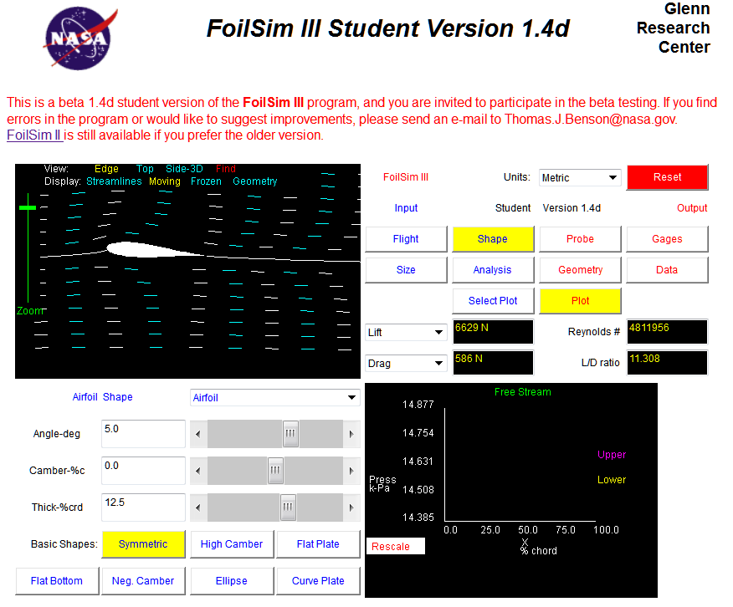
Java Foil Airfoil Simulation
Allows airfoil to be modified
Airflow can be simulated
Notes:
This process closely follows the activity. Understand the activity before presenting this information.

Slide 3
Airfoil Objective
Understand the objective
High lift
Low drag

Slide 4
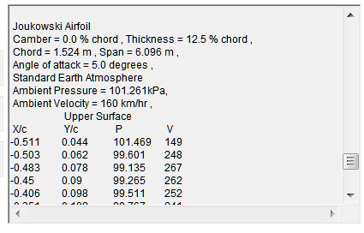
Airfoil Geometry Adjustment
Geometry tabs to change airfoil parameters
Geometry output

Slide 5
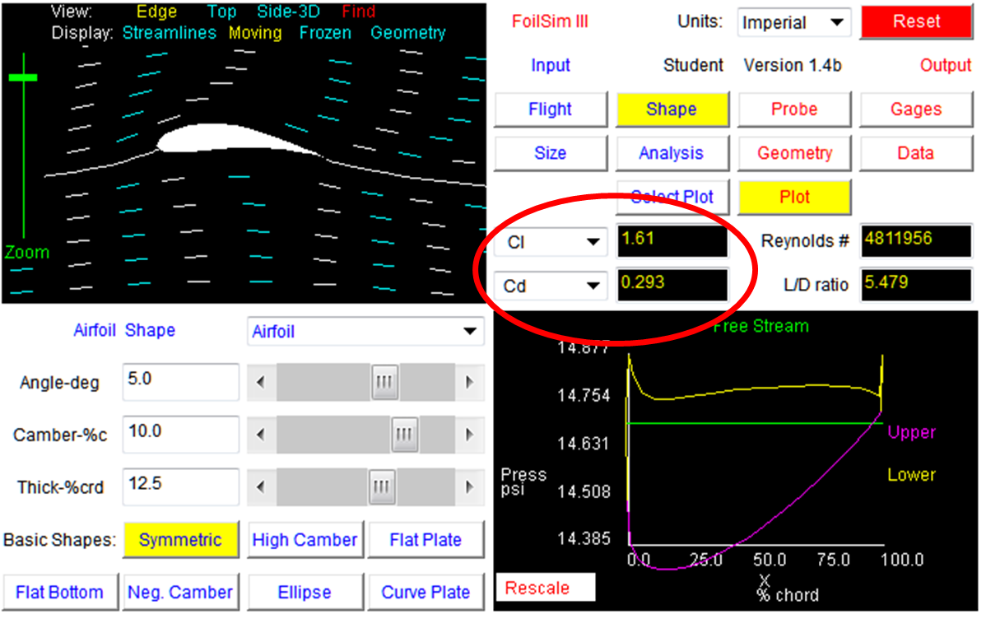
Airfoil Performance

Slide 6
References
MH Aero Tools (2010). Java Foil. Retrieved from http://www.grc.nasa.gov/WWW/K-12/airplane/foil3.html

