Slide 1
A Design Process

Slide 2
The Design Process
What is Design?
What is a Design Process?
Design Process Examples
Design Process used in IED

Slide 3
What Is Design?
The word “design” is often used as a generic term that refers to anything that was made by a conscious human effort.
Design is also a process that is used to systematically solve problems.
Notes:
Talk to students about how they use design every day. The process for getting ready for school is one example.

Slide 4
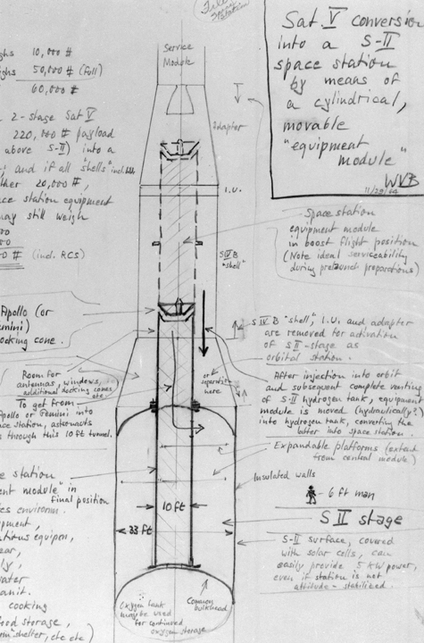
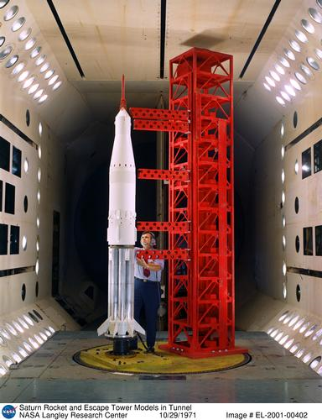
What Is a Design Process?
A design process is a systematic problem-solving strategy, with criteria and constraints, used to develop many possible solutions to solve or satisfy human needs or wants and to narrow down the possible solutions to one final choice.
– ITEA Standards for Technological Literacy
Images courtesy of NASA
Notes:
The first image is a von Braun sketch from 1964.
The second is an engineer in 1971 working with a Saturn V model.

Slide 5
Design Process
There are several design processes used across different technical fields. The following are examples.

Slide 6
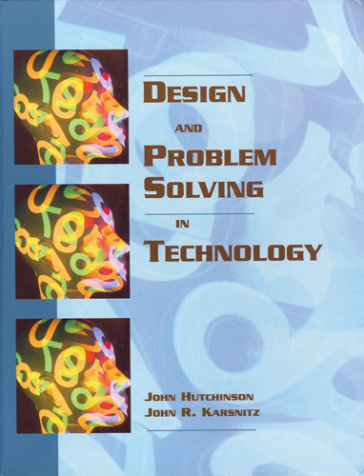
Design Process Example
Identify problems and opportunities
Frame a design brief
Investigate and research
Generate alternative solutions
Choose a solution
Developmental work
Model and prototype
Test and evaluate
Redesign and improve
Design and Problem Solving in Technology
Notes:
Several different design processes are used successfully in both industry and academia.

Slide 7
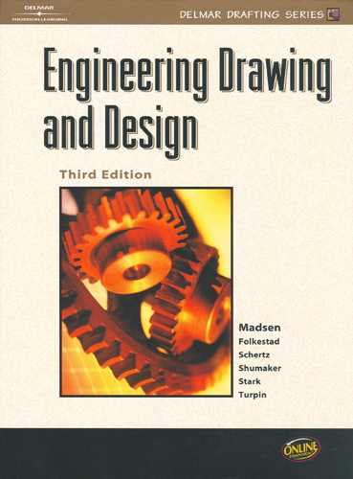
Design Process Example
Identify the need
Define the criteria
Explore/research/investigate
Generate alternate solutions
Choose a solution
Develop the solution
Model/prototype
Test and evaluate
Redesign and improve
Engineering Drawing and Design (3rd edition)

Slide 8
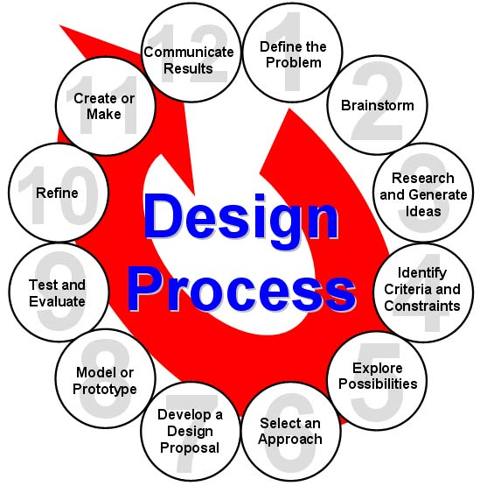
Design Process Example
Define the problem
Brainstorm
Research and generate ideas
Identify criteria and specify constraints
Explore possibilities
Select an approach
Develop a design proposal
Make a model or prototype
Test and evaluate the design using specifications
Refine the design
Create or make solution
Communicate processes and results
– ITEA Standards for Technological Literacy
Notes:
Many different design processes guide professionals in developing solutions to problems. The example that you see here is the design process implemented in PLTW courses.

Slide 9
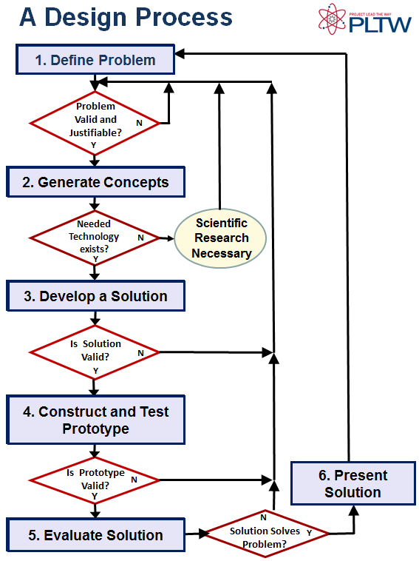
Design Process used in IED
Identify a Problem
Generate Concepts
Develop a Solution
Construct and Test a Prototype
Evaluate the Solution
Present the Solution
This design process was developed based on the University of Maryland - College Park - IRB Research Project

Slide 10
Design Process
Design process used in IED is an example of one design process
Many design processes exist and are effective
Consistently applying a single clearly defined design process provides a basis for understanding

Slide 11
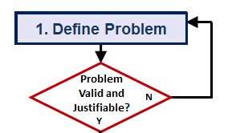
Define the Problem
Identify a problem
Validate the problem
Who says it is a problem?
Needs and wants
Prior solutions
Justify the problem
Is the problem worth solving?
Create design requirements (specifications)
Criteria and constraints
Project Proposal
In some cases, if the problem is not valid or justified, the designer must define a new problem.

Slide 12
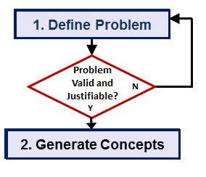
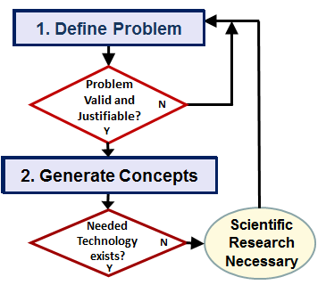
Generate Concepts
Brainstorm possible solutions
Research
Apply STEM principles
Select an approach
Decision Matrix
Assess technology needs
Design Proposal
If the technology necessary to develop the solution does not exist, scientific research may be necessary to pursue a solution.

Slide 13
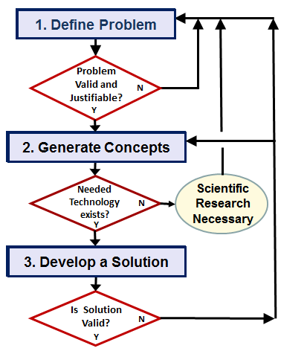
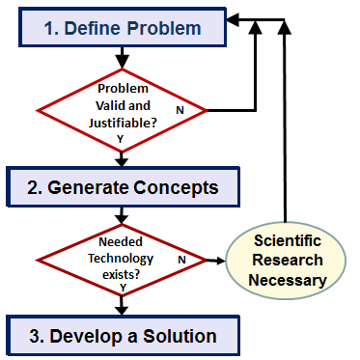
Develop a Solution
If a solution is found to be invalid, the design must return to a previous step in the design process.
Consider design validity
Function
Aesthetics
Ergonomics
Safety
Cost
Environment
Durability
Ease of Maintenance
Etc.
Create detailed design solution
Technical Drawings

Slide 14
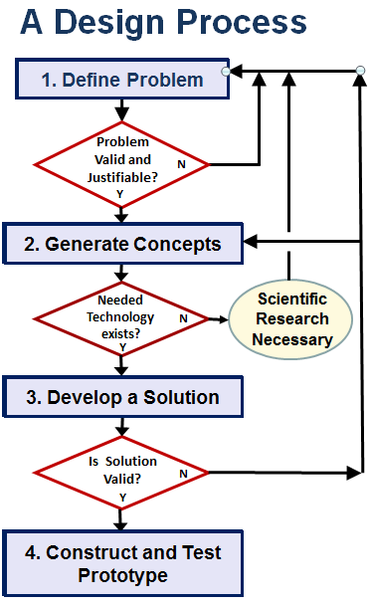
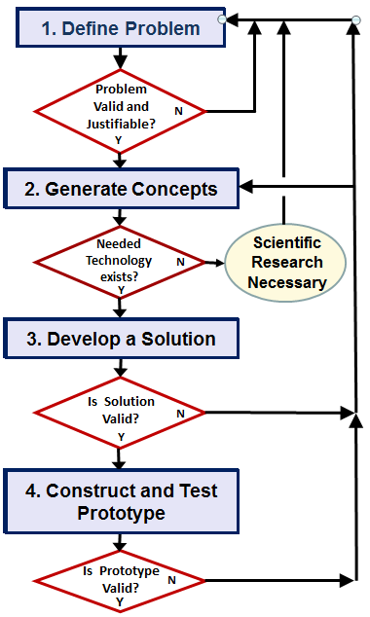
Construct and Test a Prototype
Construct a testable prototype
Plan prototype testing
Performance
Usability
Durability
Test prototype and collect data
Analyze test data
Test Report
If a testable prototype can not be built or test analysis indicates a flawed design, the designer must return to a previous step of the design process.

Slide 15
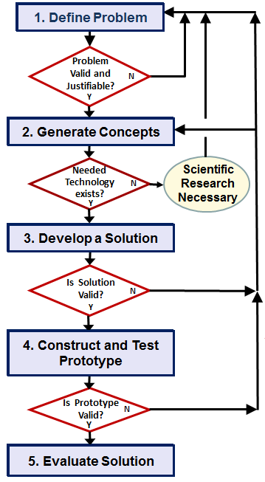
Evaluate the Solution
Evaluate solution effectiveness
Reflect on design
Recommend improvements
Optimize/Redesign the solution
[Return to prior design process steps, if necessary]
Revise design documents
Project Recommendations

Slide 16
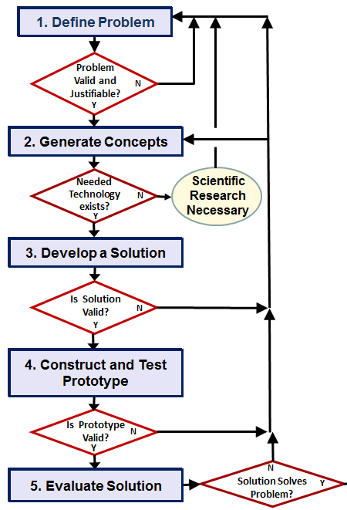
Based on the evaluation of the design, product improvement or redesign may require the designer to repeats previous steps of the design process.

Slide 17
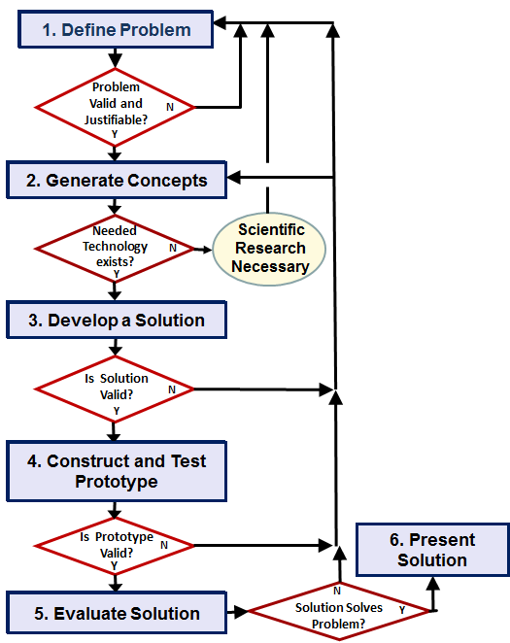
Present the Solution
Document the project
Project Portfolio
Communicate the project
Formal Presentation

Slide 18
Design Process
Non linear
Notes:
Although we have presented a design process in a somewhat linear fashion, the path from identifying a problem to presenting a solution is rarely straightforward. Designers must evaluate, reflect, redefine, and redesign throughout the process. It is common to repeat steps of the design process several times before an optimal solution is found.

Slide 19
Image Resources
National Aeronautics and Space Administration (NASA). (n.d.). NASA image exchange. Retrieved from http://nix.nasa.gov/.

