Slide 1
Activity 1.2.3a Airfoil
Construction Guide

Slide 2
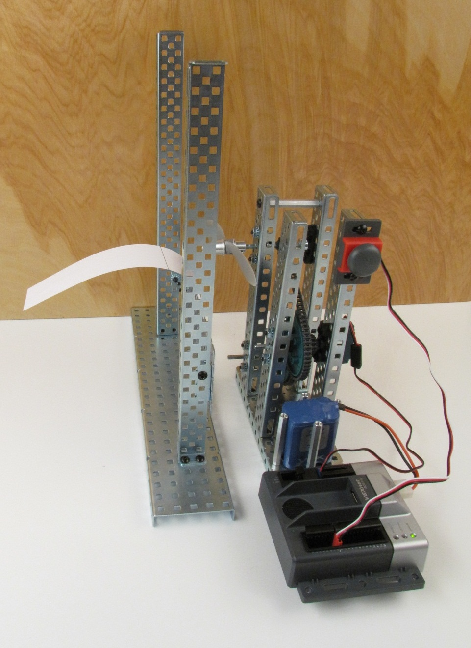
Equipment
AE VEX kit
Slow flyer propeller 8x6SF
Propeller adapter with set screw 4mm
2 in. x 9 in. strip of paper

Slide 3
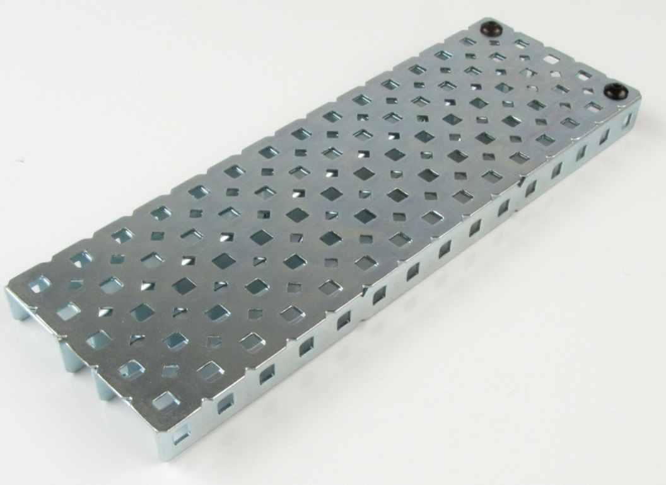
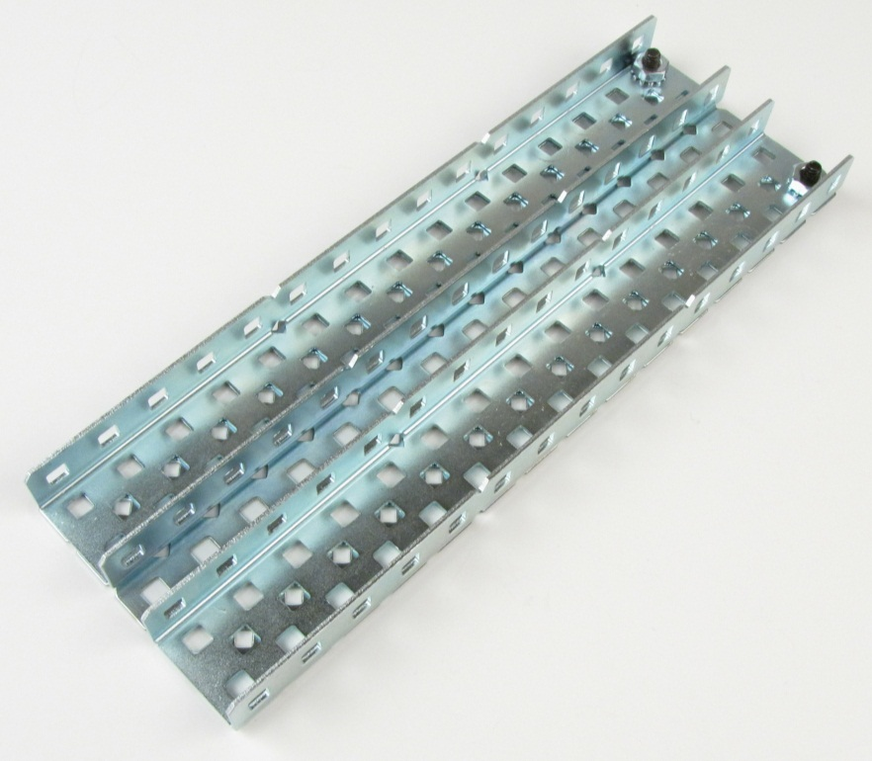
Step 1: Construct Base

Slide 4
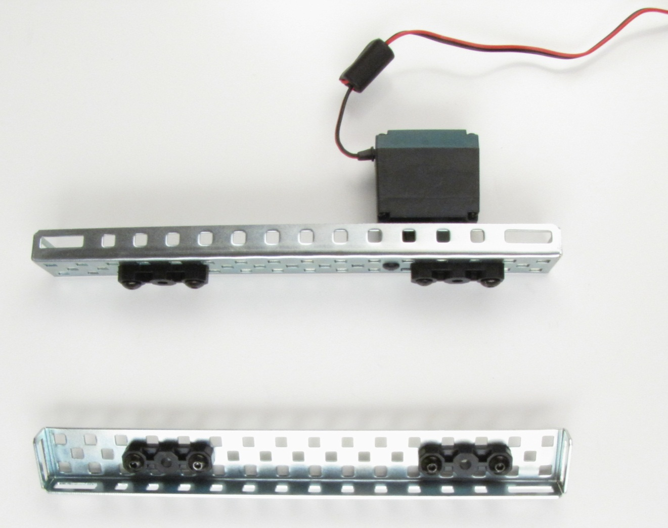
Step 2: Construct Drive Towers

Slide 5
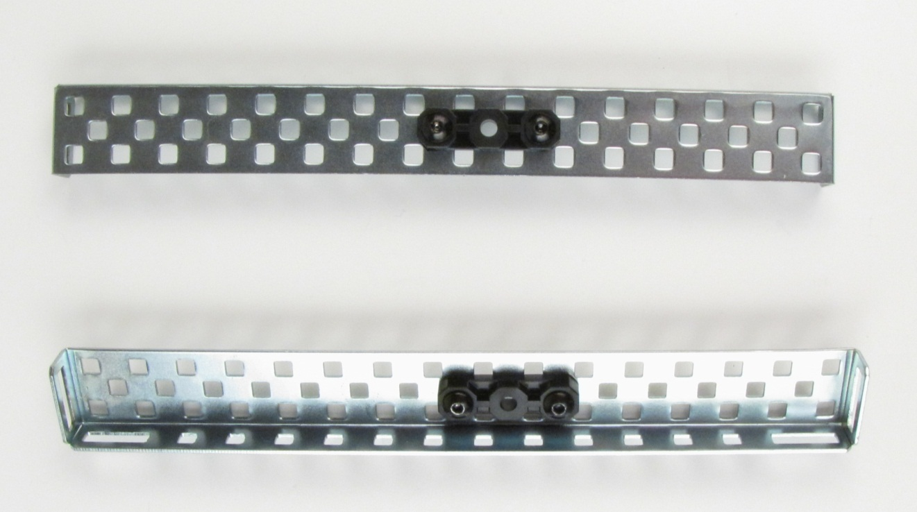
Step 3: Construct Propeller Towers

Slide 6
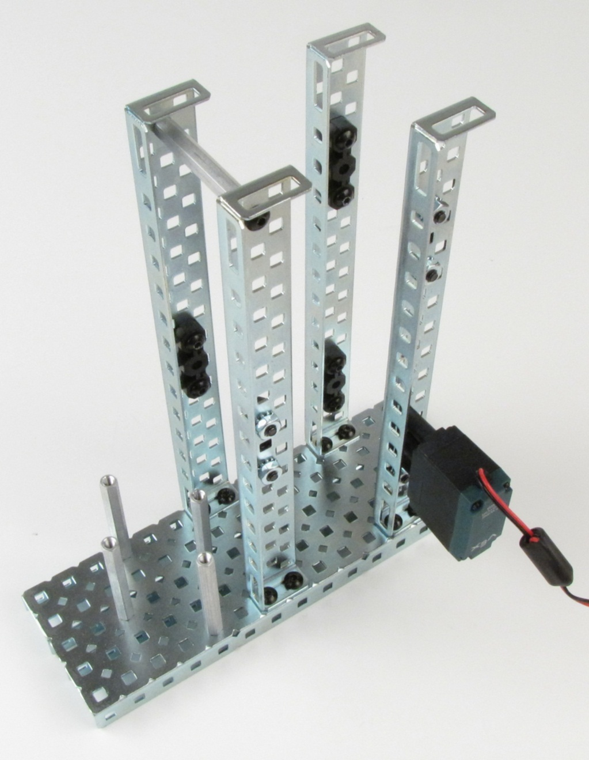
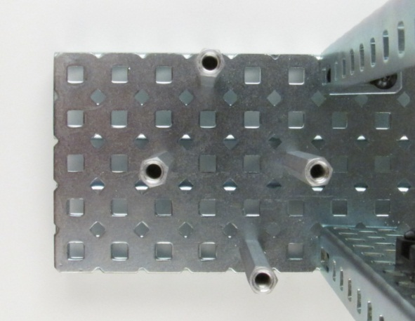
Step 4: Install Towers and Battery Placement
Towers aligned
opposite each other
2 in. spacer
2 in. spacers
x4
7th hole
4th hole

Slide 7
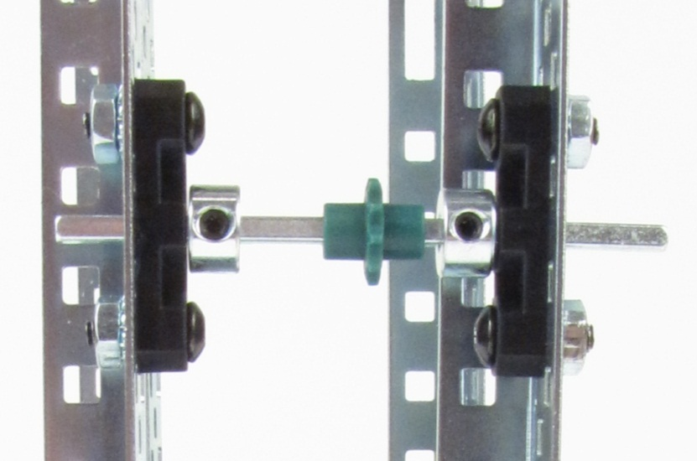
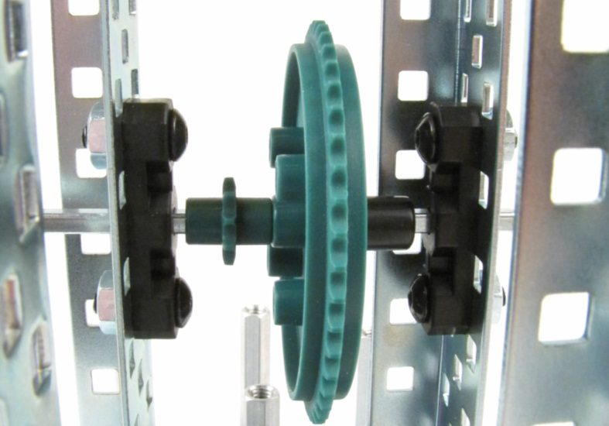
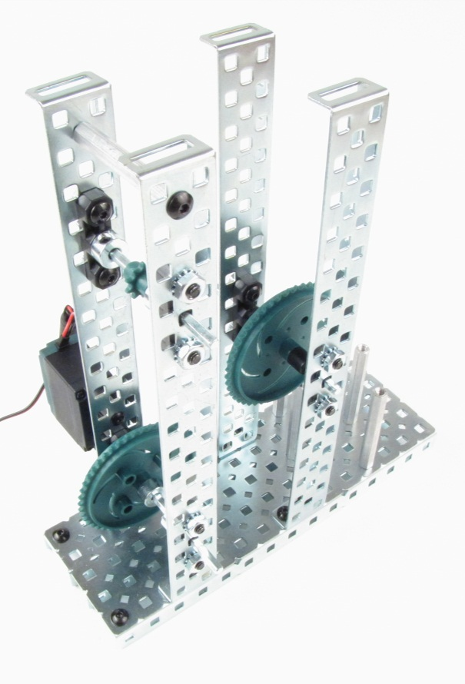
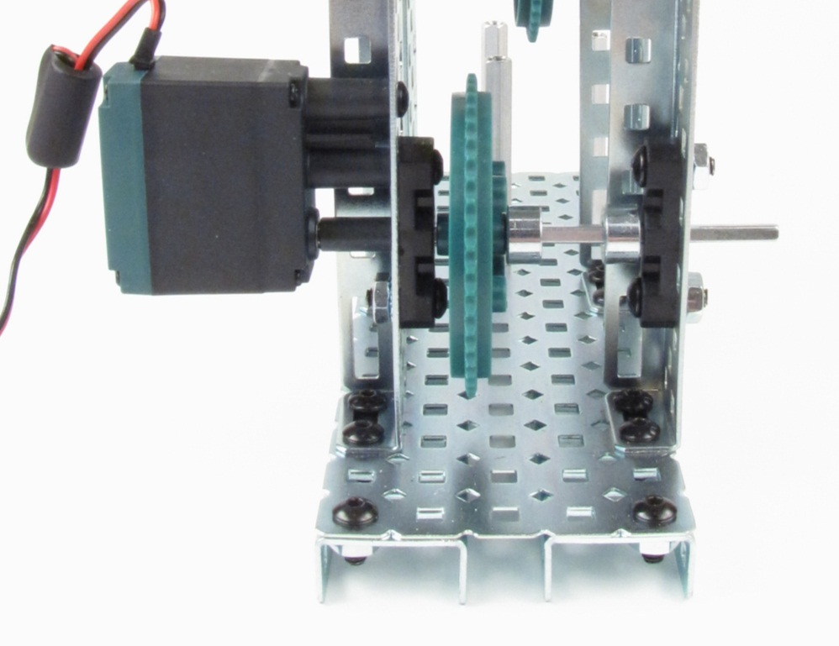
Step 5: Install Sprockets
Small gaps
Small gaps
All detail images shown
from left side

Slide 8
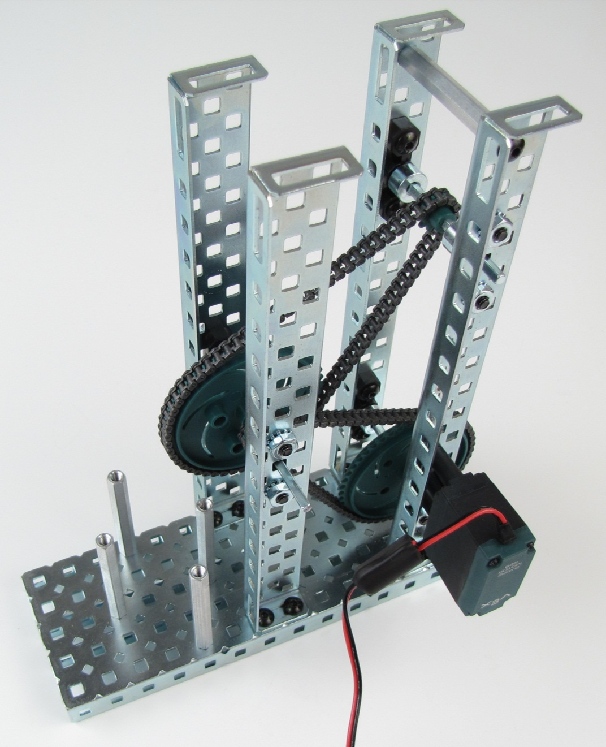
Step 6: Install Chains
11 1/2 in. chain
10 7/8 in. chain

Slide 9
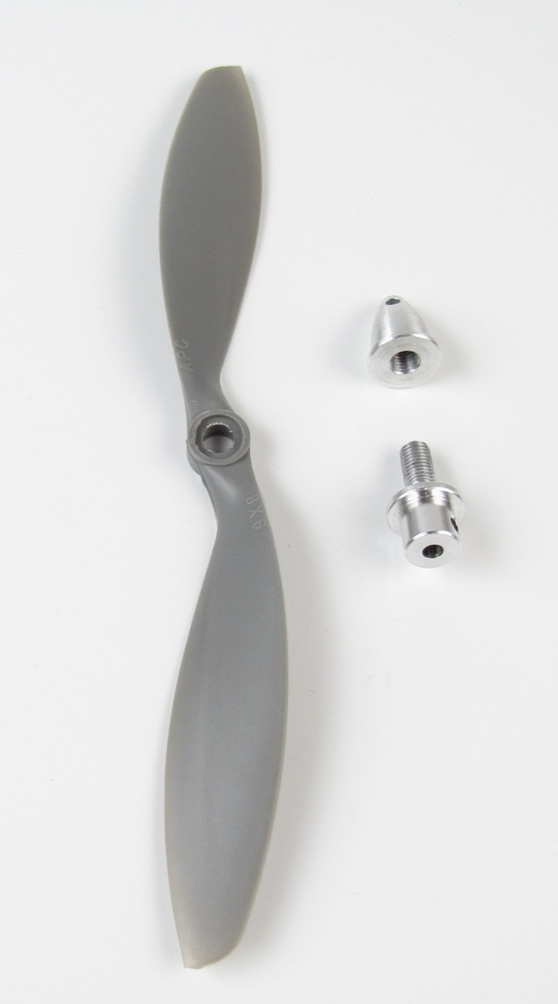
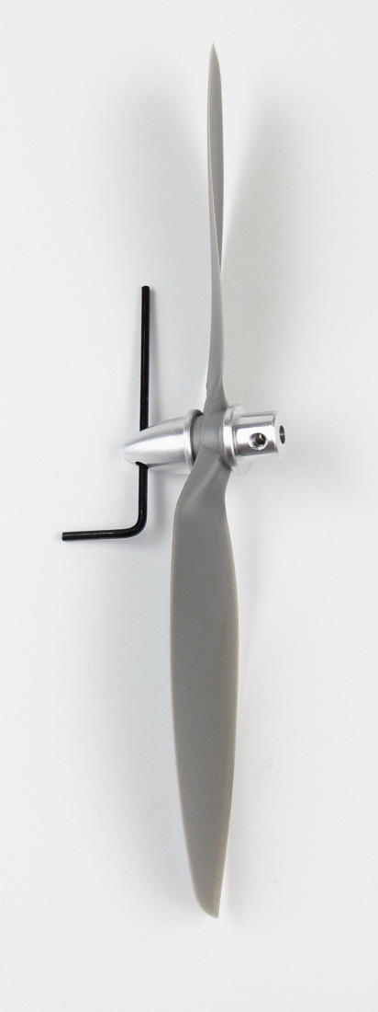
Step 7: Assemble Propeller
Slow flyer propeller
8x6SF
(label side toward nose)
Propeller adapter
with set screw 4mm
Tighten propeller adapter
using hex wrench
(Remove after tightening adapter)

Slide 10
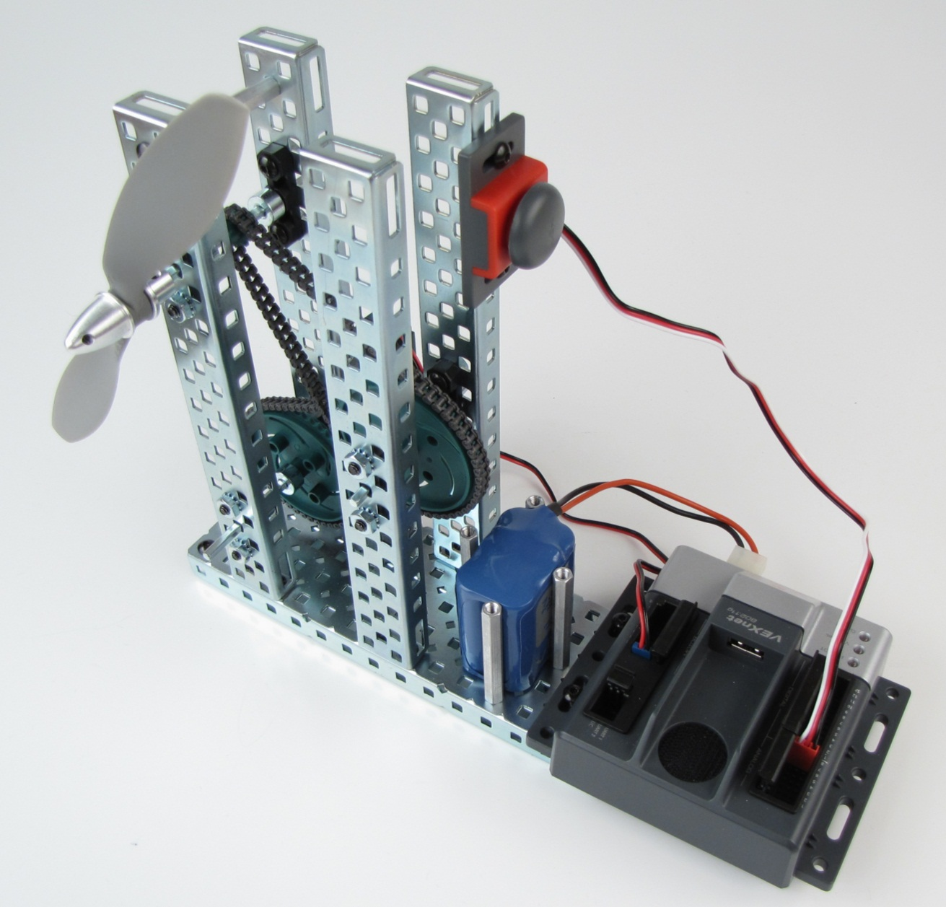
Step 8: Install Inputs and Outputs
Install bump switch
Secure propeller
to shaft with
set screw
Install battery and connect to CORTEX
Motor into
CORTEX motor 1
Bump switch into CORTEX digital 1

Slide 11
Step 9: Prepare Cortex and Joystick Hardware
1. Click image above to go to the VEX Cortex Video Trainer using ROBOTC website:
http://www.education.rec.ri.cmu.edu/products/teaching_robotc_cortex/index.html
2. Click Setup
3. Click and follow
directions
4. Click and follow
directions
5. Click and follow
directions
6. Click and follow
directions

Slide 12
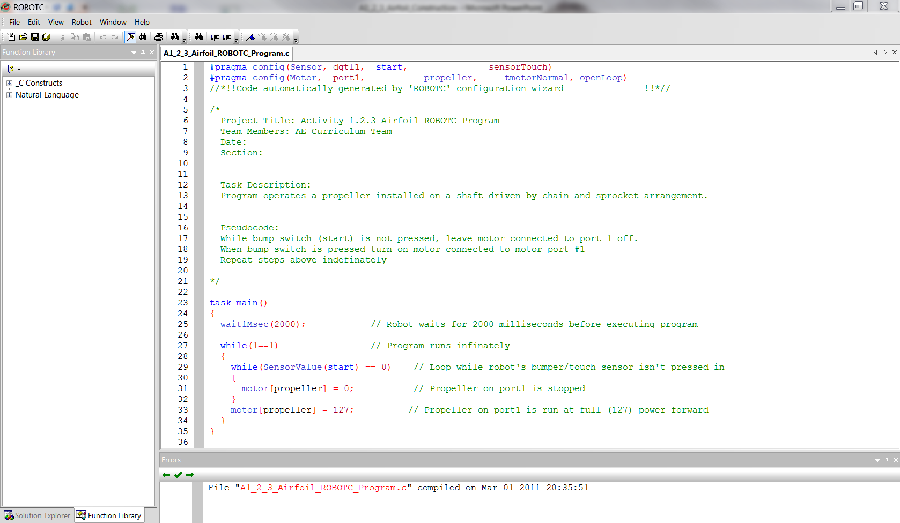
Step 10: Download ROBOTC Program to CORTEX

Slide 13
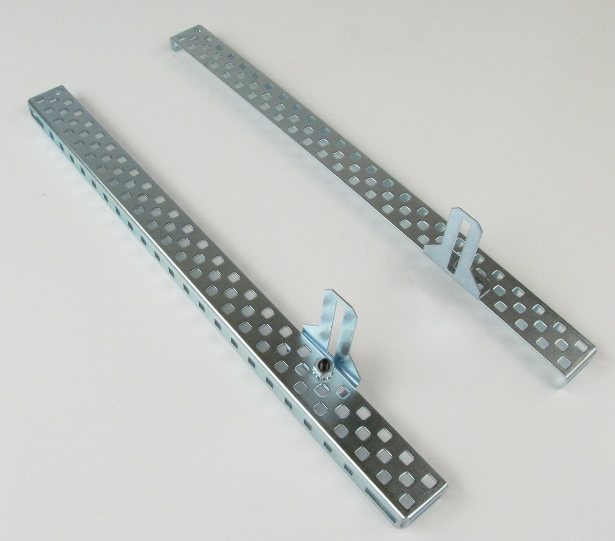
Step 11: Prepare Airfoil Support Stands

Slide 14
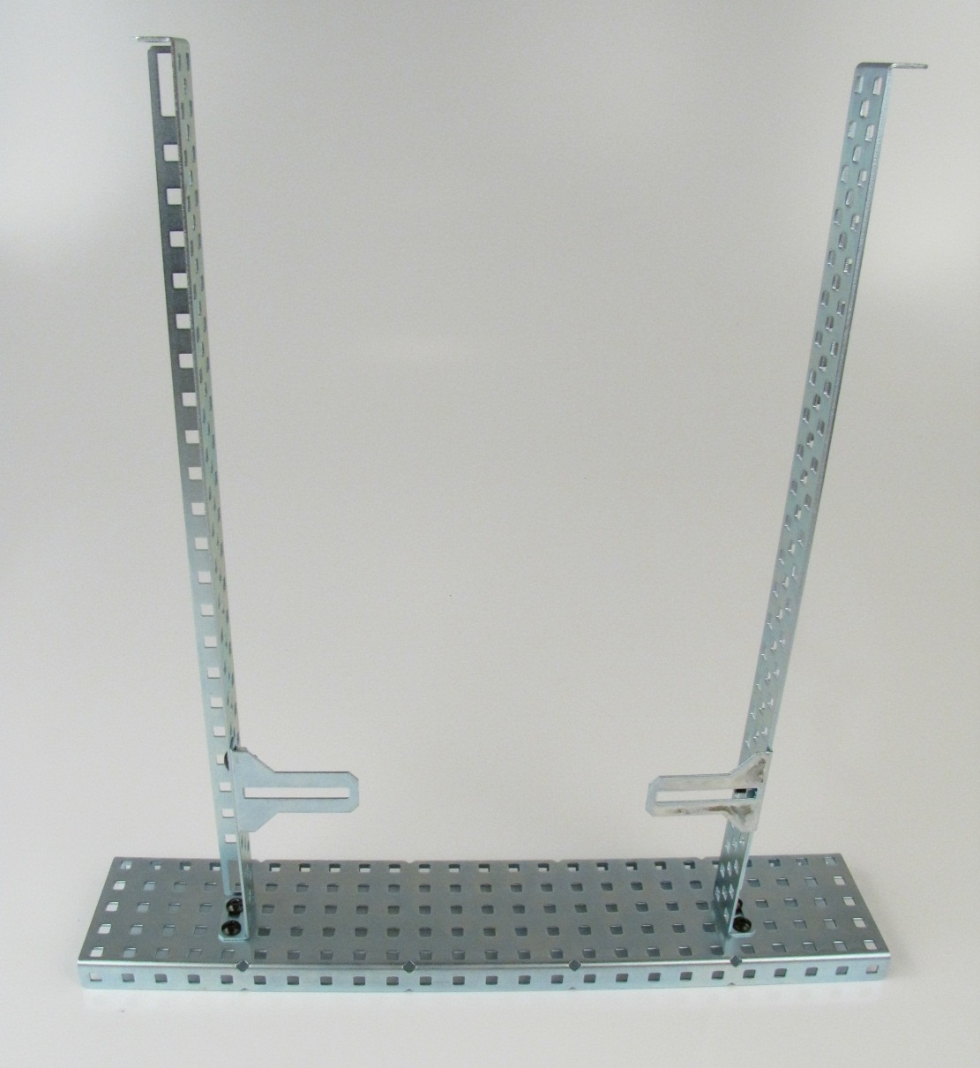
Step 12: Fasten Stands to Plate

Slide 15
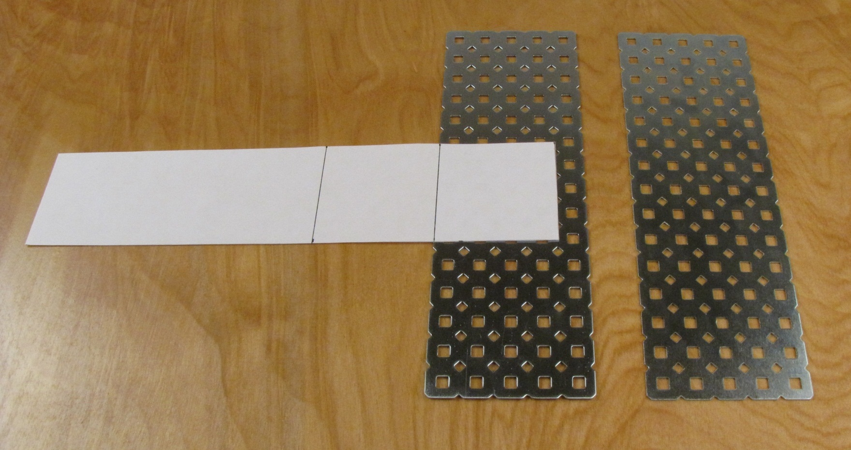
Step 13: Prepare Simulated Airfoil
2 in. x 9 in. paper with two lines
drawn 2 in. and 4 in. from edge

Slide 16
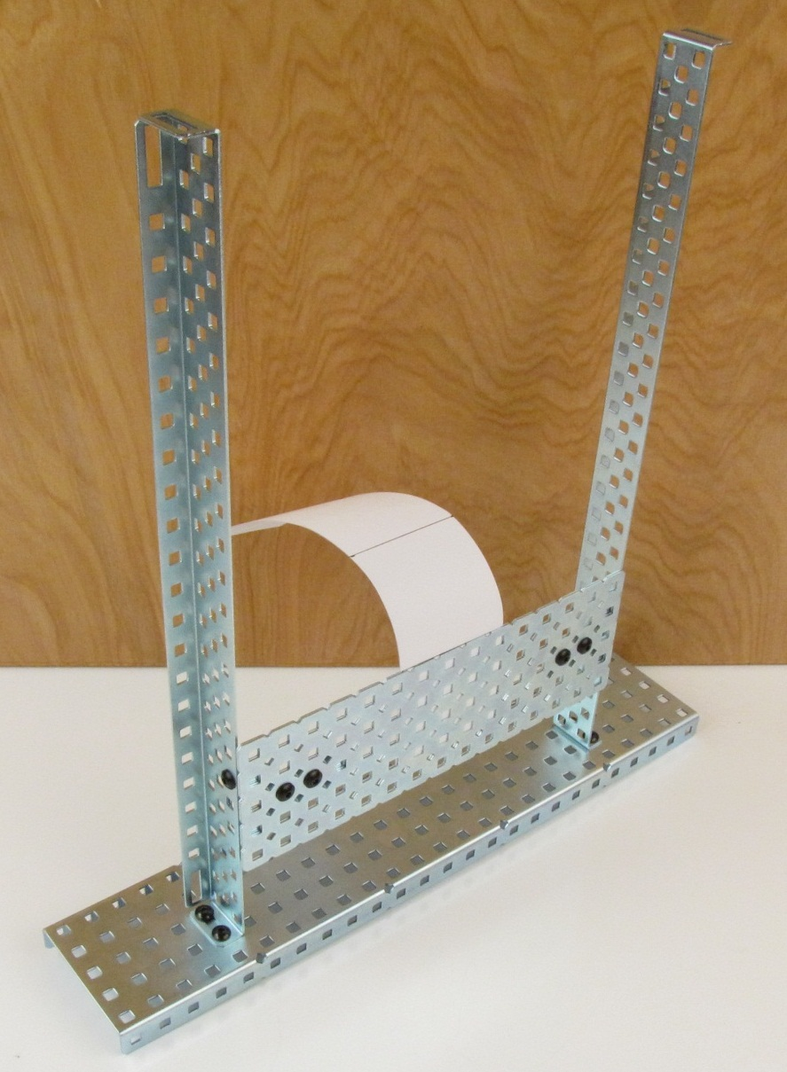
Step 14: Attach Simulated Airfoil

Slide 17
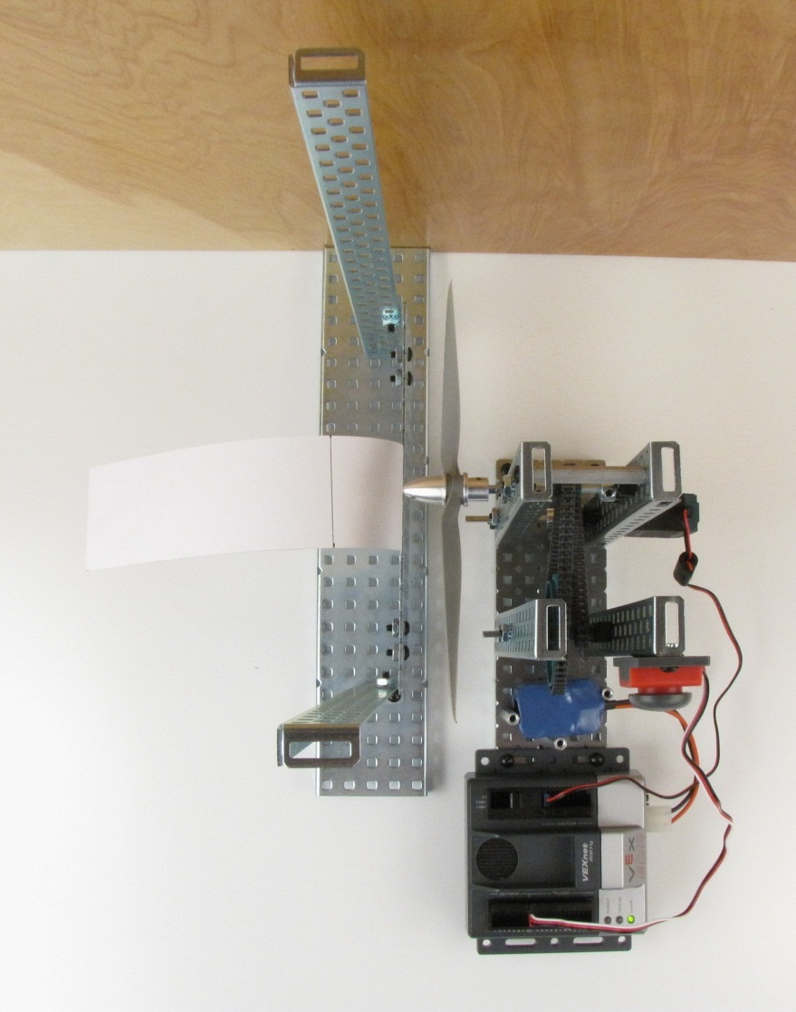
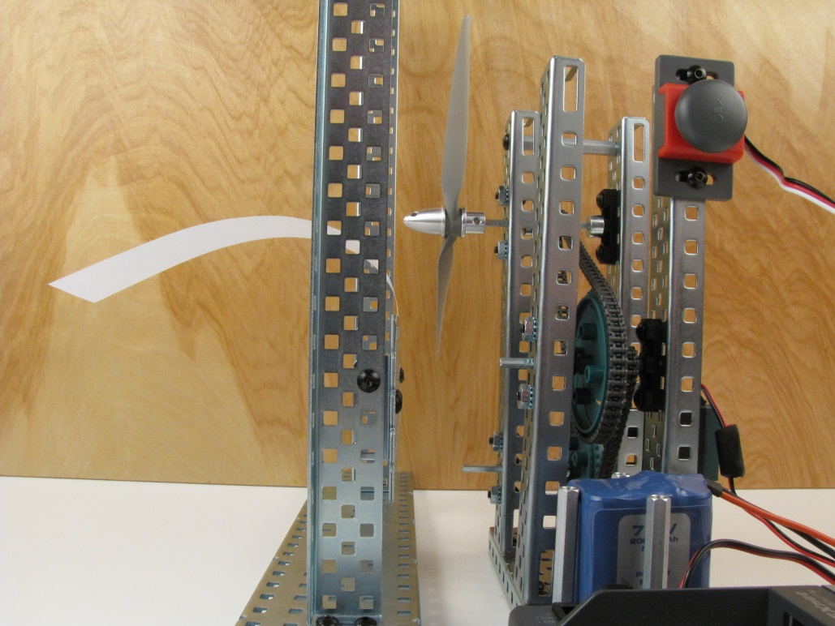
Step 14: Align Propeller and Airfoil
Align center line of the slow flyer propeller
8x6SF horizontally with the center of the paper strip
Ensure that there is a safe gap between the
propeller and the airfoil stand
Align center line of the slow flyer propeller
8x6SF above the center of the paper strip

Slide 18
Stop
Complete
Activity 1.2.3 Airfoil

