Slide 1
Energy Sources
Nonrenewable, Renewable, and Inexhaustible
Principles Of Engineering
© 2012 Project Lead The Way, Inc.

Slide 2
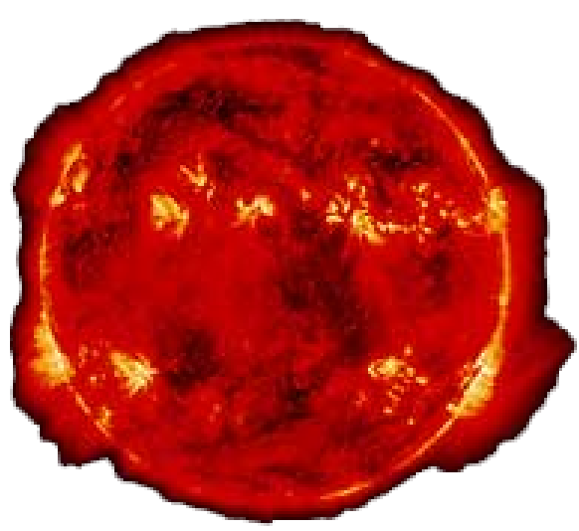
Energy Sources
Energy: The ability to do work
Energy sources are defined as
Nonrenewable
Renewable
Inexhaustible
The SUN is the original source
of almost all energy sources on Earth.

Slide 3
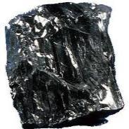
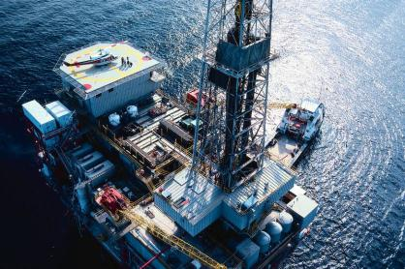
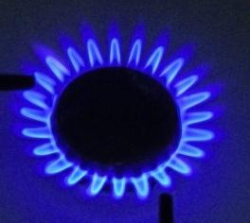
Nonrenewable Energy Sources
Sources that cannot be replaced once used
Fossil Fuels
Coal
Oil
Natural Gas
Alternative Energy: Any fuel that is not identified as a fossil fuel
Notes:
Most of our energy needs are currently met by using fossil fuels.

Slide 4
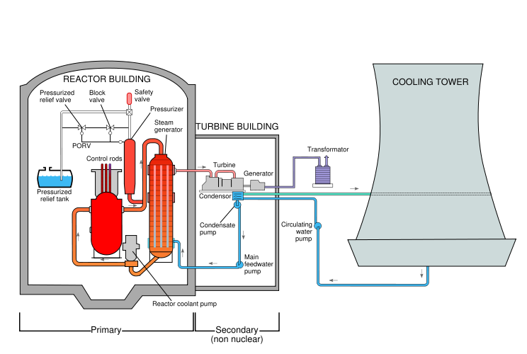
Nonrenewable Energy Sources
Sources that cannot be replaced once used
Uranium
Nuclear energy (fission)
20% of the world’s electricity comes from nuclear power

Slide 5
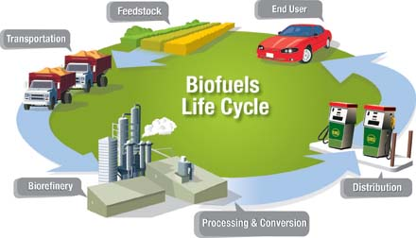
Renewable Energy Sources
Sources that can be replaced once used
Animals
Food
Biomass
Biofuel
Ethanol
Methanol
U.S. Department of Energy
Notes:
Animals have been used throughout history to perform work and in some countries still provide power. This is especially true for field work.
Energy from food supplies humans and animals with the necessary energy.
Biomass includes plant materials and animal waste used especially as a source of fuel. Historically, burning wood has been the most common method of using plant material for fuel. Fuel that is used for transportation is generally referred to as biofuel.
Ethanol that comes from crops like corn and sugar cane can be used as fuel in internal combustion engines. Ethanol fuel can be purchased at several pumps as E85, which means that 85% ethanol and 15% gasoline comprise the fuel.
Methanol can be made from coal or biomass substances.

Slide 6
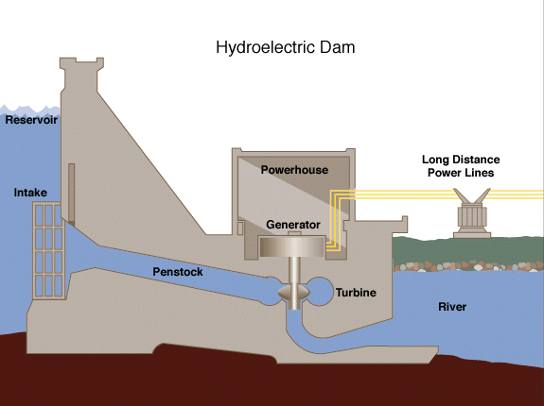
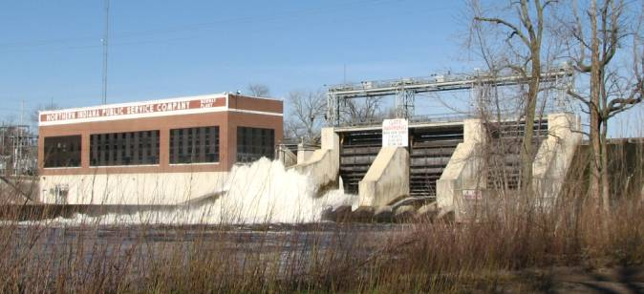
Inexhaustible Energy Sources
Hydroelectric
Tidal
Notes:
Hydroelectric energy production uses the flow of water from waterfalls and dams to produce electricity.
The incoming and outgoing tide caused by the gravitational pull from the moon can be used in two ways. One is to simply harness the energy as it flows in and out. Another is to capture the water with a dam at high tide and then release its potential energy in a controlled fashion, much like a facility would operate a reservoir.

Slide 7
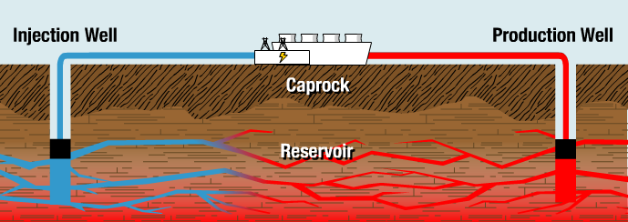
Inexhaustible Energy Sources
Geothermal
U.S. Department of Energy
Notes:
This image represents one use of geothermal energy. Geothermal energy can be used in many different capacities. It can be used to provide electricity through power plants, the heat can be used directly, or heat pumps can be used to heat spaces or water.
The sort of “hot” geothermal shown in this slide is only available west of the Rocky Mountains, for U.S. landmass. There, the crust is thinner. In hot geotermal applications, wells are about 1 km deep.
East of the Rockies, it is not feasible to drill deep enough to access hot underground temperatures. However, it is common to use “earth-coupled” heatpumps, which take advantage of the relatively constant ground temperature a mere 3-10 feet below ground. This cannot be used as source of electricity generation like hot geothermal reservoirs; instead, these systems use electricity from another source to pump water through pipes laid shallowly in the ground, thereby moving 3 to 4 units of heat energy in or out of a building for every one unit of electrical energy consumed.

Slide 8
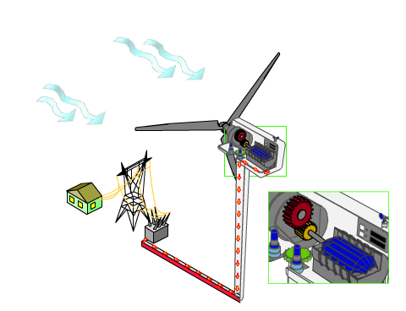
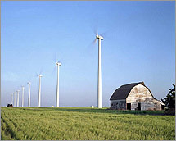
Inexhaustible Energy Sources
Wind
U.S. Department of Energy
Notes:
Wind energy turns turbines to create electricity.

Slide 9
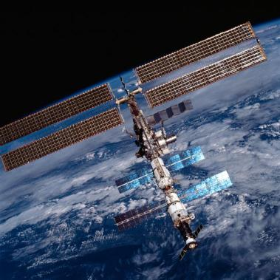
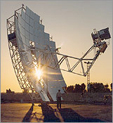
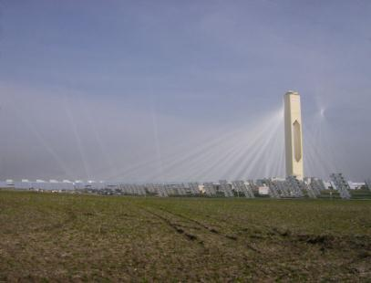
Inexhaustible Energy Sources
Solar
U.S. Department of Energy
PS10
Notes:
Solar energy can be concentrated to provide enough heat to power a generator.
Photovoltaic cells can be put on a roof to generate electricity. They also power many devices sent into space.
The image at bottom left shows a solar tower that concentrates the sun’s rays to produce steam. That steam then powers a generator. The solar tower is called PS10.

Slide 10
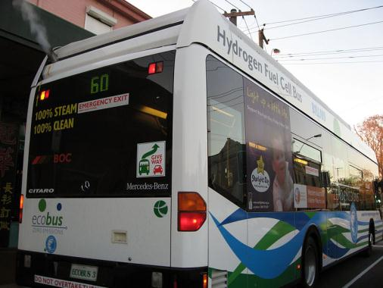
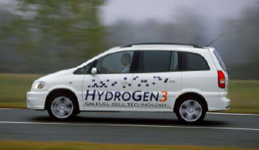
Ways to Store Energy
Hydrogen
Batteries
Are not themselves a source of energy
U.S. Department of Energy
Notes:
Hydrogen technology is used to store energy. It is not a source of energy in the same sense as solar, geothermal, or oil.
Hydrogen can be burned for fuel, and the resulting water can then be split back into hydrogen and oxygen using electricity. Depending on the source of this electricity, hydrogen might be categorized as inexhaustible (if solar power is used), renewable (if biomass is used), or non-renewable (if coal is used).
Fuel cells allow hydrogen and oxygen to react without any open flame, giving off electricity as well as heat. In the future it may be possible to bioengineer microbes to give off usable quantities of hydrogen as a byproduct, in which case hydrogen could be categorized as a fuel source in its own right.

Slide 11
Image Resources
Microsoft, Inc. (n.d.). Clip art. Retrieved January 10, 2008, from http://office.microsoft.com/en-us/clipart/default.aspx
U.S. Department of Energy. (n.d.). Retrieved April 16, 2008, from http://www.doe.gov/

