Slide 1
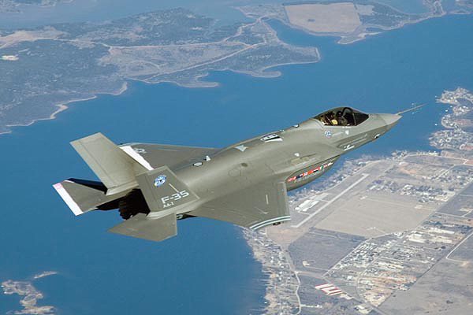
Aircraft Control Surfaces and Components

Slide 2
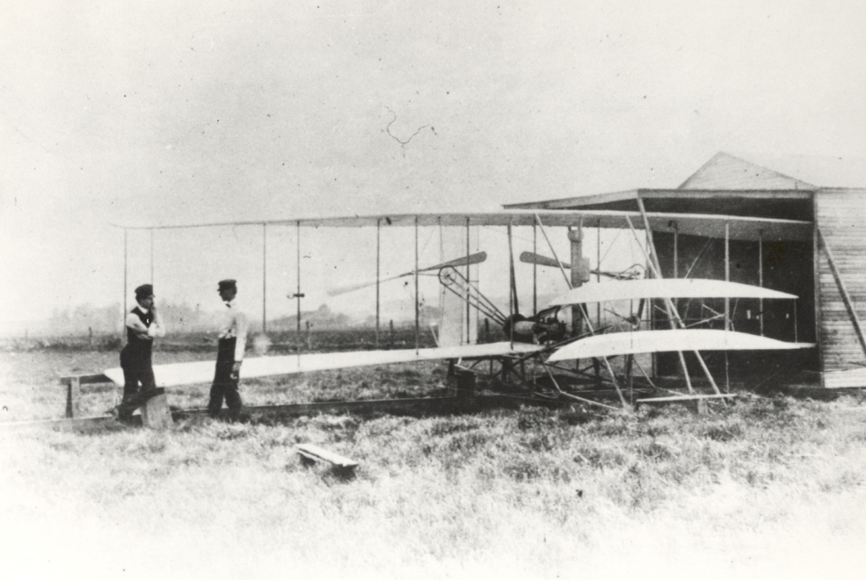
Aircraft Components and Control
Aircraft range from simple home-built machines to complex fighter jets
All aircraft have common structural and control components that allow for controlled flight
Notes:
Aircraft stability is the characteristic of an airplane in flight that causes it to return to a condition of equilibrium, or steady flight, after it is disturbed.
Aircraft can be controlled by shifting pilot or passenger weight such as in an ultralight or a hang glider.

Slide 3
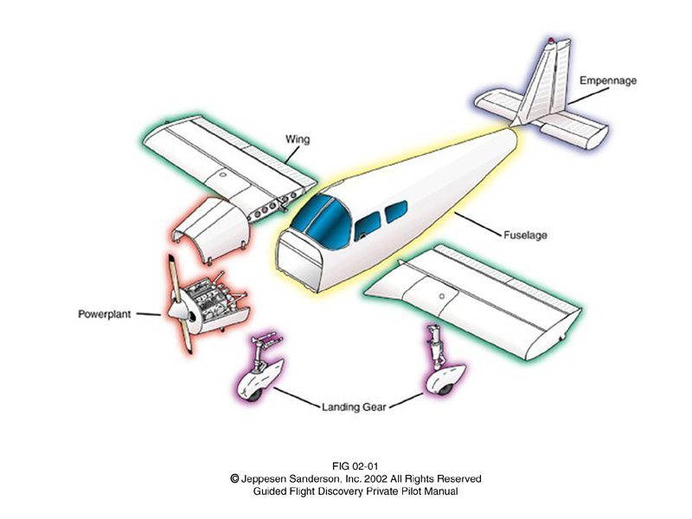
Aircraft Components
Five typical components
Empennage
Wing
Fuselage
Power Plant
Landing
Gear
Notes:
The fuselage is the typically enclosed space that holds the cockpit and cabin. The cockpit is the term for the area where the pilots control the aircraft. The cabin is where passengers sit or cargo is stored. The fuselage serves as the structure to which parts of the aircraft are attached.
The wings provide lift when sufficient air is flowing over them. Wings are attached to the fuselage at the top, middle, or lower portion and are referred to as high-wing, mid-wing, or low-wing, respectively. A single set of wings is called a monoplane. Two sets of wings are called biplanes. The wing has flaps and ailerons attached at its trailing edge. Flaps are closest to the fuselage and are deployed downward equally on the left and right wing to slow the aircraft while producing more lift. Ailerons are moved in opposite directions to change the direction of flight.
The empennage or tail helps the aircraft point into the relative wind like feathers on an arrow. The empennage consists of four major components: Vertical stabilizer, rudder, horizontal stabilizer, and elevator. These are used to maintain stability and change the aircraft attitude or direction relative to horizontal with wings level.
The landing gear absorbs the energy of landing and supports the aircraft while on the ground. The strongest sets of wheels are in the center of the aircraft closest the center of gravity. The other wheels are either located toward the rear of the aircraft (tailwheel configuration) or toward the nose of the aircraft (nosewheel configuration). The nosewheel configuration is also known as tricycle gear. Landing gear can be fixed so that it remains locked in place during the entire flight. Landing gear can also be retractable, which is more expensive and complex but much more fuel efficient.
Powerplants come in many forms. In the case of the small aircraft shown, the powerplant consists of an engine and propeller. Propulsion systems will be presented in greater detail later in this curriculum.

Slide 4
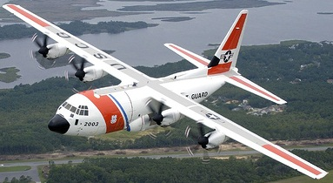
Aircraft Components
Vertical Stabilizer
Empennage
Rudder
Horizontal Stabilizer
Elevator
Flaps
Cockpit
Aileron
Fuselage
Power Plant
Wing

Slide 5
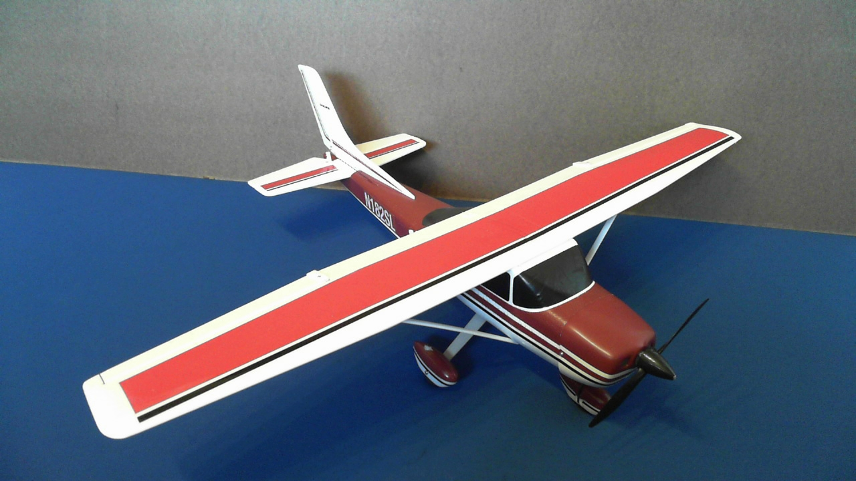
Aircraft Components
Rudder and
Vertical Stabilizer
Empennage
Elevator and
Horizontal Stabilizer
Cockpit
Flaps
Ailerons
Power Plant
Fuselage
Wing
Notes:
If used in your classroom demonstrate the Cessna remote control aircraft components and flight.

Slide 6
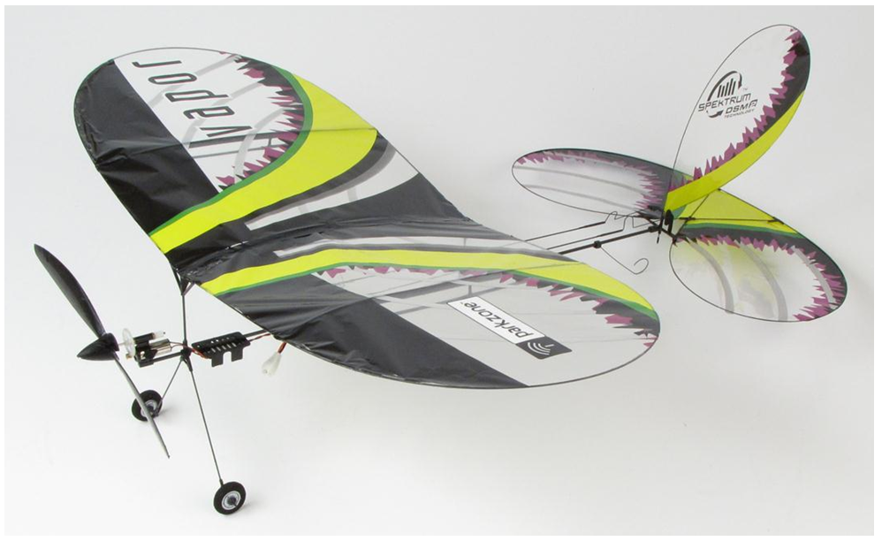
Aircraft Components
Rudder
(No vertical stabilizer)
Empennage
Elevator
(No horizontal stabilizer)
Cockpit
Power Plant
Wing
(No ailerons or flaps)
Fuselage
Notes:
If used in your classroom demonstrate the Vapor micro remote control aircraft components and flight.

Slide 7
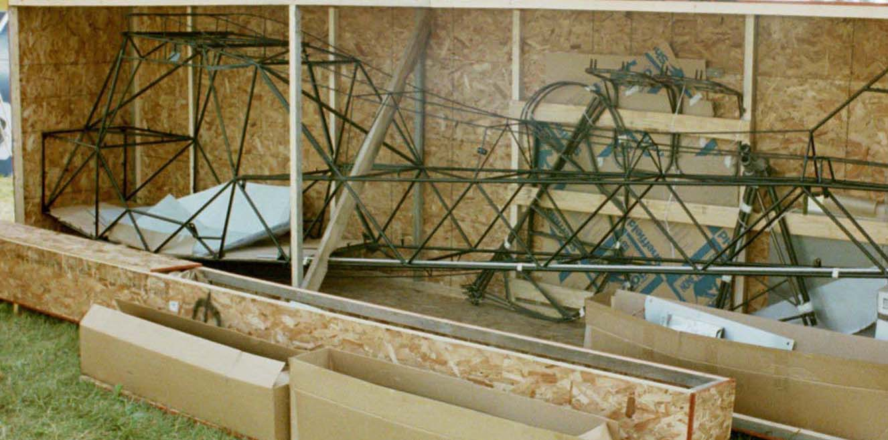
Fuselage
Notes:
The image above is a fuselage frame to which aircraft components and the skin are attached.

Slide 8
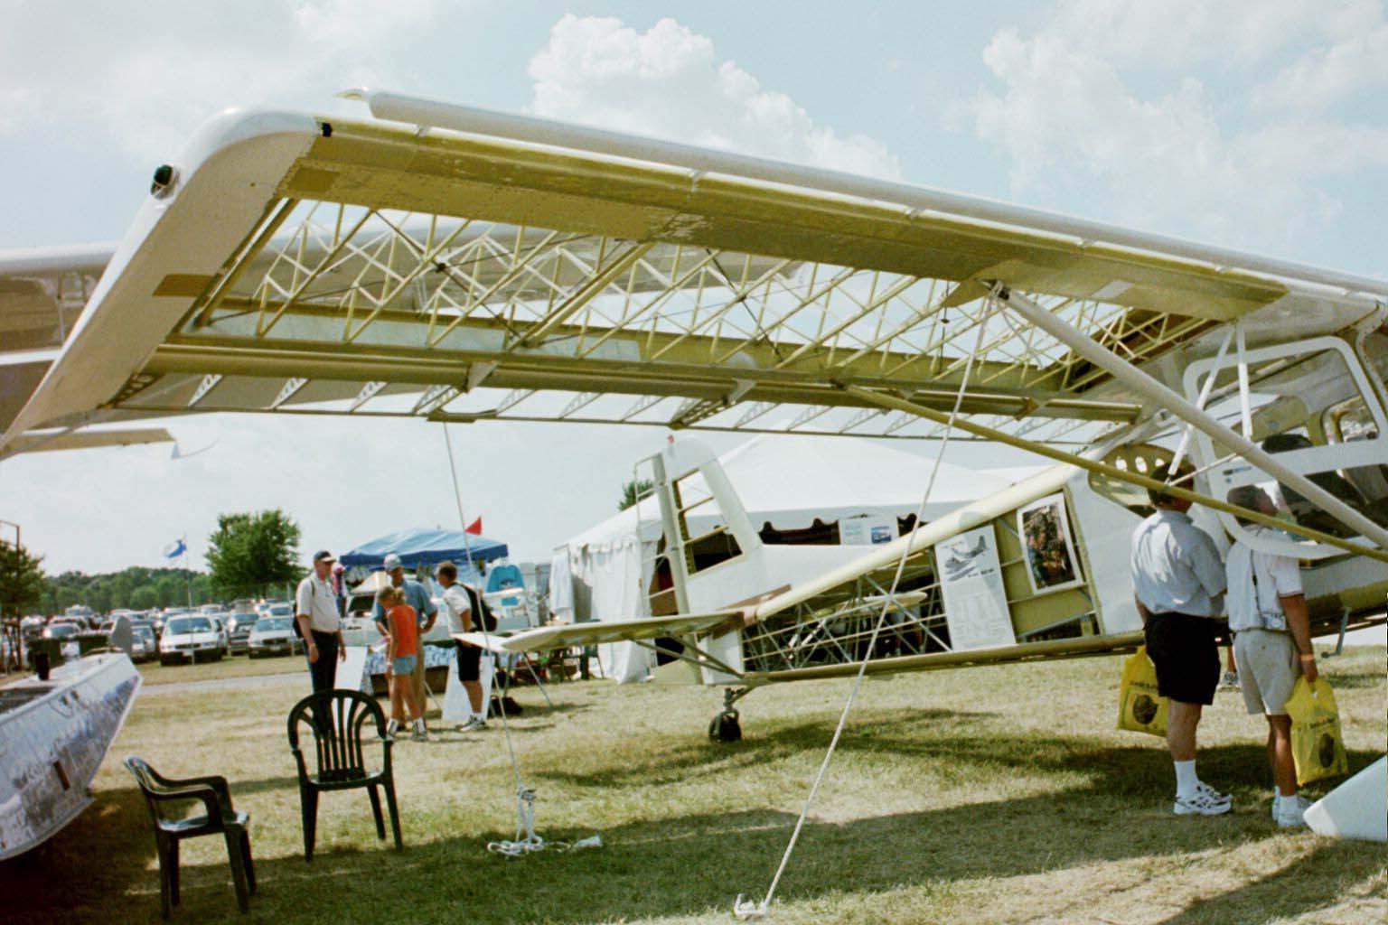
Wing
Ribs
Spar
Wing Strut

Slide 9
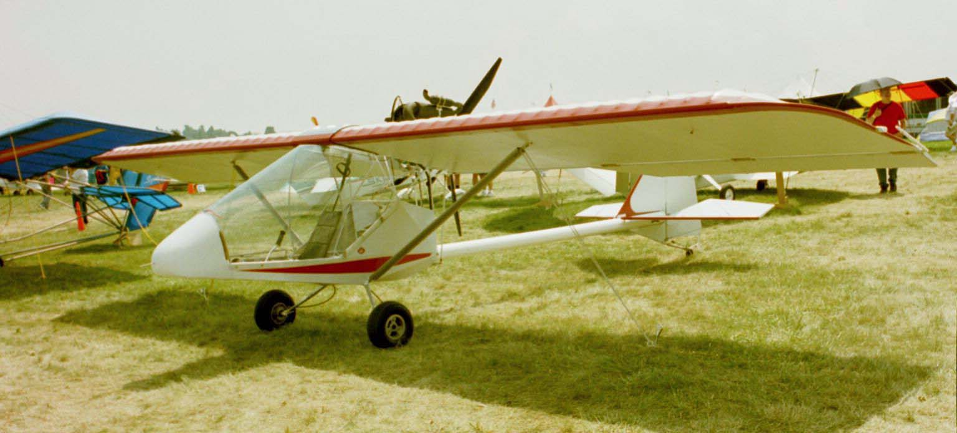
High Wing

Slide 10
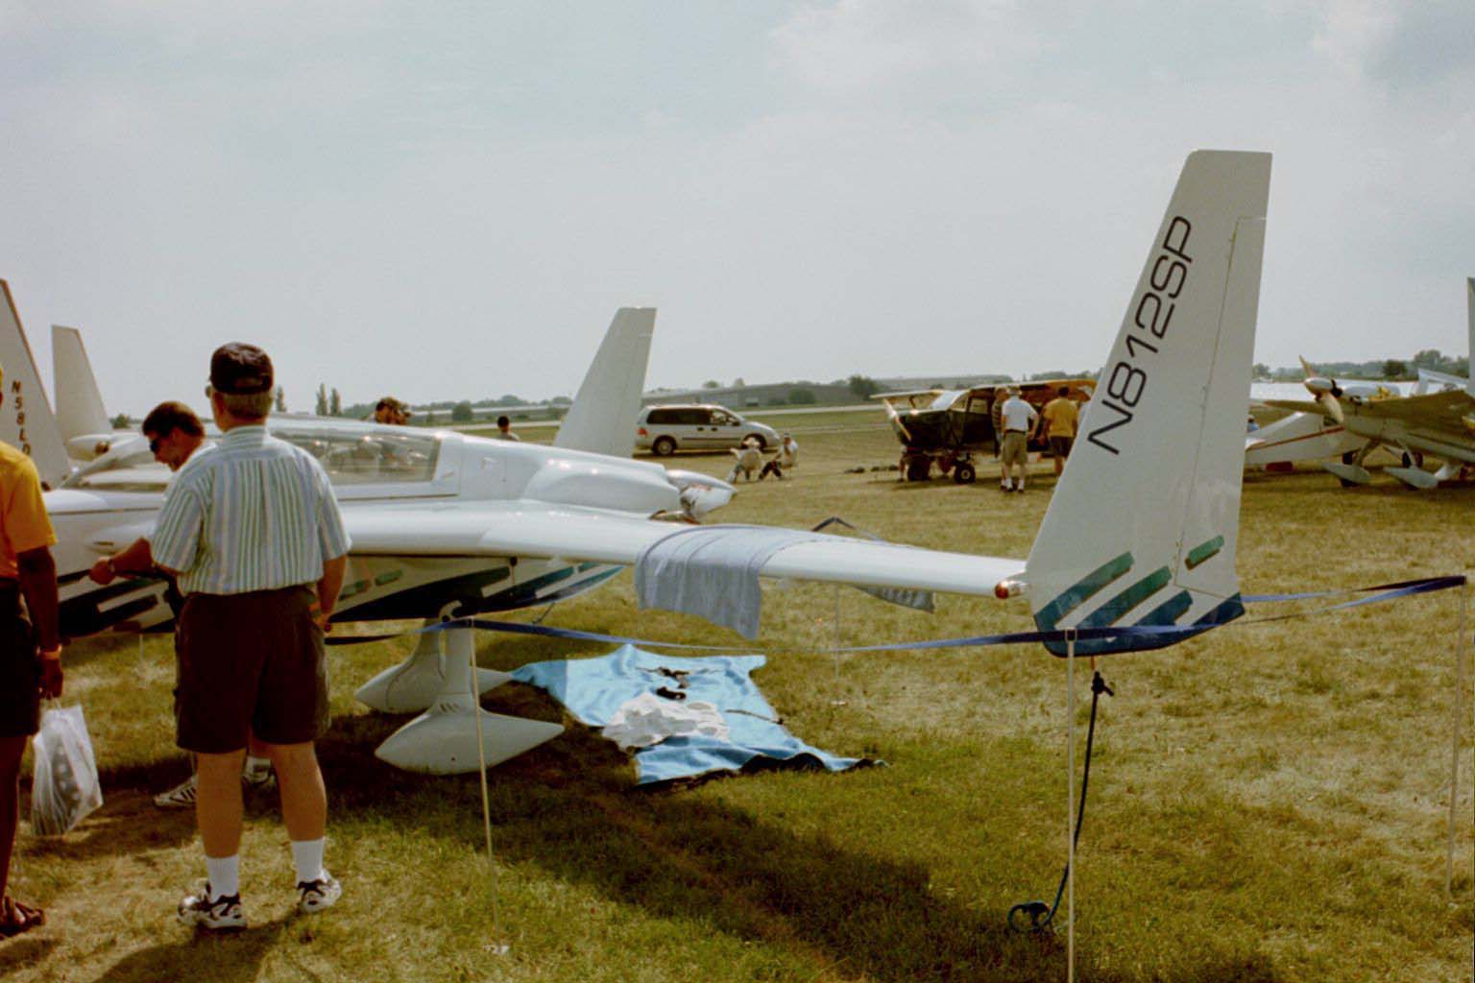
Mid Wing

Slide 11
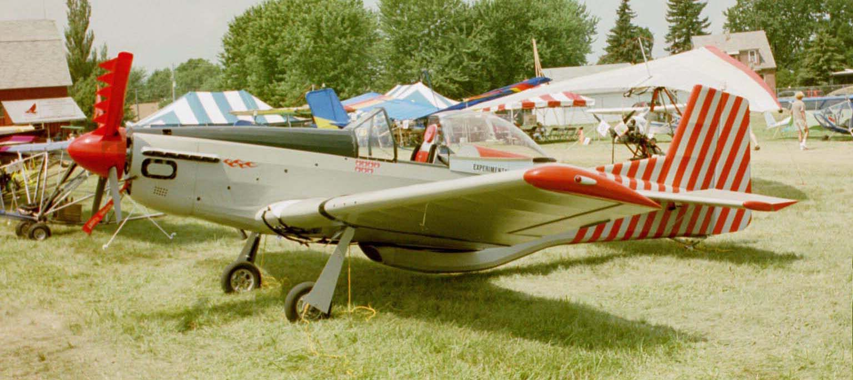
Low Wing

Slide 12
Multiple Wings – Biplane

Slide 13
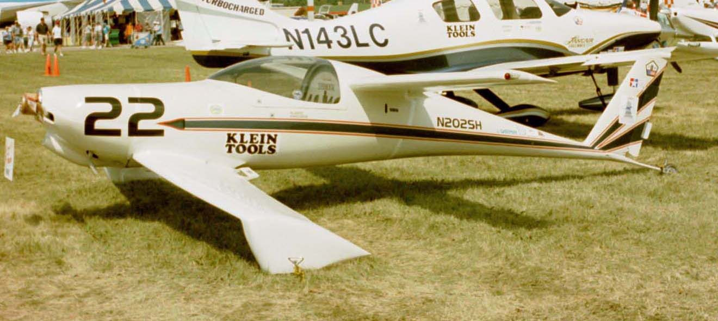
Canard Wings
Notes:
Canard wings possess a major wing surface area well forward of the center of gravity.

Slide 14
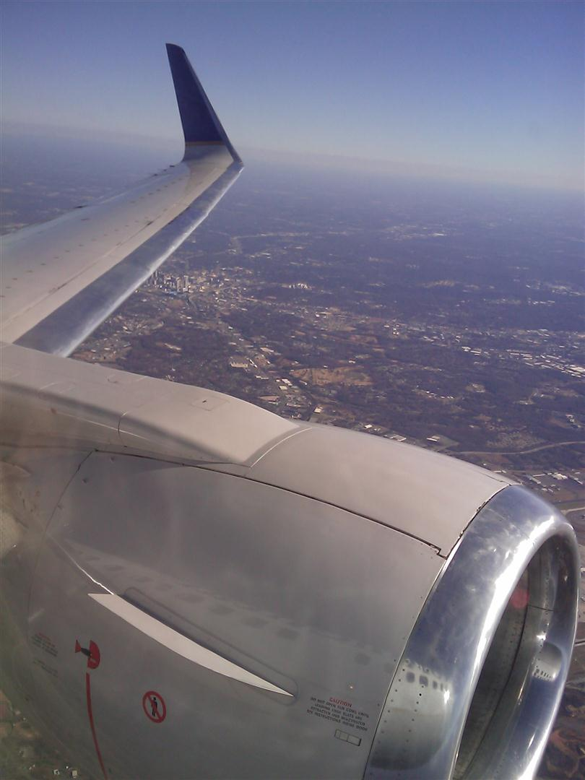
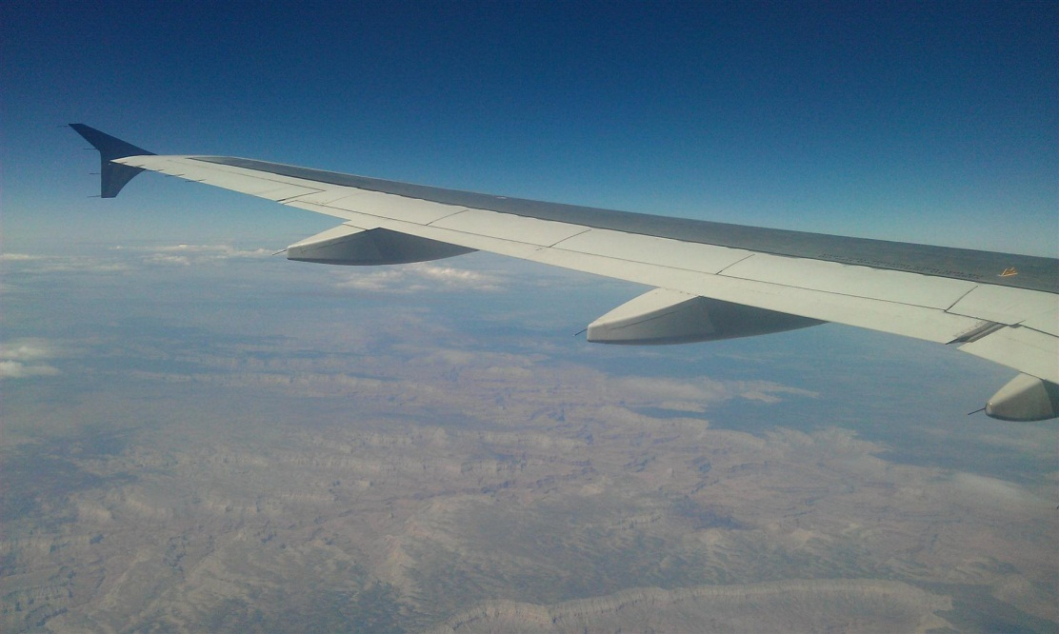
Winglet
Notes:
Vertical extension of a wing tip used to limit air from recirculating from the high pressure airflow below the wing to low pressure above the wing. This recirculation induces wing tip vortices and increases drag.

Slide 15
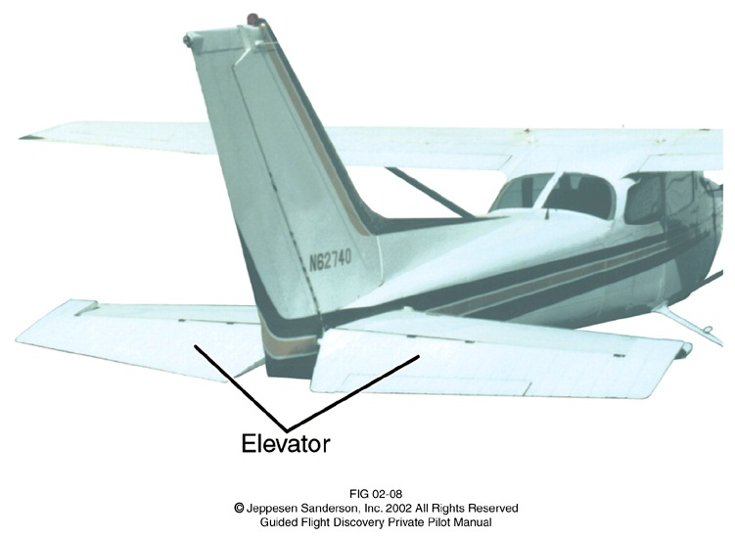
Empennage and Wing Components
Vertical Stabilizer
Rudder
Flaps
Ailerons
Elevator
Elevator
Horizontal Stabilizer
Horizontal Stabilizer
Notes:
Students should attempt to identify the parts in their journals before you reveal the solution. This slide is animated to allow students to identify each component before the label is revealed.

Slide 16
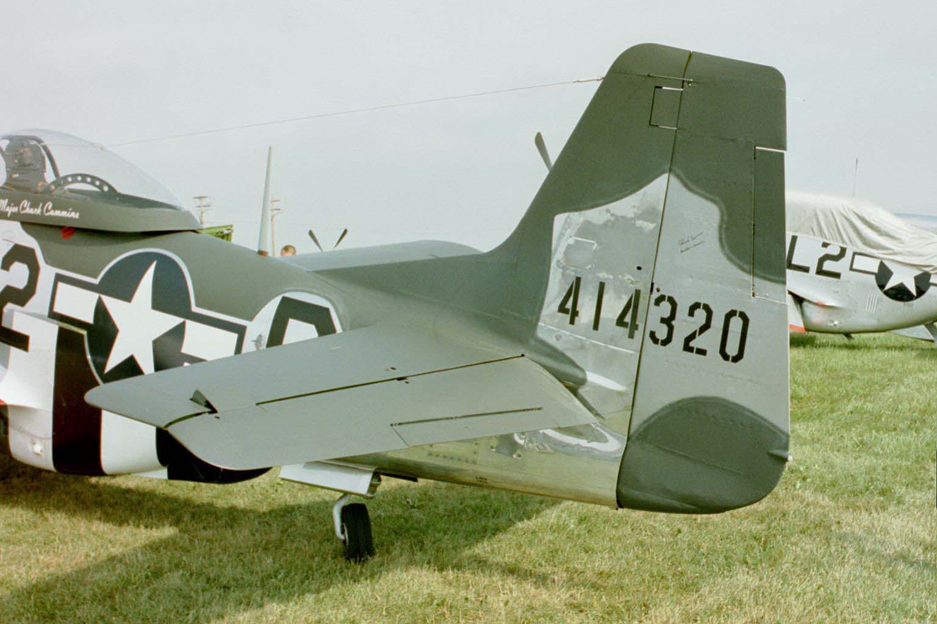
Empennage
Vertical Stabilizer
Trim Tab
Horizontal Stabilizer
Elevator
Trim Tab
Rudder

Slide 17
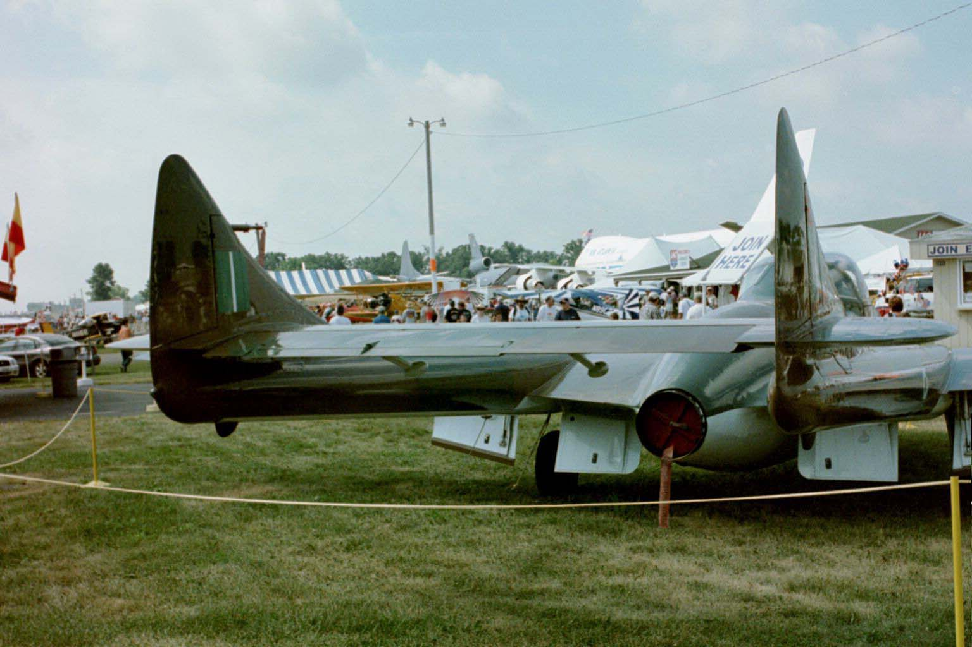
Twin Vertical Stabilizers

Slide 18
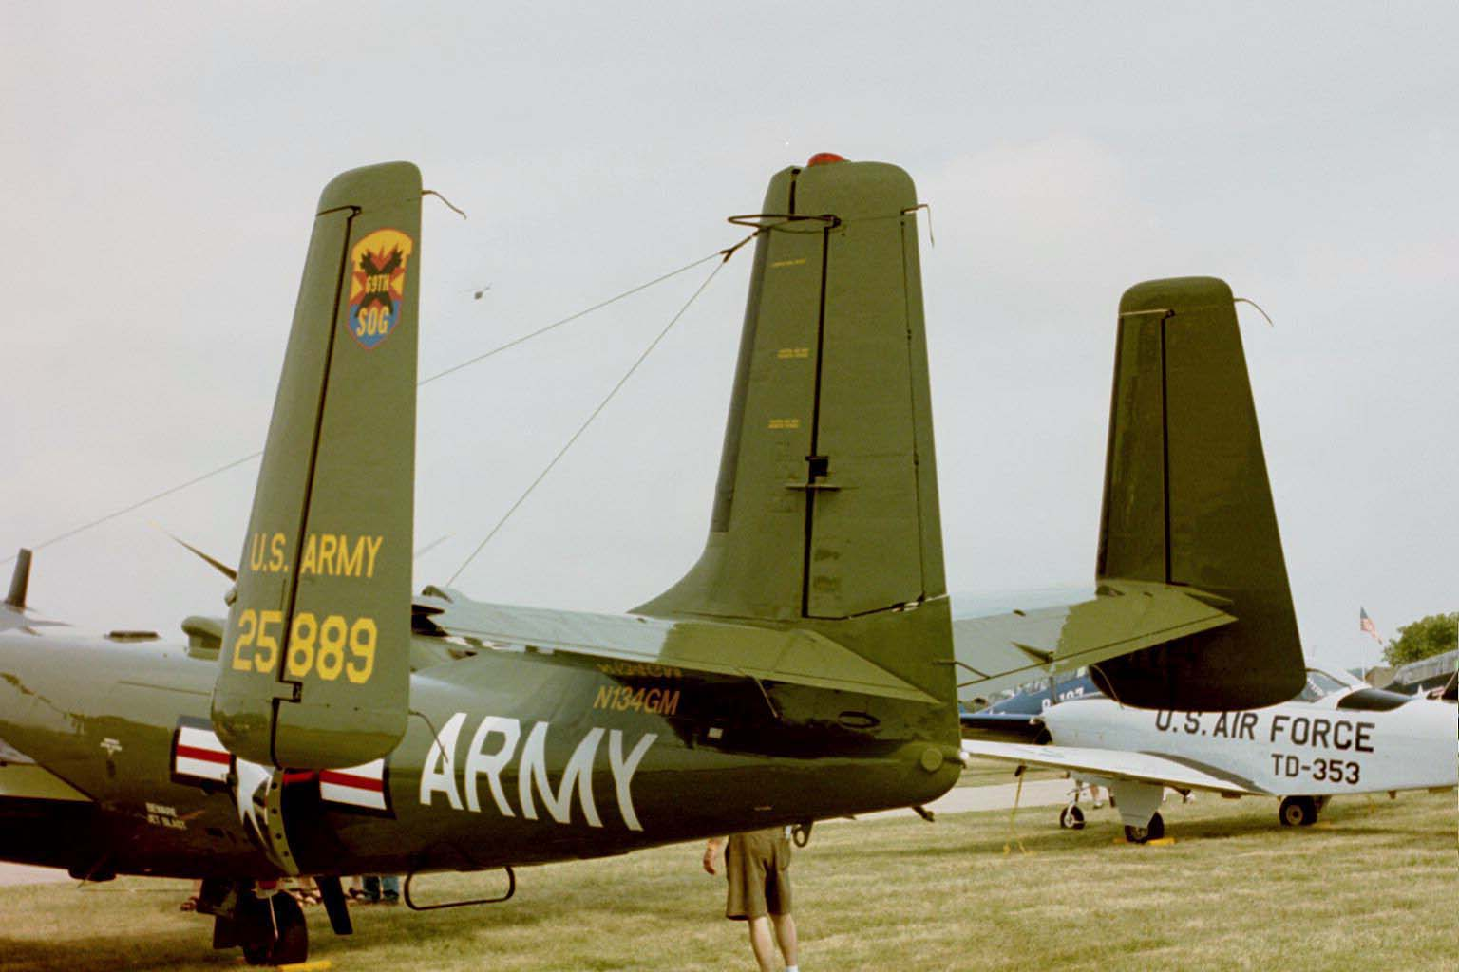
Triple Vertical Stabilizers

Slide 19
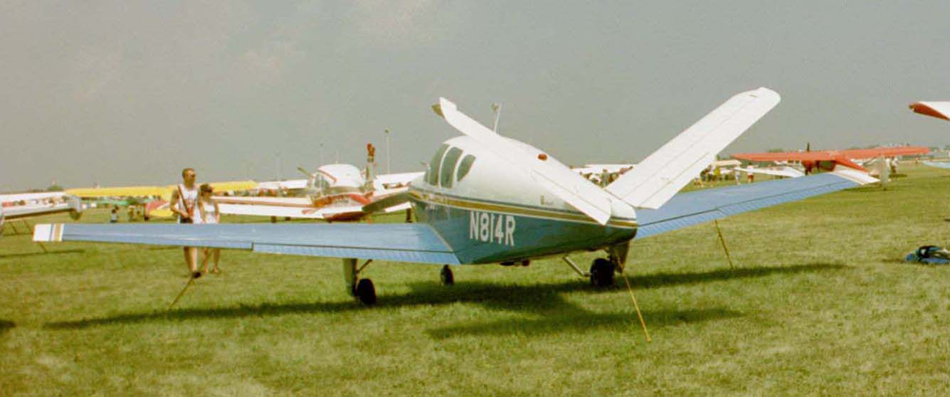
V Tail
Notes:
Note the relative percentage of wing that is flap versus aileron.

Slide 20
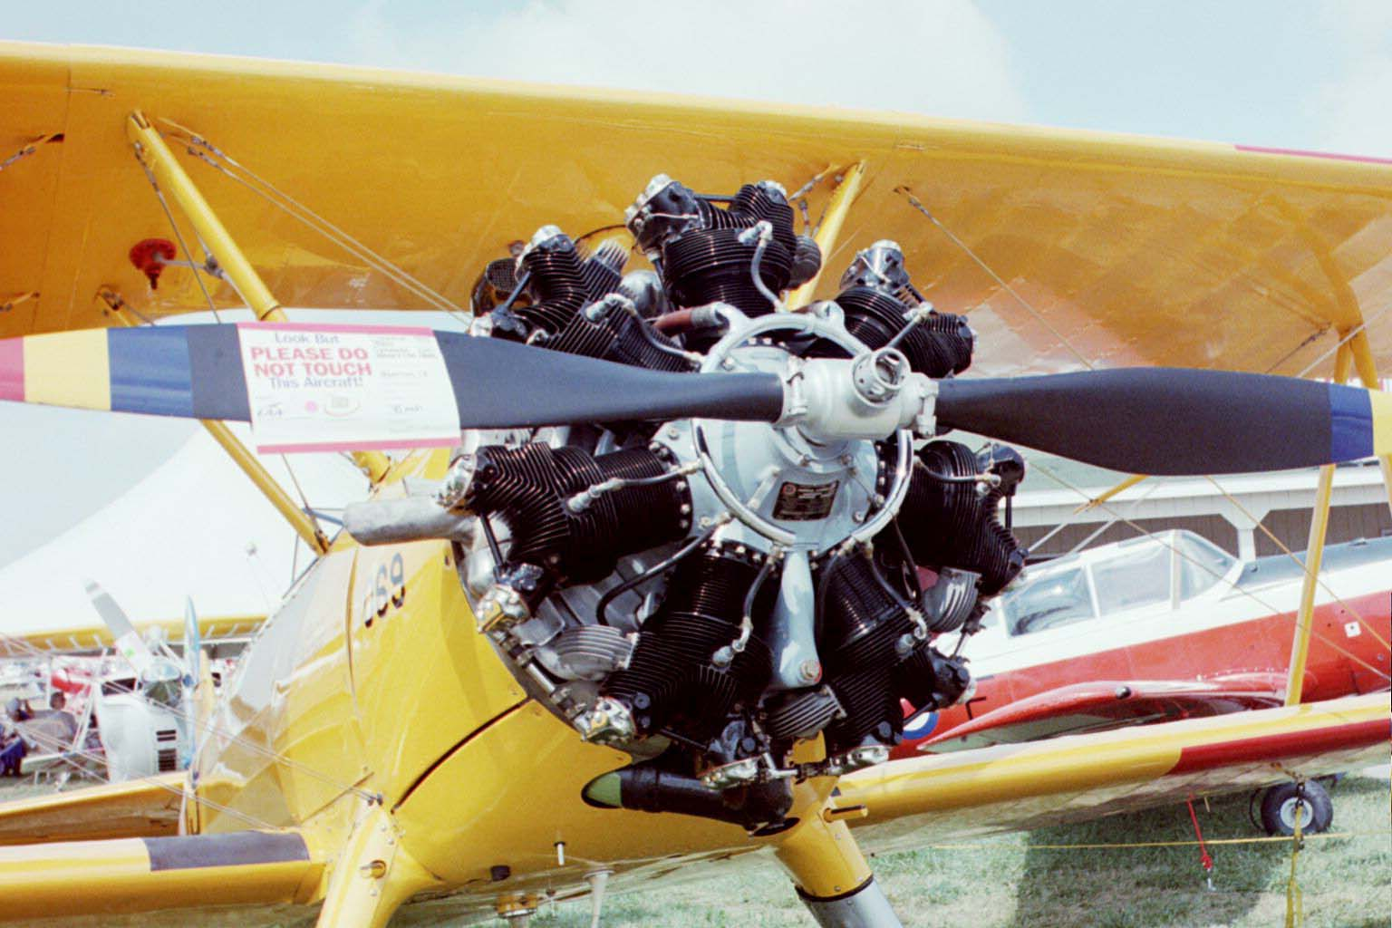
Powerplant – Tractor
Engine
Propeller

Slide 21
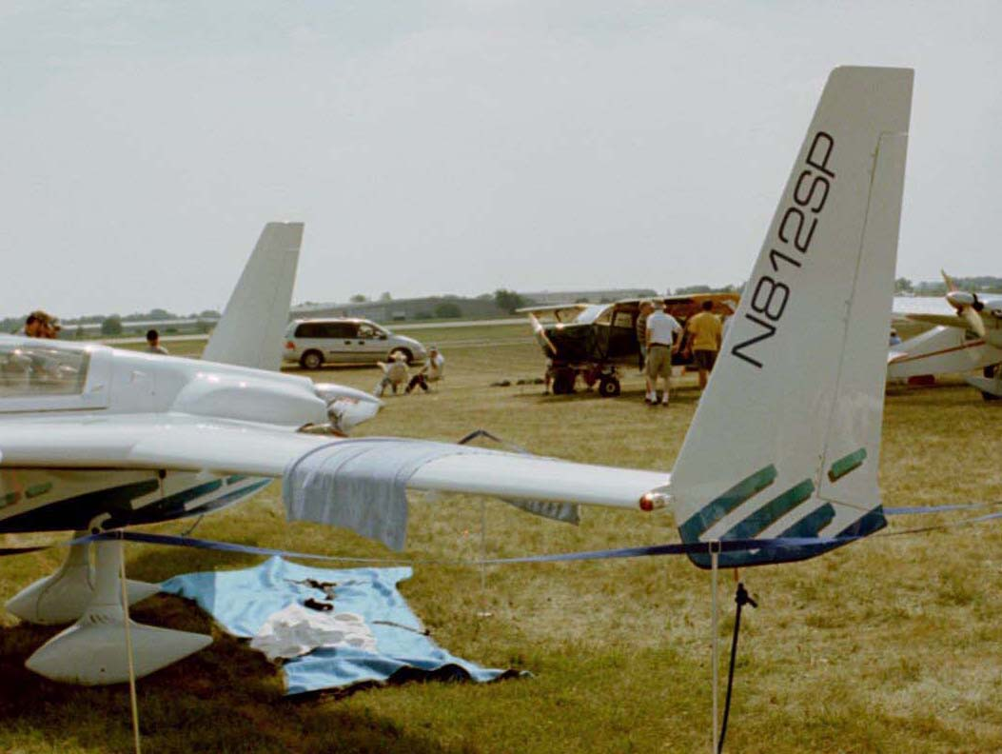
Powerplant – Pusher
Engine
Propeller

Slide 22
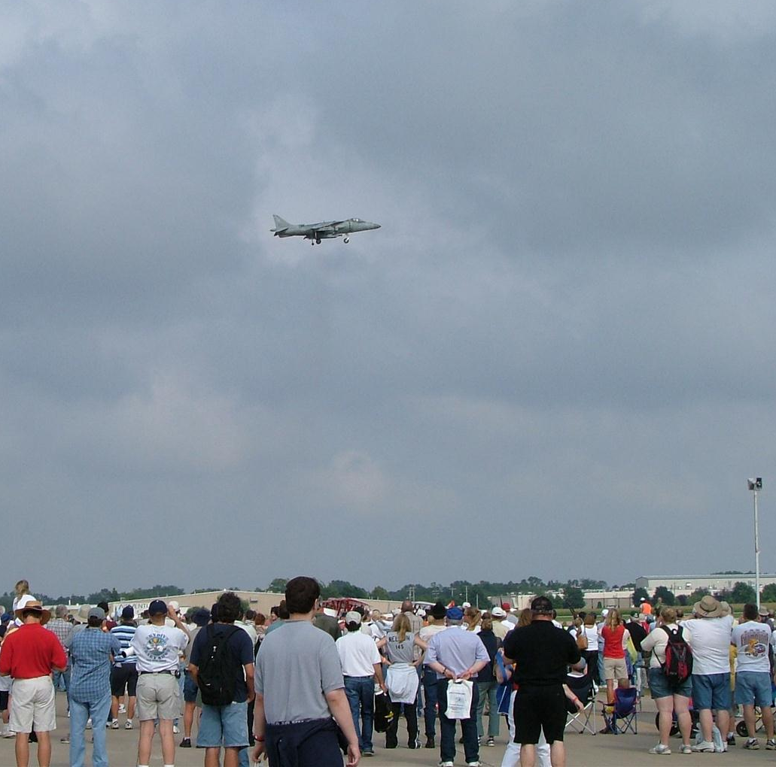
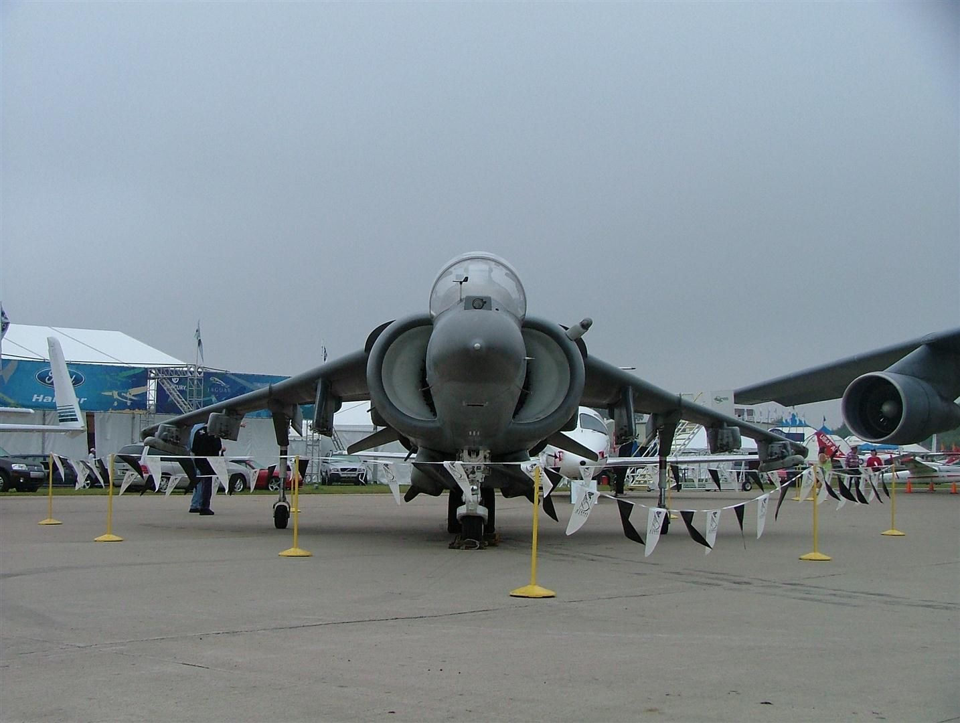
Powerplant – Variable Direction
Exhaust smoke from vertical thrust
Notes:
Aircraft above is a Harrier jet which can rotate its thrust from downward facing for vertical takeoff and landing to aft facing to propel it forward.

Slide 23
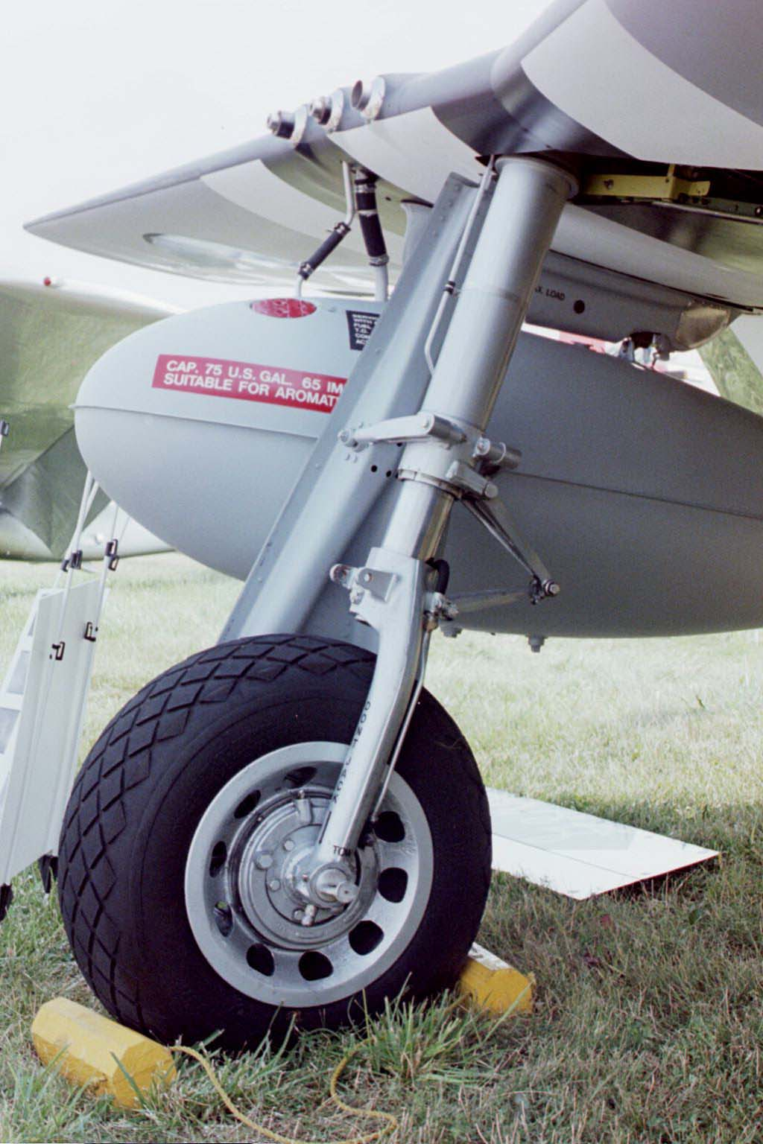
Landing Gear – Oleo Strut
Oleo strut
Brakes
Tire
Axle
Rim

Slide 24
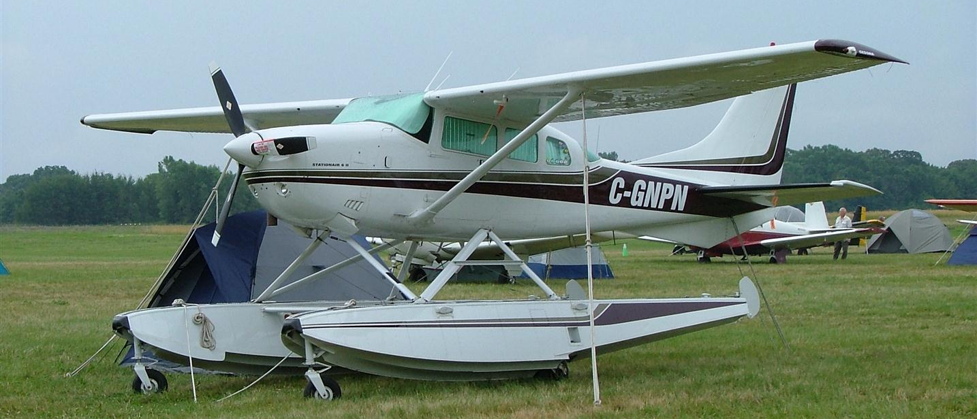
Landing Gear – Floats
Notes:
Photos from EAA airshow in Oshkosh, WI.

Slide 25
Conventional Gear – Tail-Dragger
Main Gear
(2 wheels)
Tail Wheel

Slide 26
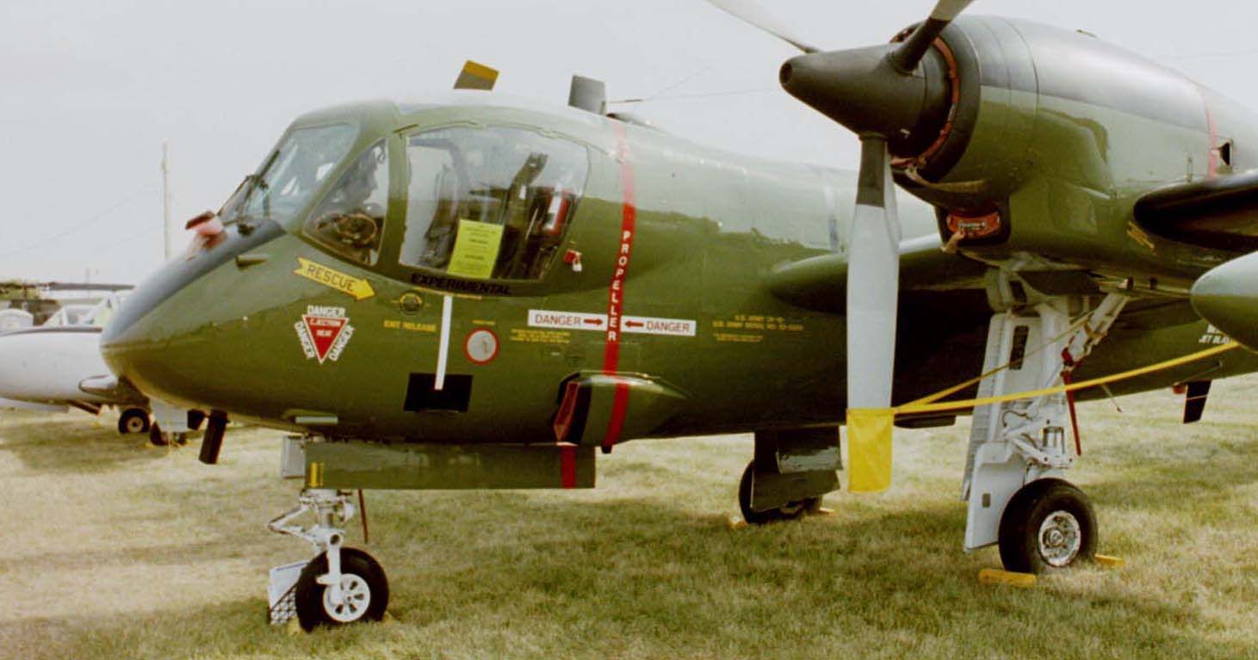
Tricycle Gear
Main Gear
(2 wheels)
Nose Wheel

Slide 27
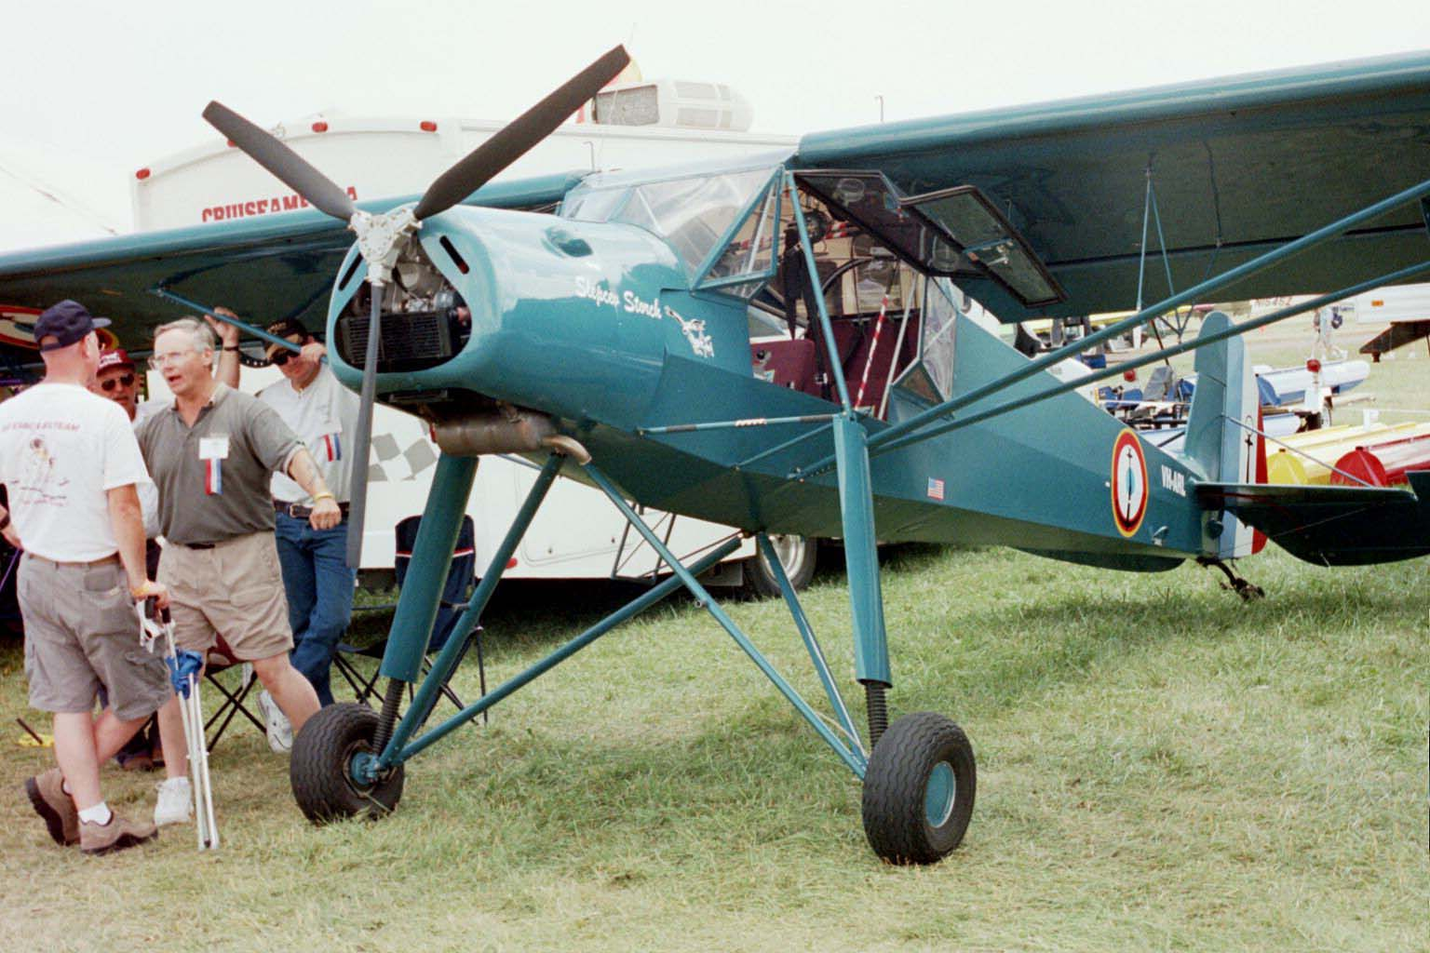
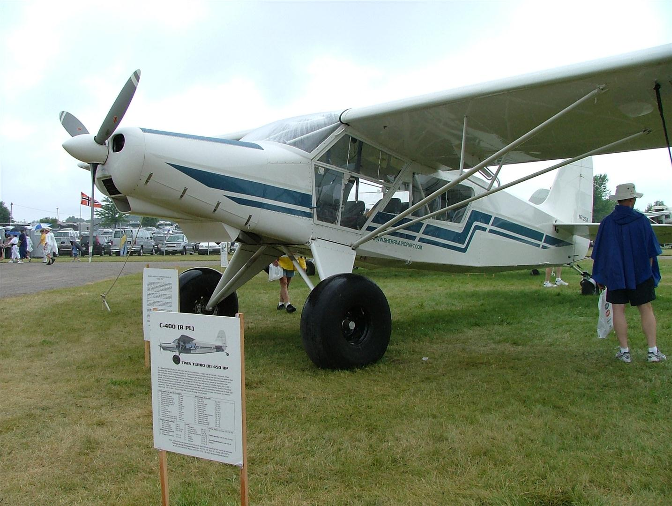
Specialized Landing Gear
Rough Field
Soft Field

Slide 28
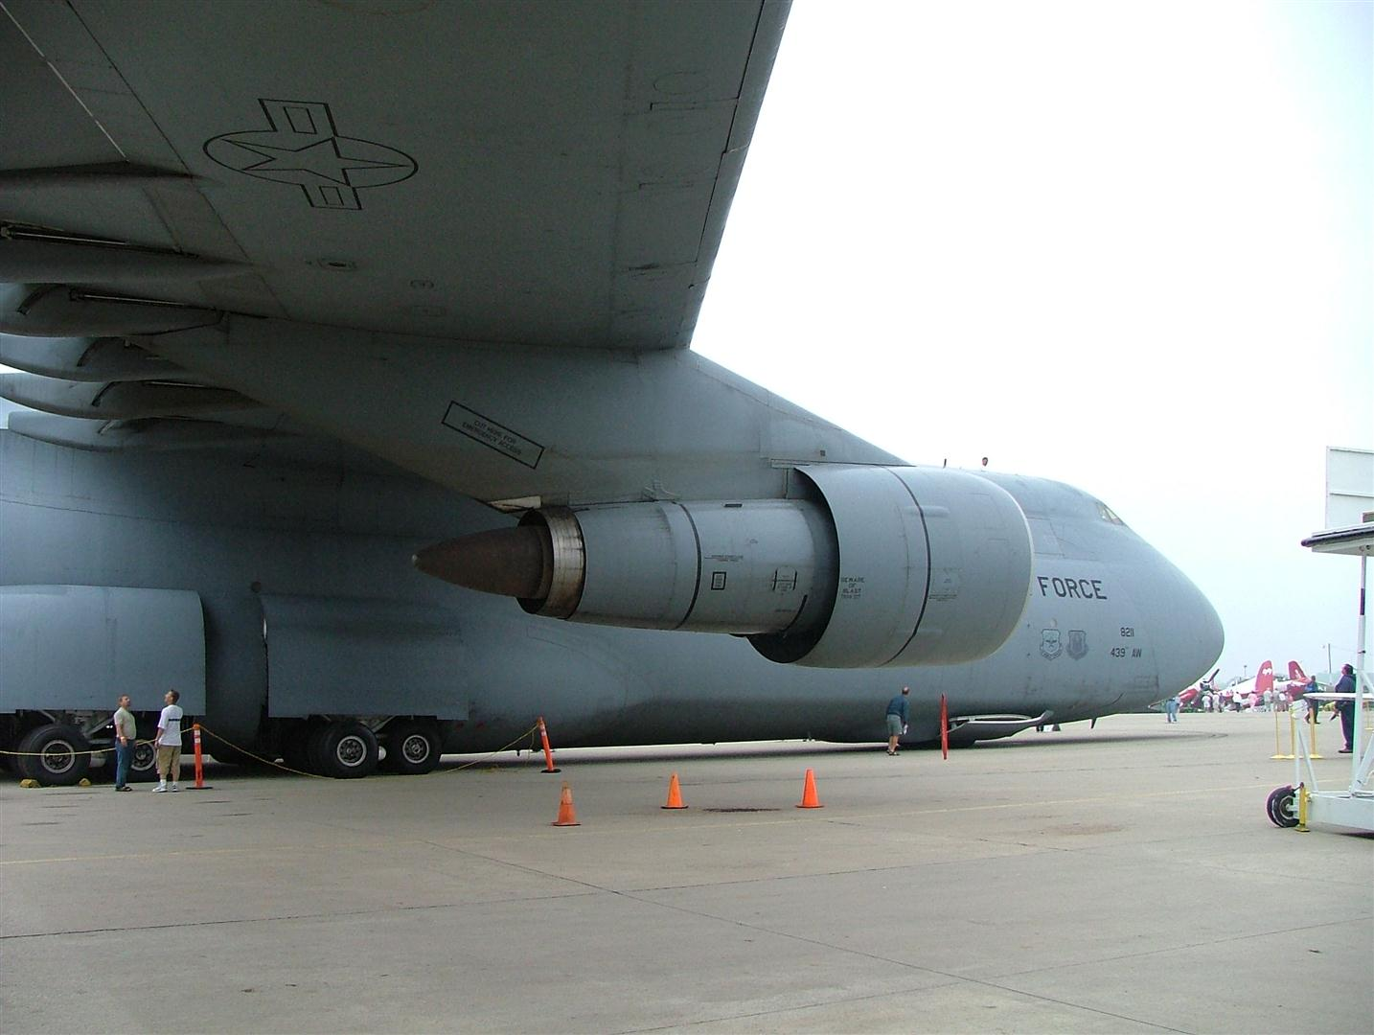
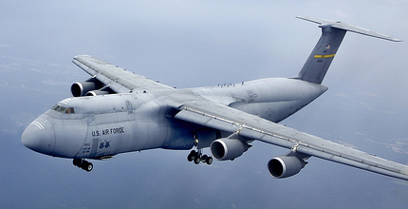
Aircraft Size
Lockheed C-5 Galaxy
Notes:
Aircraft can be very large. The aircraft shown is a Lockheed C-5 Galaxy. The people shown in the image demonstrate the scale of the aircraft.

Slide 29
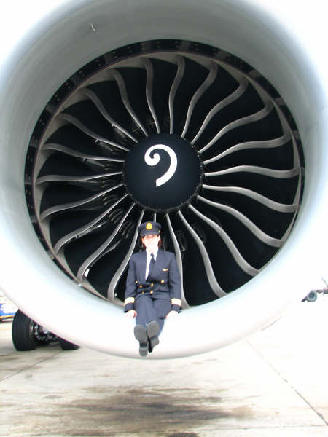
Aircraft Size
Boeing 777 Engine Intake
Notes:
The Boeing 777 engine is so large that it dwarfs the pilot seated in the engine inlet.

Slide 30
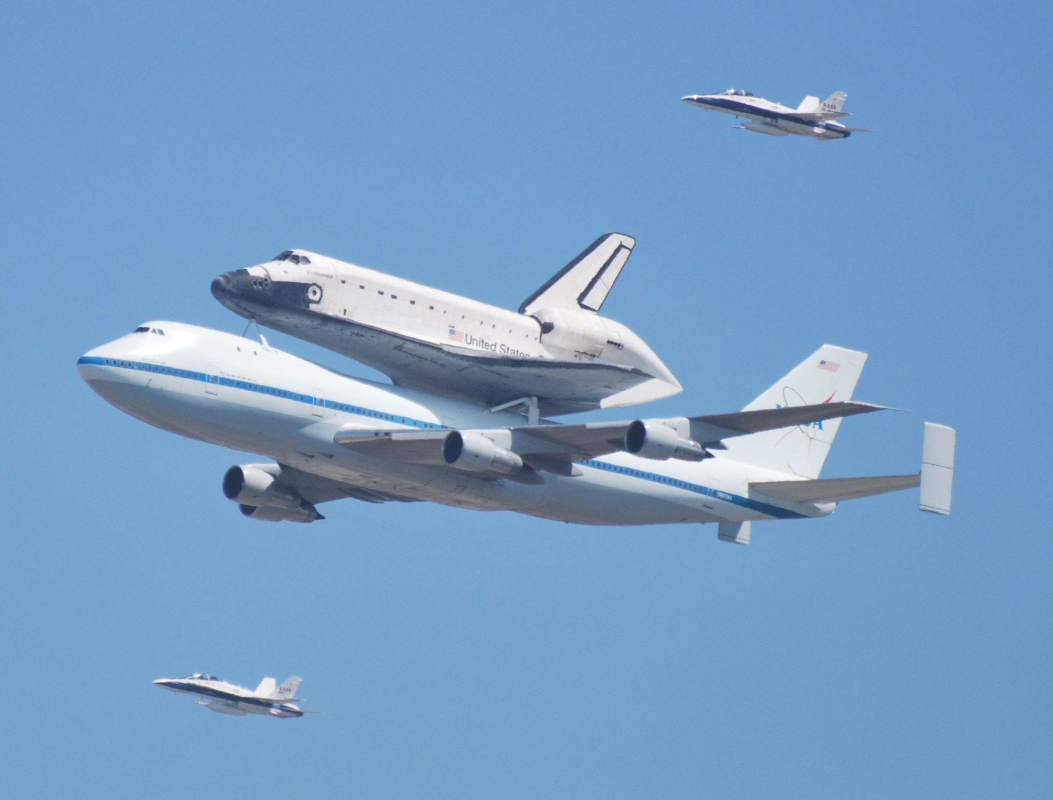
Specialty Aircraft
Notes:
Aircraft may be designed or modified to perform specialty functions. This example is a Boeing 747 modified to transport a space shuttle. The image above is of the final flight of Space Shuttle Endeavour landing in Los Angeles in September, 2012.

Slide 31
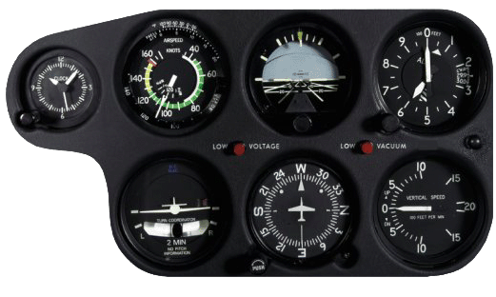
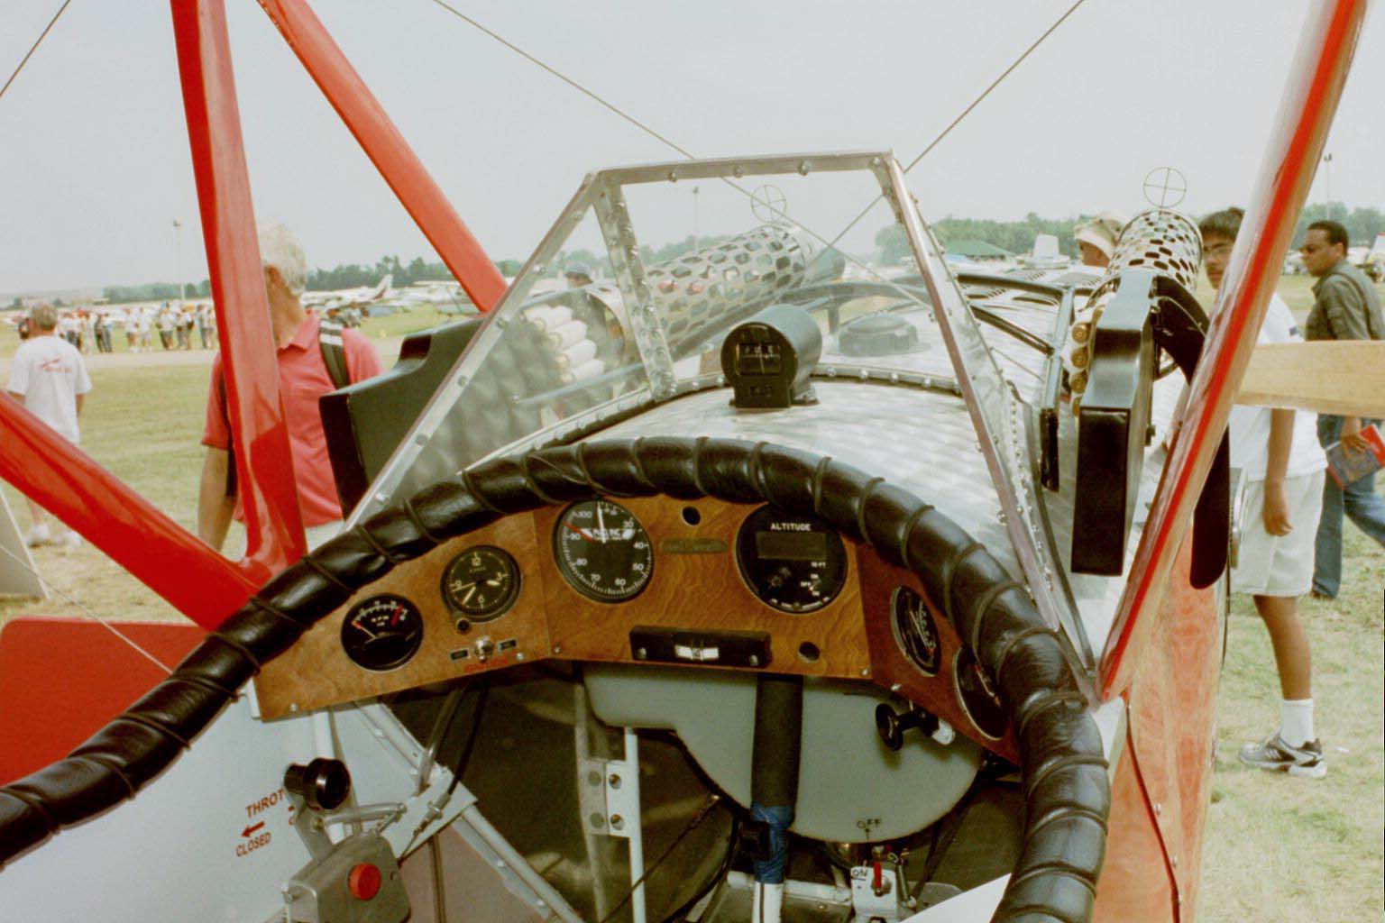
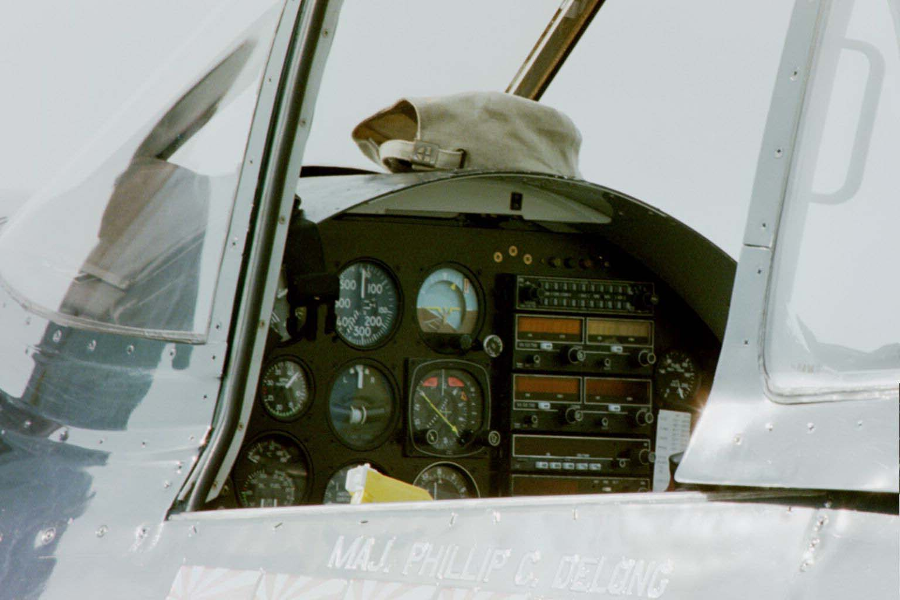
Instrument Panel
Notes:
Instrument panels vary in layout but display crucial information to a pilot to operate the aircraft.

Slide 32
Center of Gravity
Center of Gravity (CG) is point where weight of object is balanced
Centroid located on the line of symmetry
Centroid of object with multiple lines of symmetry is located at intersection of lines of symmetry

Slide 33
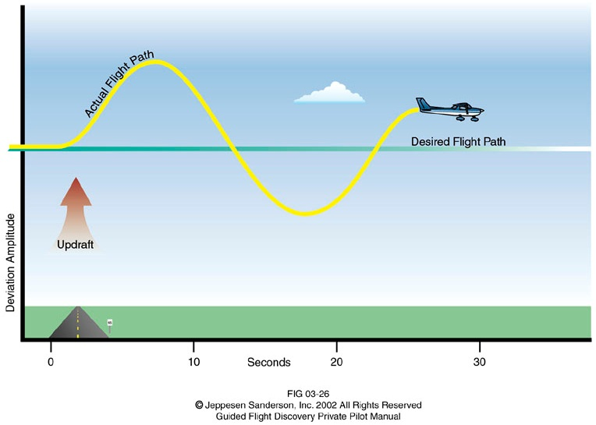
Stability
Aircraft with positive stability returns to steady flight after disturbance
Maneuverability is an indication of an aircraft’s ability to handle the stress of maneuvers
Controllability is an indication of an aircraft’s ability to react to pilot inputs
Notes:
Aircraft design often requires a trade-off between stability and maneuverability. Training aircraft are typically more stable to compensate for a student’s developing skill level. Fighter jets are typically more maneuverable though less stable to maximize the aircraft’s tactical value.

Slide 34
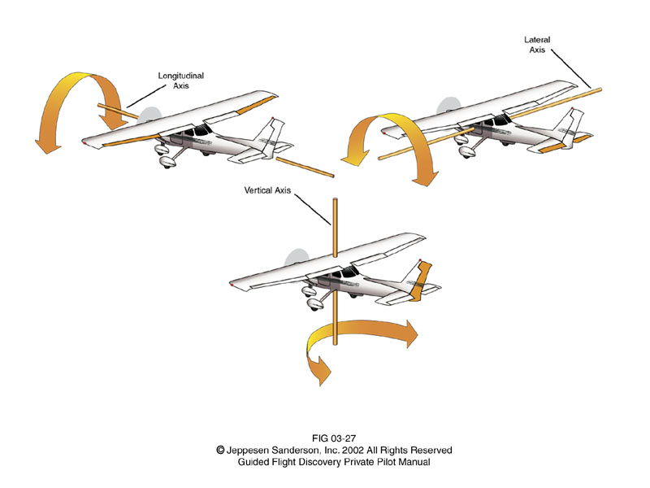
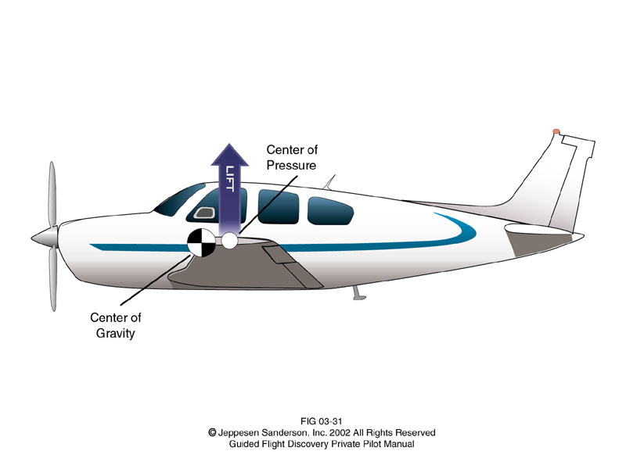
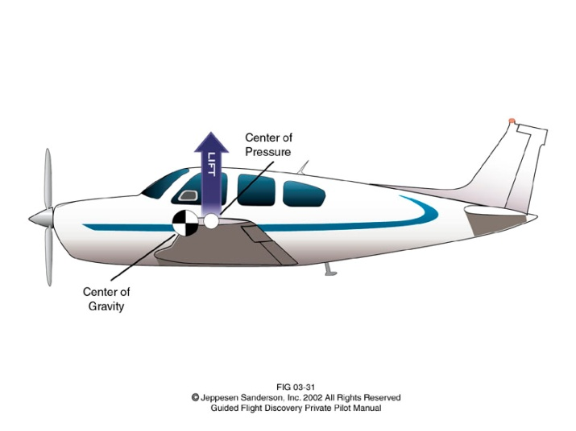
Aircraft Attitude
Aircraft have three axes of flight which intersect at the center of gravity
Aircraft must be stable around these three axes for controlled flight
Aircraft must be controlled to rotate around these three axes to change direction
Lateral
Axis
Longitudinal
Axis
Vertical
Axis
Center of
Pressure
Center of
Gravity
Notes:
Aircraft stability is the characteristic of an airplane in flight that causes it to return to a condition of equilibrium, or steady flight, after it is disturbed.

Slide 35
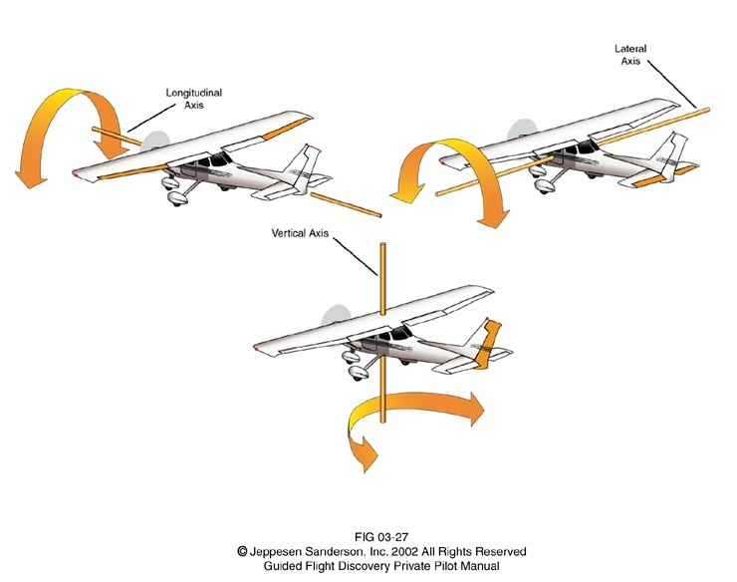
Aircraft Stability and Movement Around Three Axes of Flight
Lateral
Axis
Roll
Longitudinal
Axis
Pitch
Vertical
Axis
Yaw
Notes:
The axis of flight is oriented along the fuselage and along the wings.
An aircraft is said to roll about the longitudinal axis. Its stability about the longitudinal axis is known as roll stability.
An aircraft moving about its lateral axis is said to adjust its pitch or change its pitch attitude. Its stability about the lateral axis is known as pitch stability.
An aircraft is yawing when moving about the vertical axis. Its stability about the vertical axis is known as yaw stability.

Slide 36
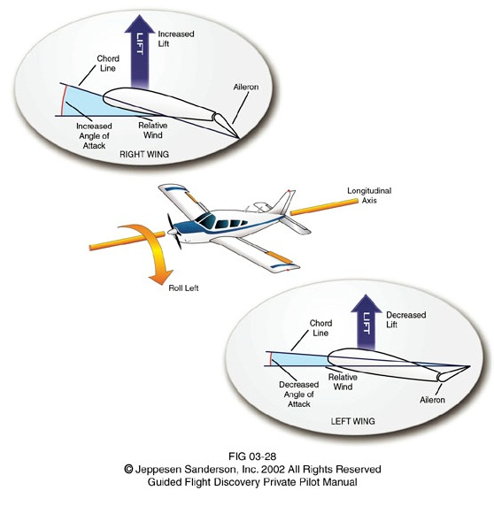
Aircraft Roll Stability and Control
To turn left, the aircraft must roll left.
Right wing must raise
and left wing must descend.
Longitudinal
Axis
Right aileron is lowered and left aileron is raised.
Notes:
Aircraft heading or direction of flight is changed by rolling the aircraft using the ailerons. Many people new to aviation make the mistake of thinking that causing aircraft to yaw or rotate about the vertical axis changes its heading. This is likely because people relate flying an aircraft to driving an automobile where the heading is changed by pointing the nose of the car in the desired direction. A pilot will yaw an aircraft in order to align the aircraft fuselage to fly efficiently into the relative wind (i.e., wind that is generated by the aircraft motion). In essence the air flowing over the body of the aircraft should flow smoothly along it and not strike either side of the body. Rolling an aircraft is also known as banking.

Slide 37
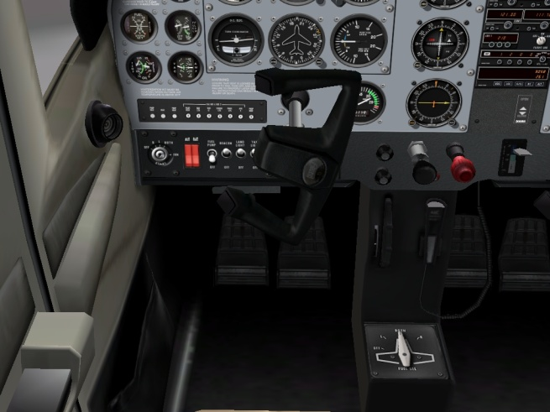
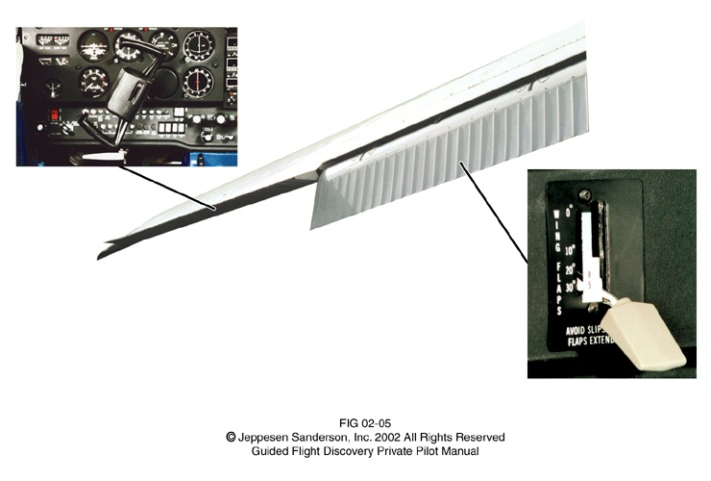
Flight Controls that Cause Ailerons and Flaps to Move
Yoke rotated
left
Left and right
flaps lower
Left wing shown
Left aileron raises
Right aileron lowers
Flaps lever lowered
Notes:
Ailerons are moved in opposite directions to roll the aircraft and change the direction of flight. Ailerons are controlled by twisting the yoke to the left or right.
Flaps are closest to the fuselage and are deployed downward equally on the left and right wing to slow the aircraft by creating drag while producing more lift. Flaps are controlled by the flap lever.

Slide 38
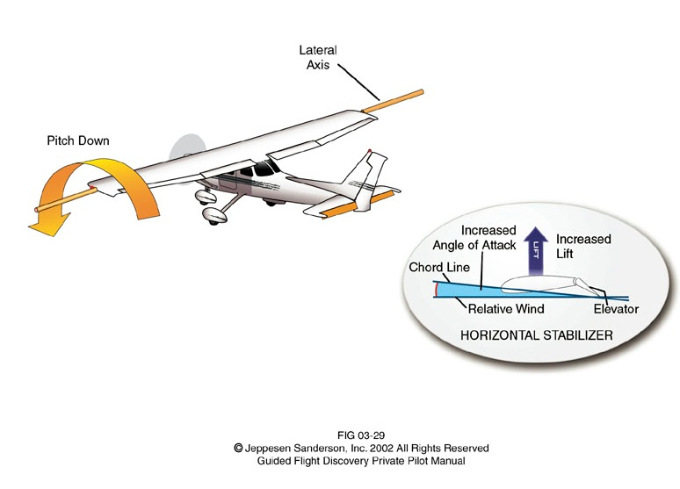
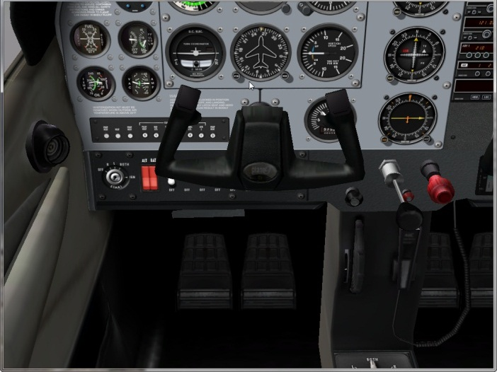
Aircraft Pitch Stability and Control
Lateral
Axis
To descend, the pilot reduces power and lowers the elevator to pitch down
Pitch Down
Lower the elevator
Push the yoke
forward
Notes:
An aircraft climbs (ascends) when lift and thrust exceed weight and drag. An aircraft descends when the opposite is true. To climb a pilot inputs more thrust and pulls back on the yoke to raises the elevator for a pitch up attitude. To descend a pilot reduces power and pushes forward on the yoke to lower the elevator for a pitch down attitude.

Slide 39
Aircraft Pitch Stability and Control
Elevator
Notes:
If used in your classroom then use the Vapor micro remote control aircraft to demonstrate the concepts within the presentation.

Slide 40
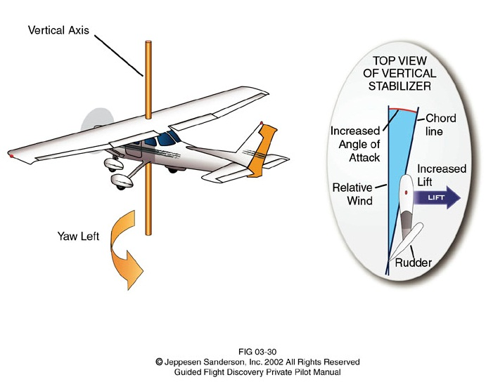
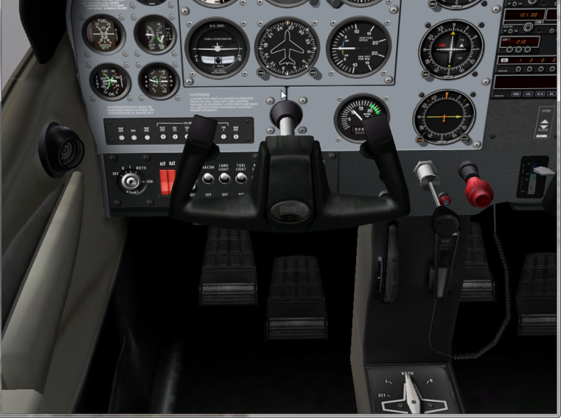
Aircraft Yaw Stability and Control
To yaw the aircraft
nose left, the rudder must deflect left.
Vertical Axis
Push left pedal
away from you.
Yaw Left
Notes:
Aircraft heading or direction of flight is changed by rolling the aircraft using the ailerons. Many people new to aviation make the mistake of thinking that causing aircraft to yaw or rotate about the vertical axis changes its heading. This is likely because people relate flying an aircraft to driving an automobile where the heading is changed by pointing the nose of the car in the desired direction. A pilot will yaw an aircraft in order to align the aircraft fuselage to fly efficiently into the relative wind (i.e., wind that is generated by the aircraft motion). In essence the air flowing over the body of the aircraft should flow smoothly along it and not strike either side of the body. The rudder deflection causes the aircraft to yaw. The rudder is controlled by the pedals. Pressing the right pedal will cause the rudder and the aircraft to deflect right. When the right rudder pedal is pressed, the left automatically moves toward you.

Slide 41
Aircraft Yaw Stability and Control
Rudder
Notes:
If used in your classroom then use the Vapor micro remote control aircraft to demonstrate the concepts within the presentation.

Slide 42
Aircraft Motion and Control
Axis | Motion | Stabilized by | Control | Pilot Control
Longitudinal | Roll | Wings | Aileron | Yoke twist left or right
Lateral | Pitch | Horizontal stabilizer | Elevator | Yoke forward or aft
Vertical | Yaw | Vertical stabilizer | Rudder | Rudder pedals
Roll
Lateral
Axis
Pitch
Longitudinal
Axis
Yaw
Vertical
Axis

Slide 43
References
Jeppesen (2007). Private pilot: Guided flight discovery. Englewood, CO: Jeppesen.
Jeppesen Sanderson, Inc. (2006). Guided flight discovery private pilot images [CD-ROM]. Englewood, CO: Jeppesen Sanderson, Inc.
National Aeronautics and Space Administration (2009). Airplane parts definitions. Retrieved from http://www.grc.nasa.gov/WWW/K-12/airplane/airplane.html
National Aeronautics and Space Administration (2009). Wilber and Or. Retrieved from http://grin.hq.nasa.gov/IMAGES/SMALL/GPN-2002-000126.jpg

Slide 44
References
Chapple G. (Photographer). (2012). Shuttle 1. [Photo].
Lockheed Martin (2010). C-5M first flight-3a. Retrieved from http://www.flickr.com/photos/lockheedmartin/3570610406/in/set-72157618866063402
Lockheed Martin (2010). F-35 Lightning II. Retrieved from http://www.lockheedmartin.com/products/f35/
Lockheed Martin (2010). Lockheed Martin C-130 in flight. Retrieved from http://www.flickr.com/photos/lockheedmartin/976461432/
Meyer, A. (2010). X-Plane (Version 9.21rc2) [Computer software]. Columbia, SC: Laminar Research.

Slide 45
References
Senson, Ben. (2010). Madison Memorial High School, Wisconsin.

